Slide 1
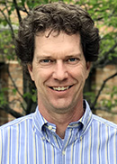
Thank You for Attending Today’s Webinar:
TSI PortaCount Respirator Fit Testing – What you need to know
Your Host
Matt DeLacluyse Operations Manager RAECO Rents mattd@raecorents.com
Featured Speakers
Jordan Mikell-jordanm@raecorents.com
Marty Brands
marty.brands@tsi.com

Slide 2



Get Social with RAECO Rents
www.linkedin.com/company/raeco-rents
@RaecoRents
www.youtube.com/user/RaecoRentsVideos

