Slide 1
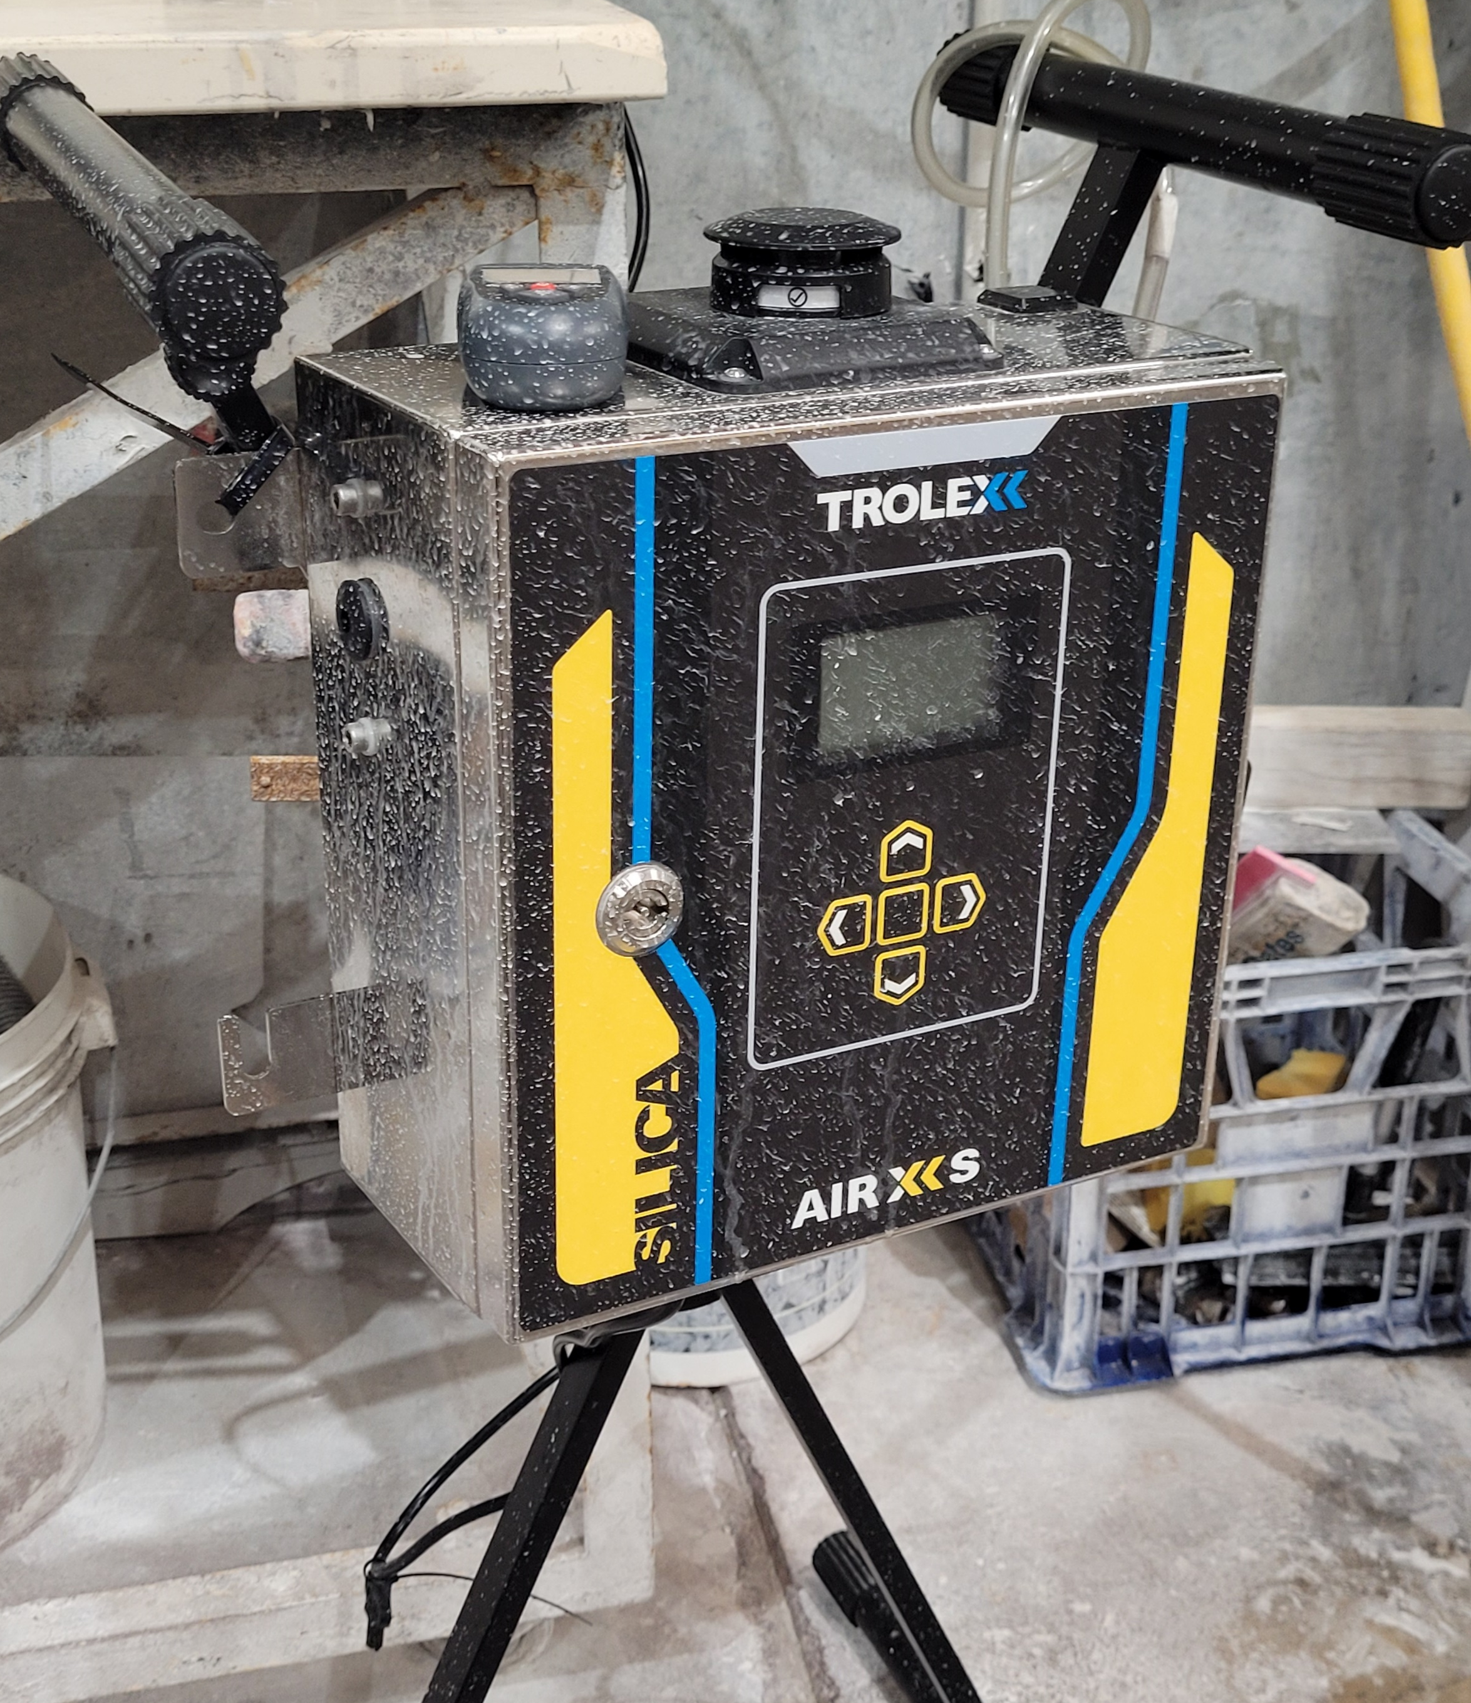


Real-Time RCS Detection
The Product
Provide Real-time, instantaneous information on changing Silica levels in industrial environments
Provide on-device / control room display of RCS measurement in mg/m3
Rolling averaging periods based on 1min, 15min, 1hr, 4hrs, 8hr shift patterns
On device Warnings and Alarms based on custom trigger thresholds (0.05 mg/m3 for example)
Data logging for download and post analysis using the Trolex BreatheXS software application, exportable to CVS file
Real-Time RCS Detection

Slide 2
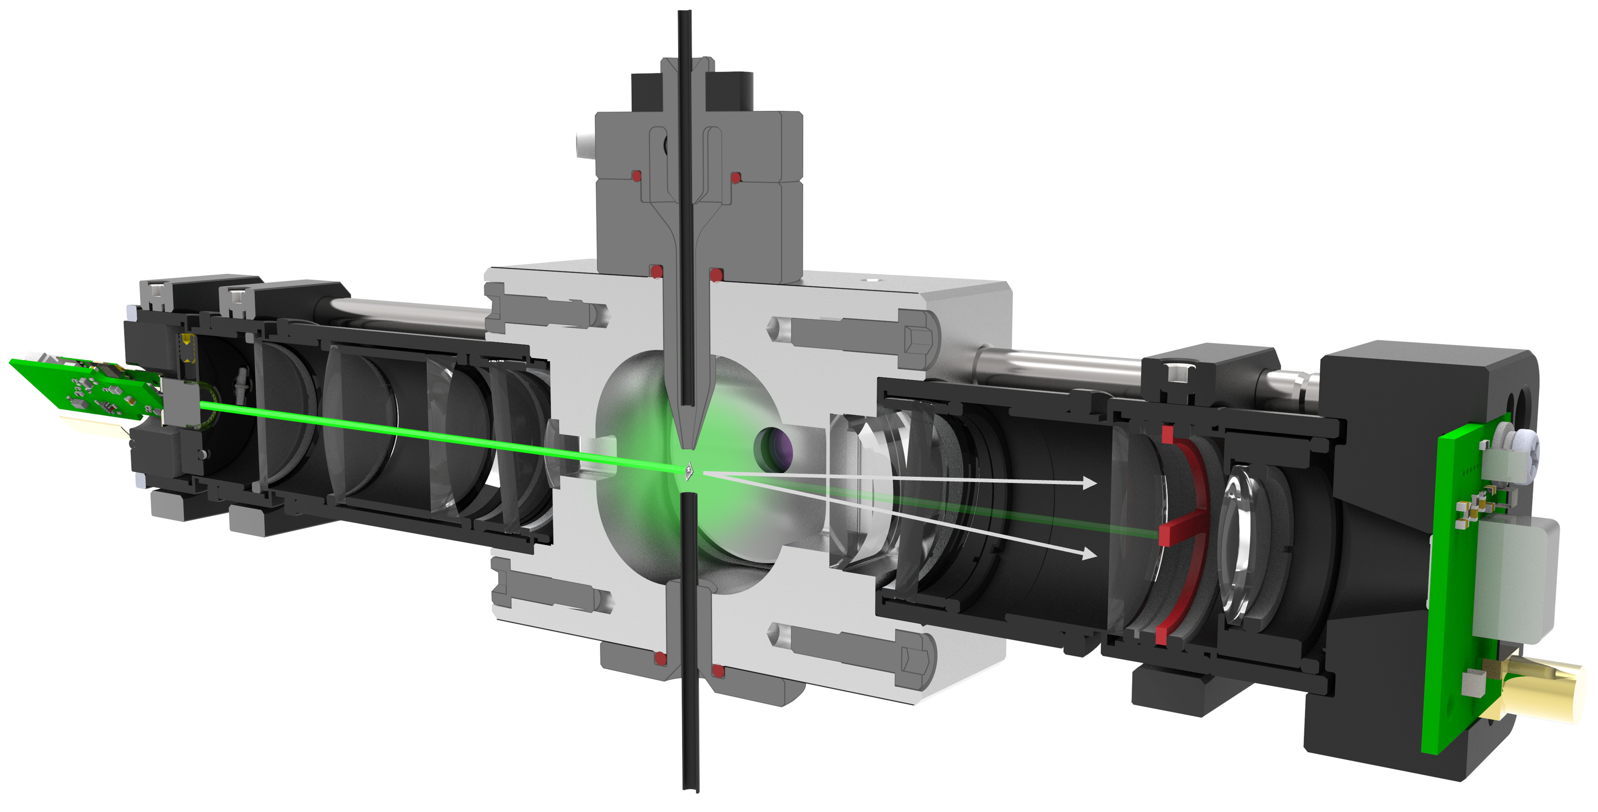
Real-Time RCS Detection
The Method
From the sampled airflow the Air XS Sensor determines the following to support the identification of RCS particles
Sample Air Flow ~1.5L/min
Filtered Sheath Flow
Airflow Per Litre (Dynamic)
~10,000 triggers per second
Particle count per second
Particle Density
Positive RCS count over general dust
RCS content in mg/m³
Sample Exit Flow
Real-Time RCS Detection

Slide 3
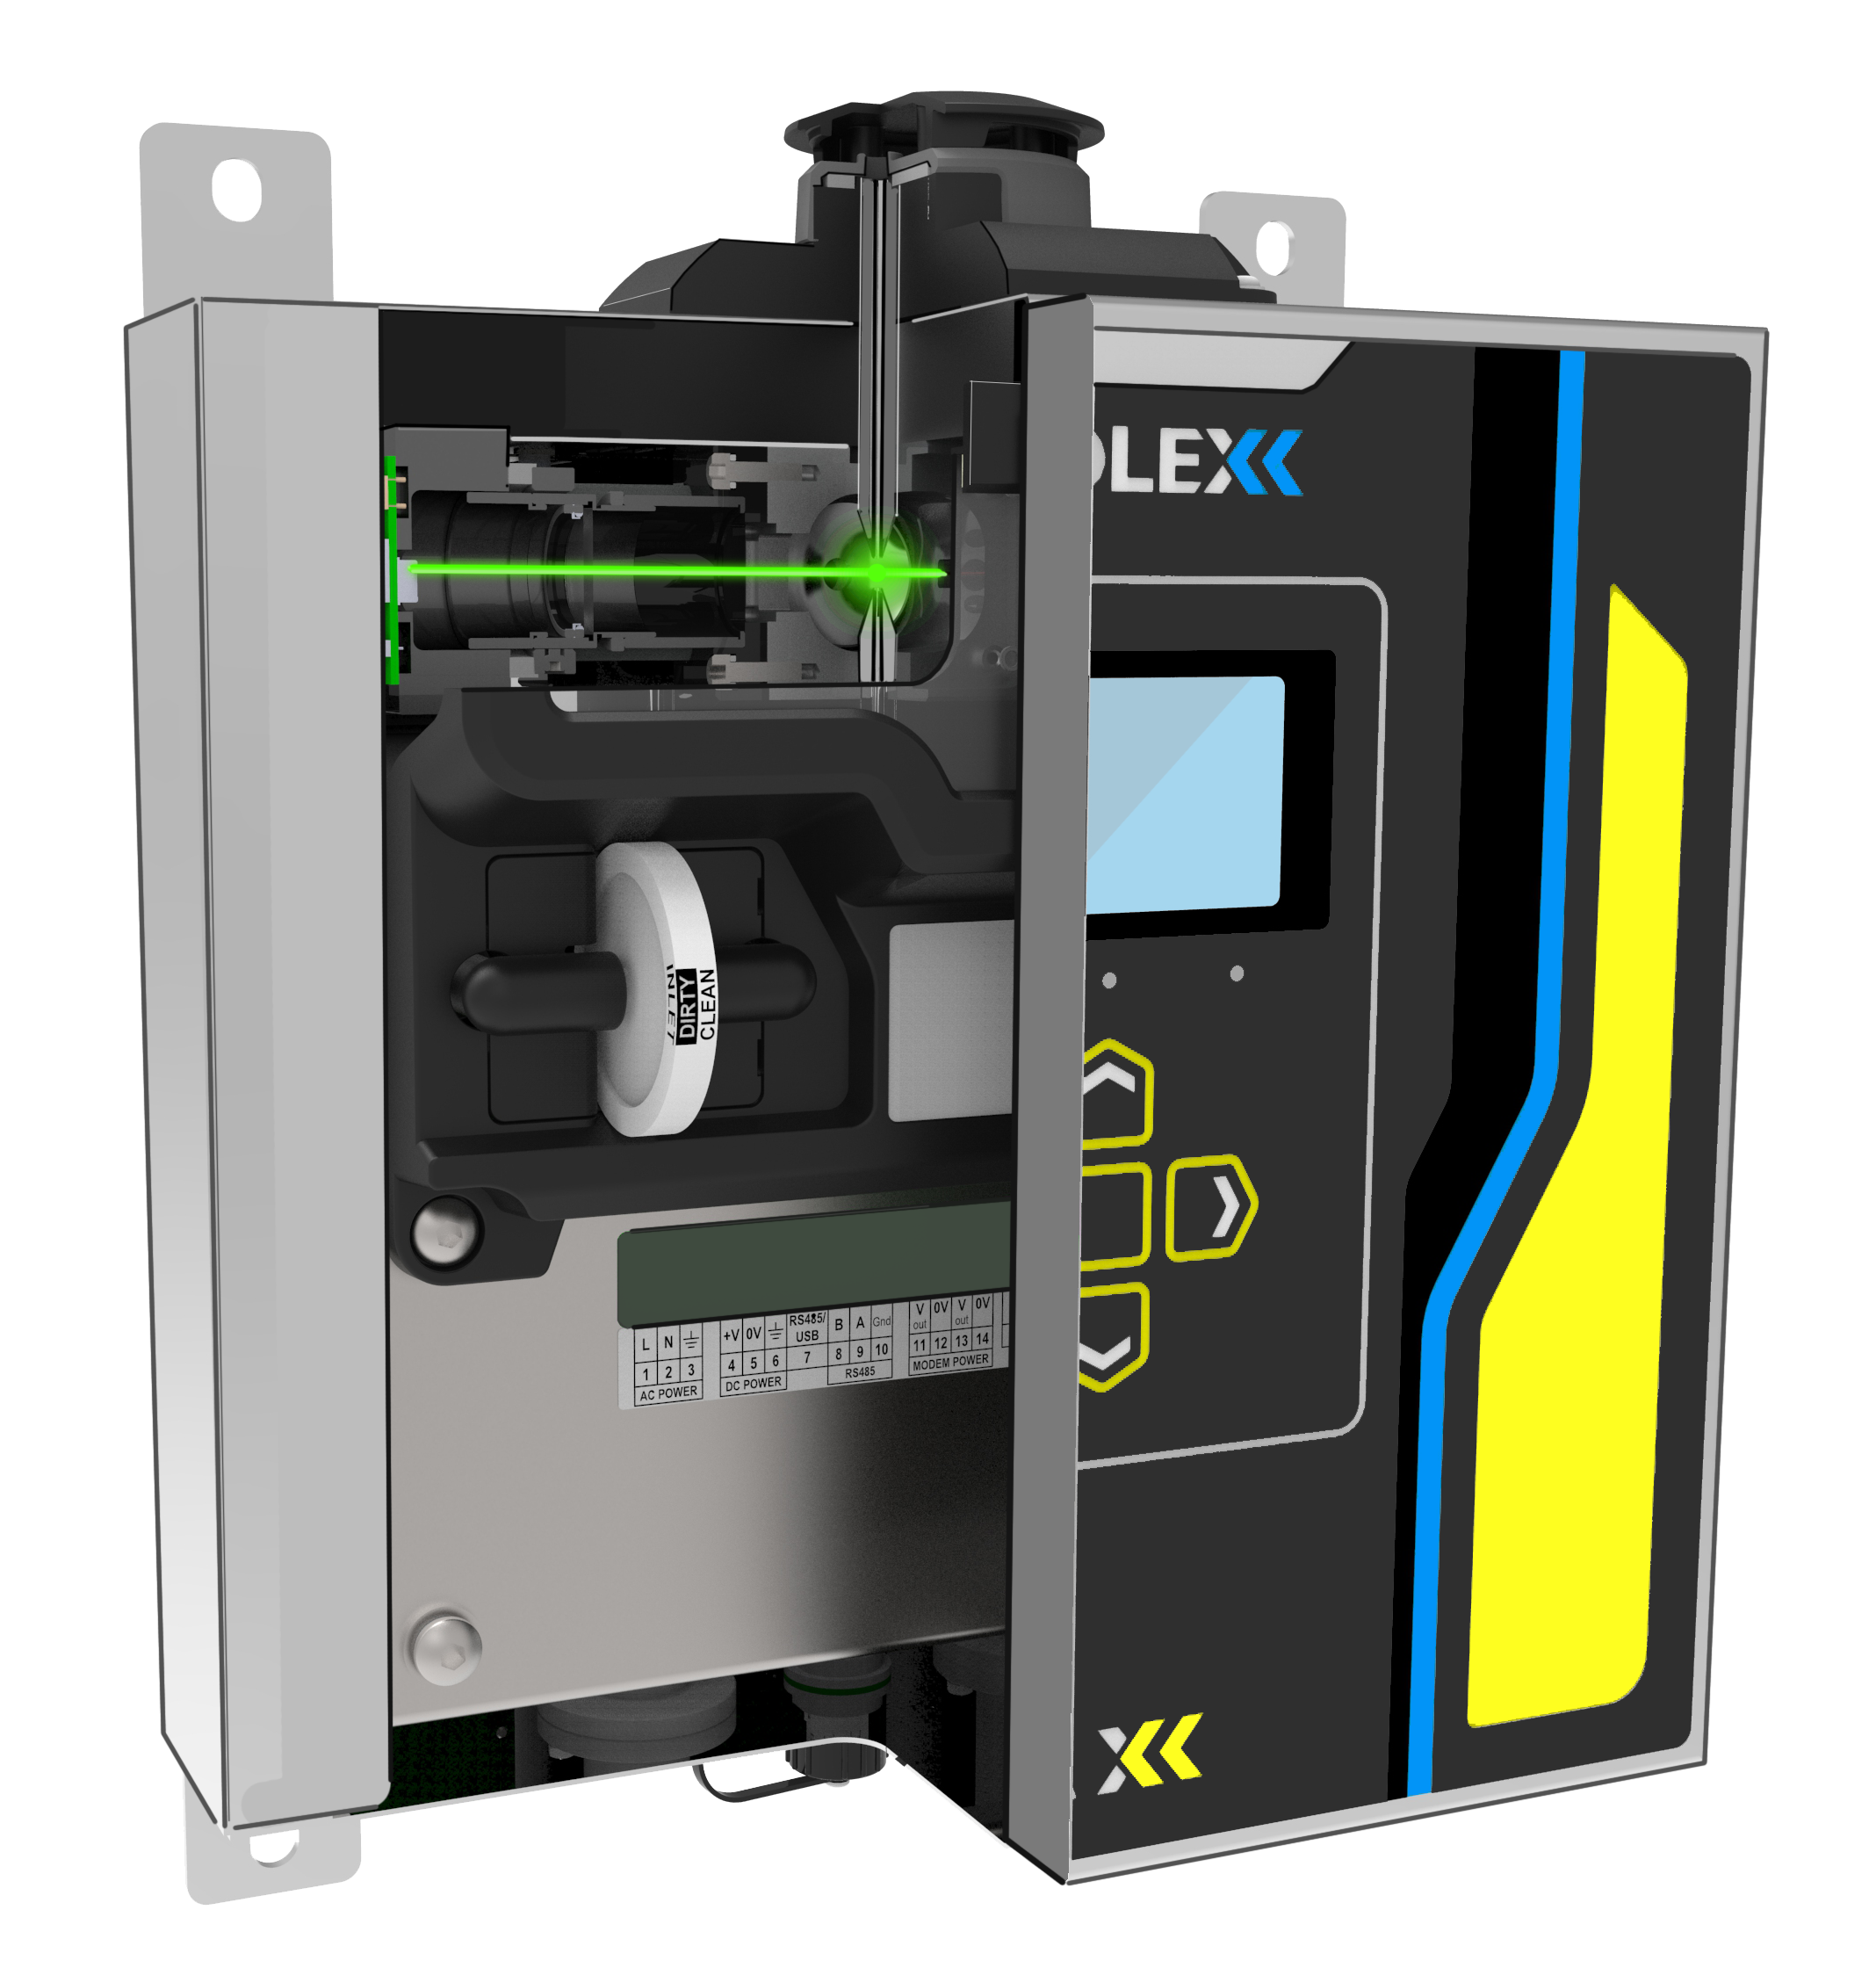
Real-Time RCS Detection
Sample Air Flow ~1.5L/min
Sample Exit Flow
Real-Time RCS Detection

Slide 4



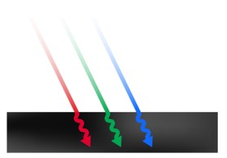
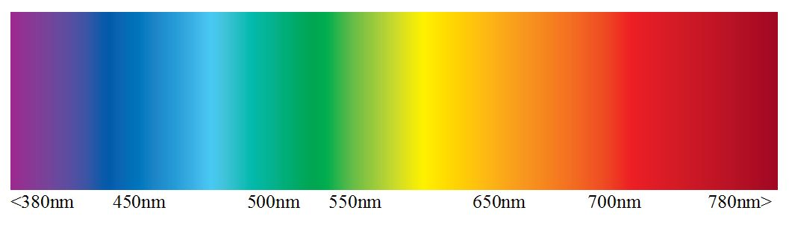
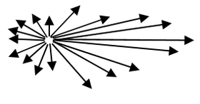
Real-Time RCS Detection
Optical Refraction Technology (ORT)
Laser Lightsource
Particulate Size
Particulate Density
Optical Wavelength
Optical Diffraction
Light Absorption
Signatures
Particulate Sizes 10um – 1um
Reference Density Bulk / Particle
Specifically tuned for Particle Types
Changes in optical Light Scatter / Diffraction Pattern
Reference input vs. output for reference material types
Particle size, shape, symmetry and structure
Real-Time RCS Detection

Slide 5
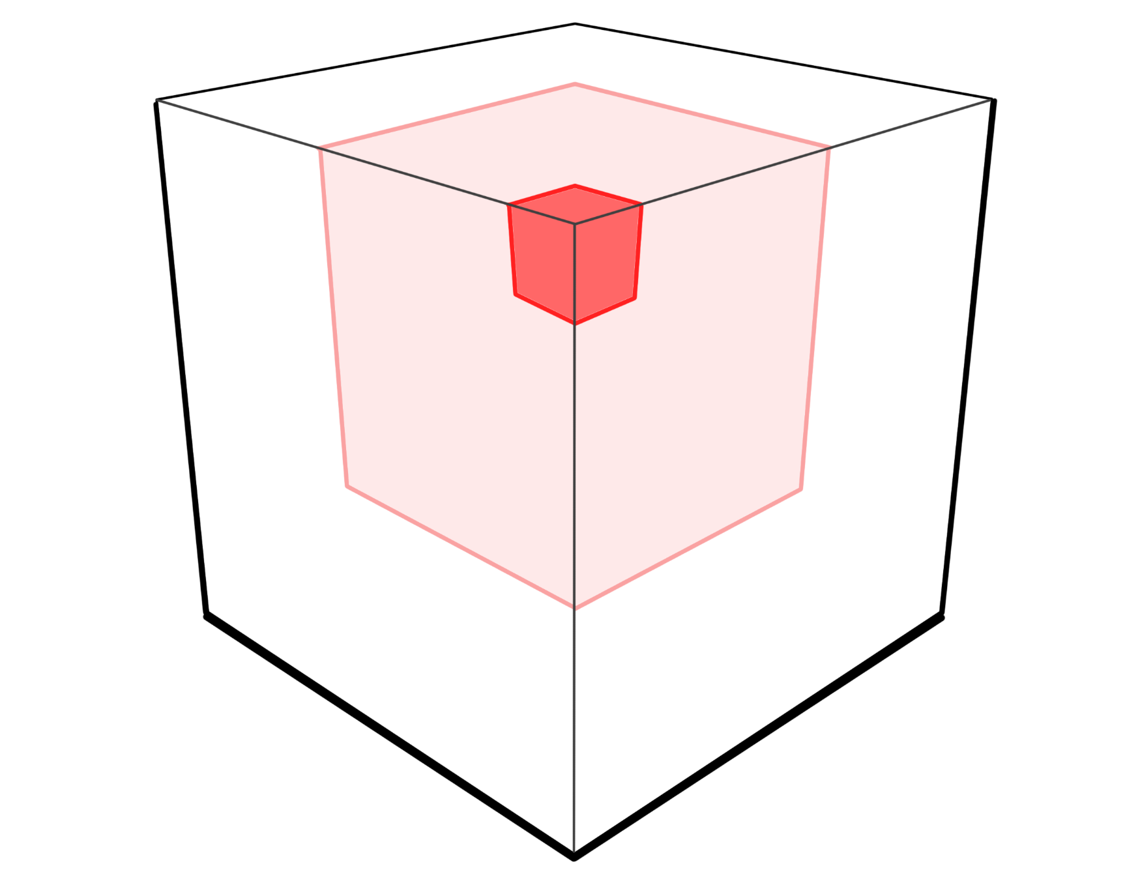


Real-Time RCS Detection
Device Measurement
Sample Concentration
Mixed Particulates
Silica Content
Total volume of Air (Litres) sampled over a given time
Volume of Particles sampled from 1 – 40µm in counts
Volume of Silica Particles sampled from 1 – 10µm in counts and mg.m⁻³
Real-Time RCS Detection

Slide 6

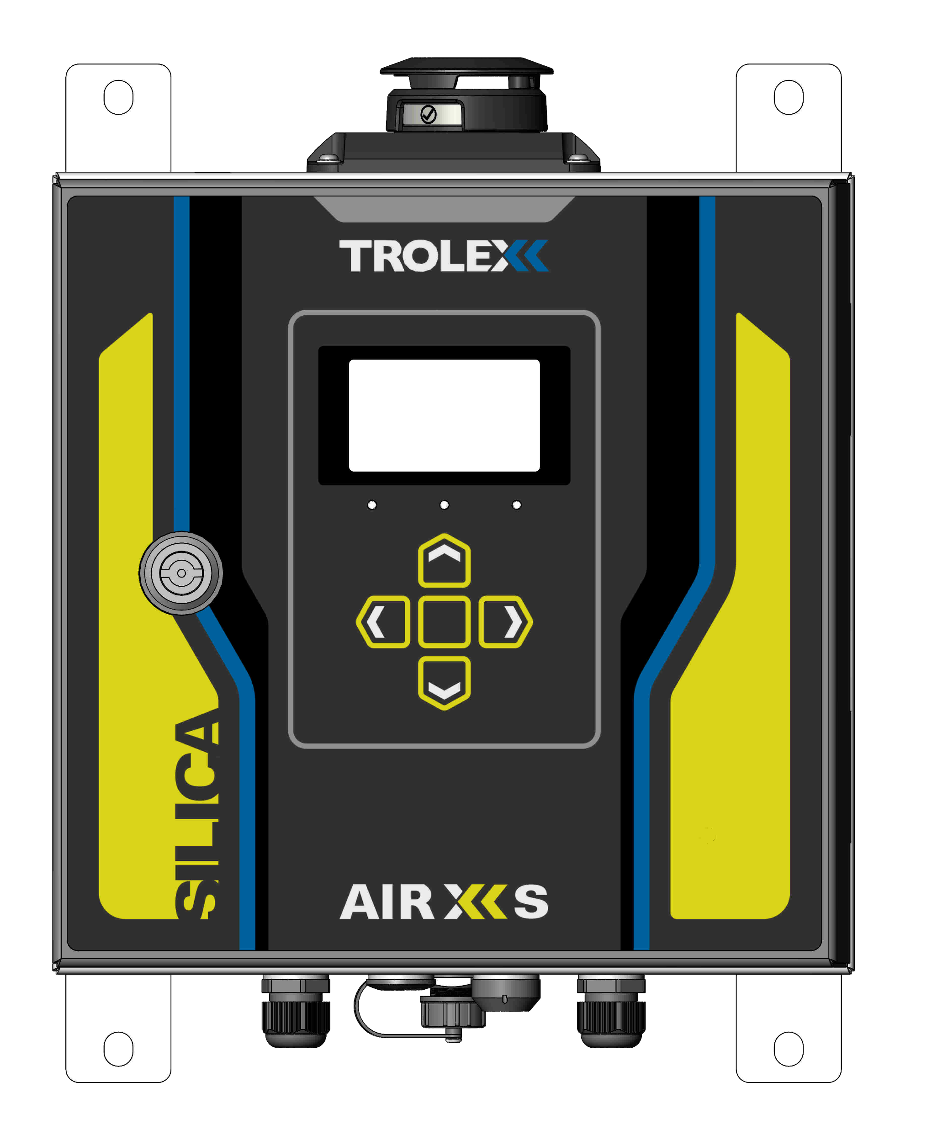
Real-Time RCS Detection
Active Sampling Area
Airborne particulates drawn into device relative to the dust inlet port situated on the top of the device.
Active sampling area typically draws from a ~1m radius in calm air conditions.
Devices should be positioned relative to particle generation sources or areas of interest
Sampling can be influenced by environmental conditions such as airflow, local extraction and ambient surroundings.
Sampling Zone
Real-Time RCS Detection

Slide 7
Real-Time RCS Detection
Sensing Parameters
L.O.D
1 µm (micron) Particulate
1 µg/m³ (Microgram) Mass
Continuous Loading
25 mg/m³
Max Dust Loading
150 mg/m³
Real-Time RCS Detection

Slide 8

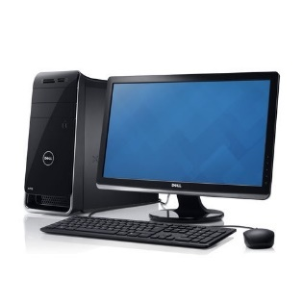


Real-Time RCS Detection
Device Connectivity
Breathe XS Desktop Application
AC or DC Power Input
Ethernet or RS485 Serial
(Data Registers)
USB Data Download
Windows / Mac PC
Or Network
Real-Time RCS Detection

Slide 9

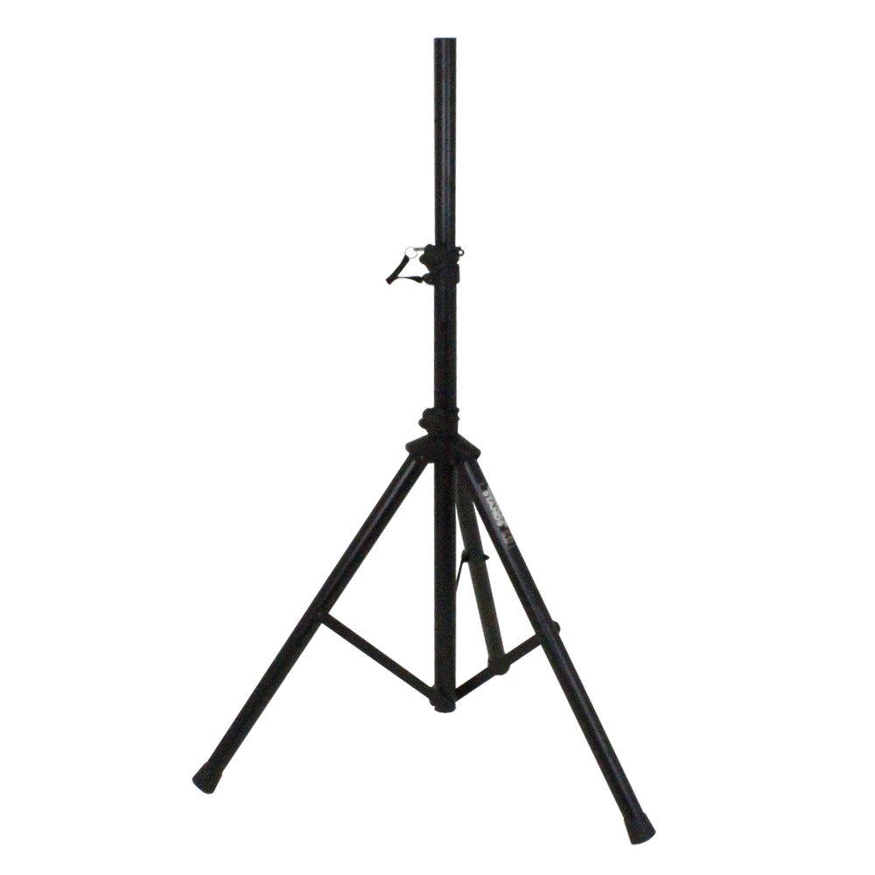
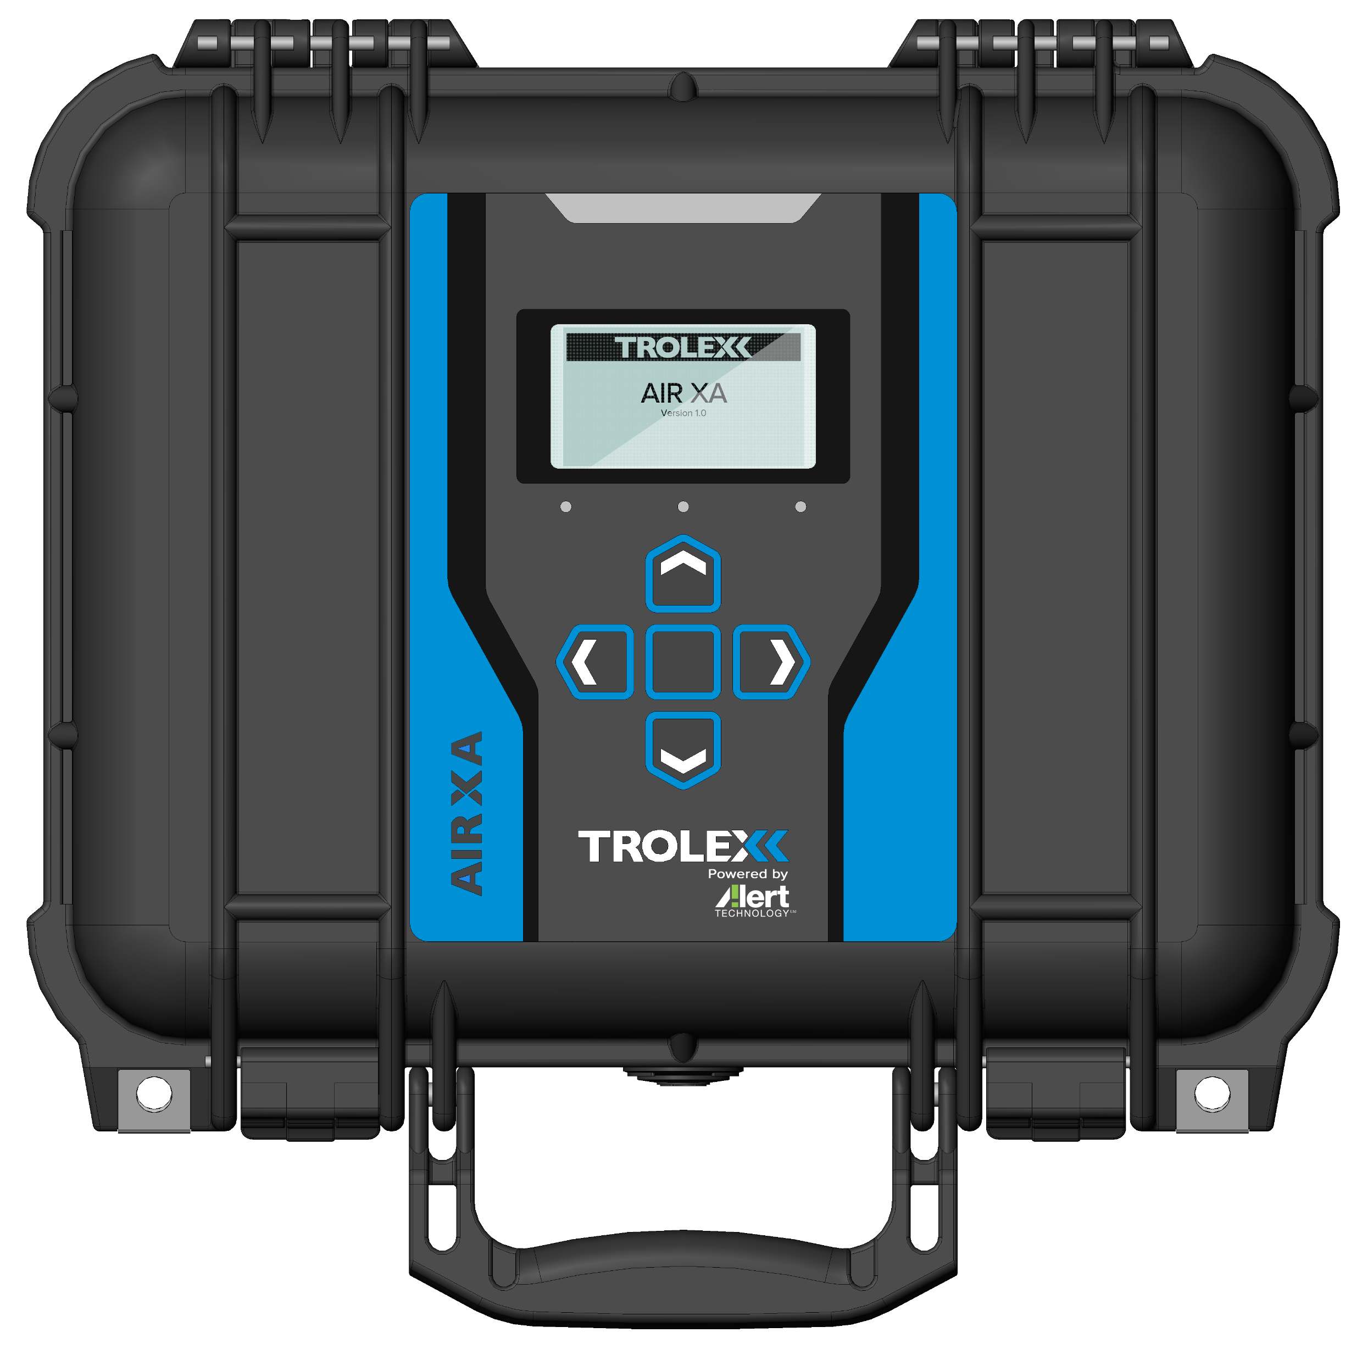
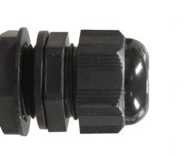
Real-Time RCS Detection
Device Set-Up
AC Power
Data / Comms
DC Power
USB Data Download
Fixed Location Monitoring
Transportable Monitoring
Real-Time RCS Detection

Slide 10
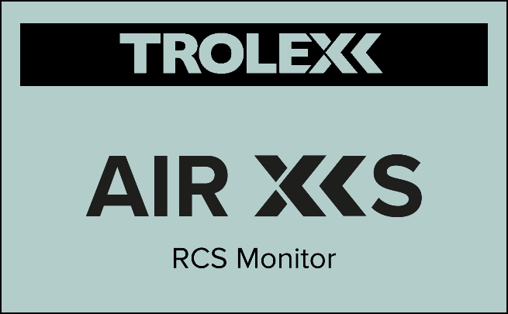
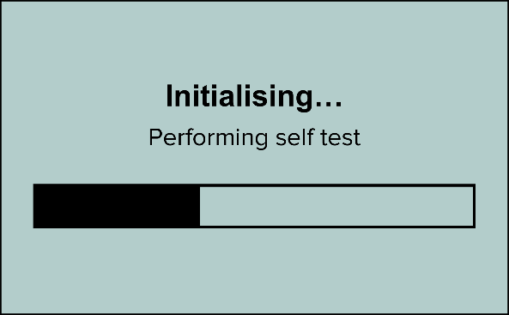
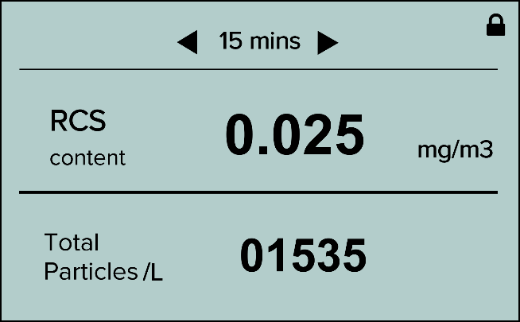
Real-Time RCS Detection
Device Power On and Sampling
Start Up Splash Screen
1.
Warm Up / Self Test
2.
Sampling…
3.
Real-Time RCS Detection

Slide 11

Real-Time RCS Detection
On Device Display Readout
Sampling Time
15 mins
RCS
00.04
mg.m⁻³
content
2350
Particles /L
Real-Time RCS Detection

Slide 12
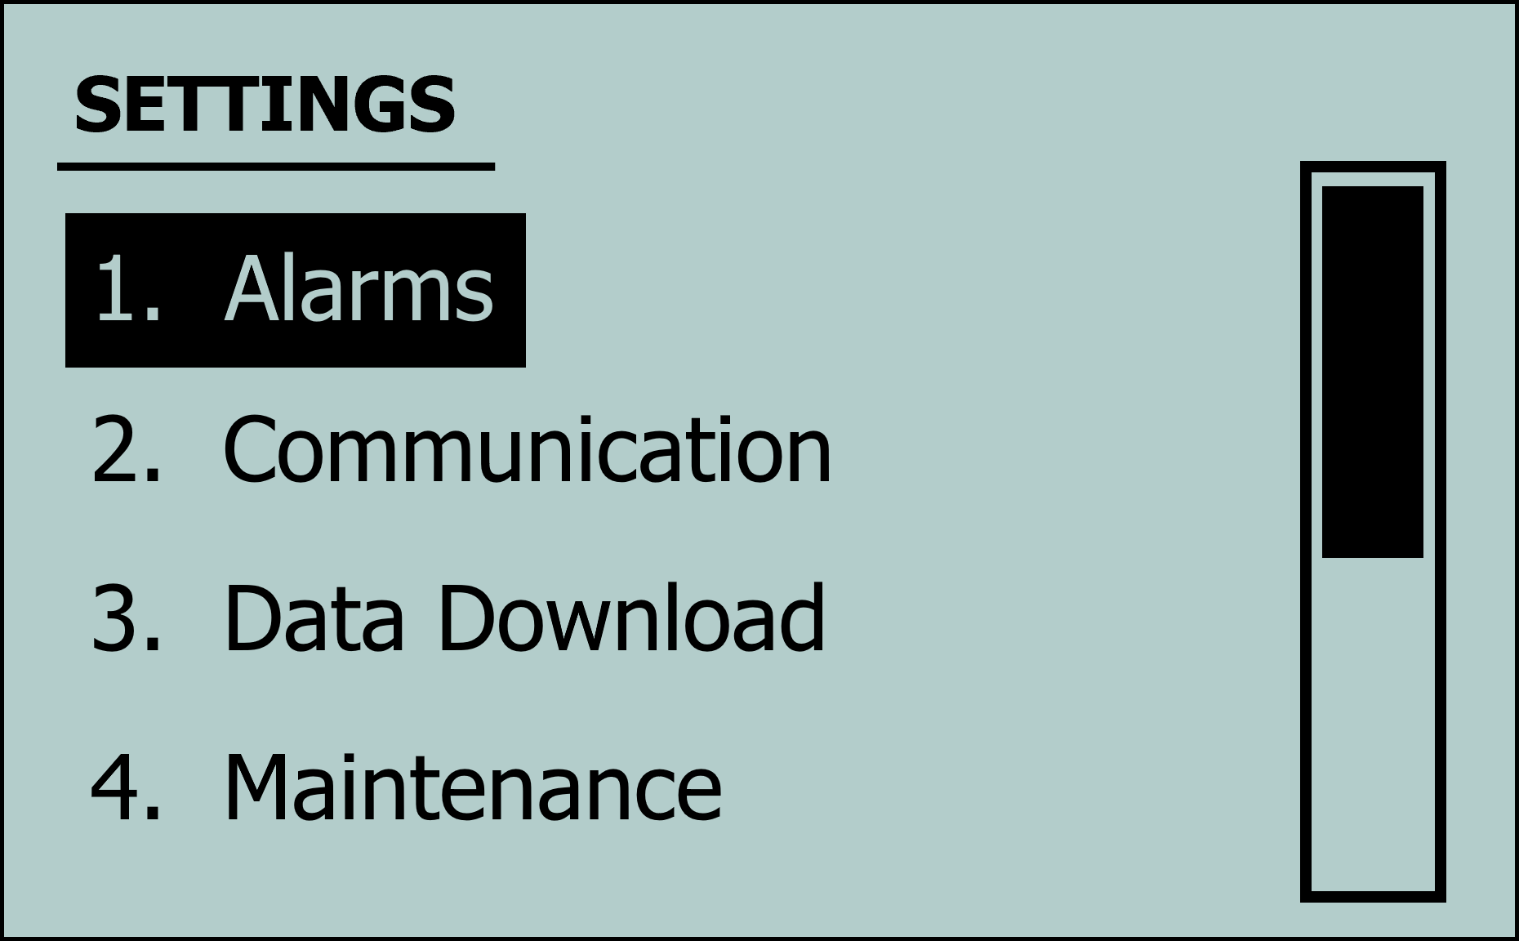

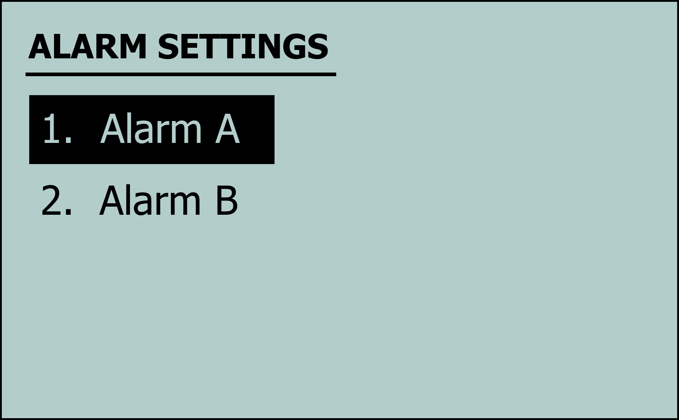
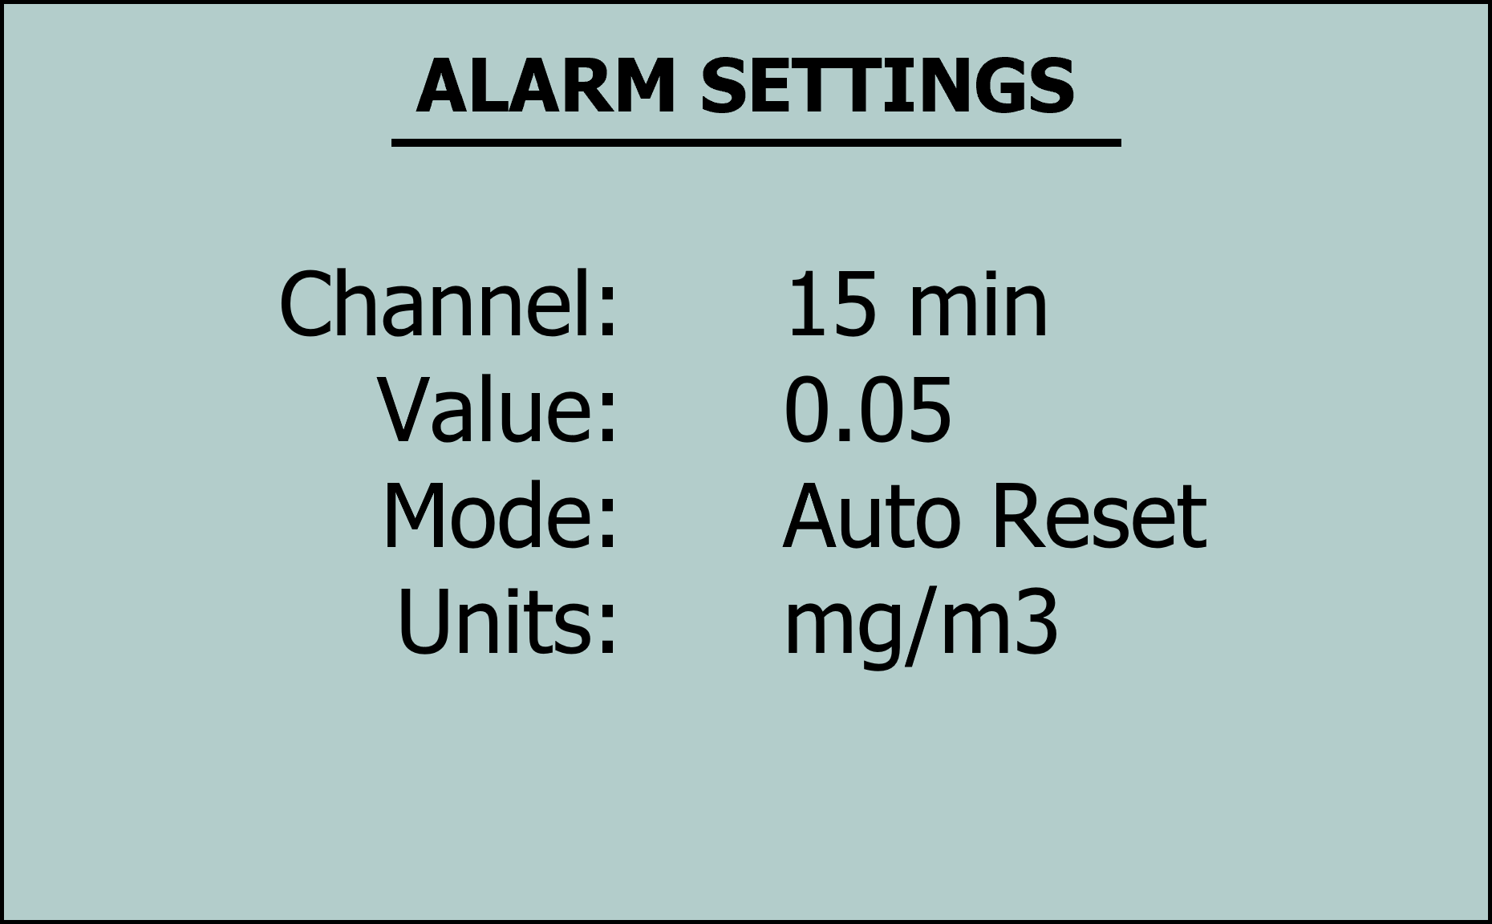
Real-Time RCS Detection

Slide 13
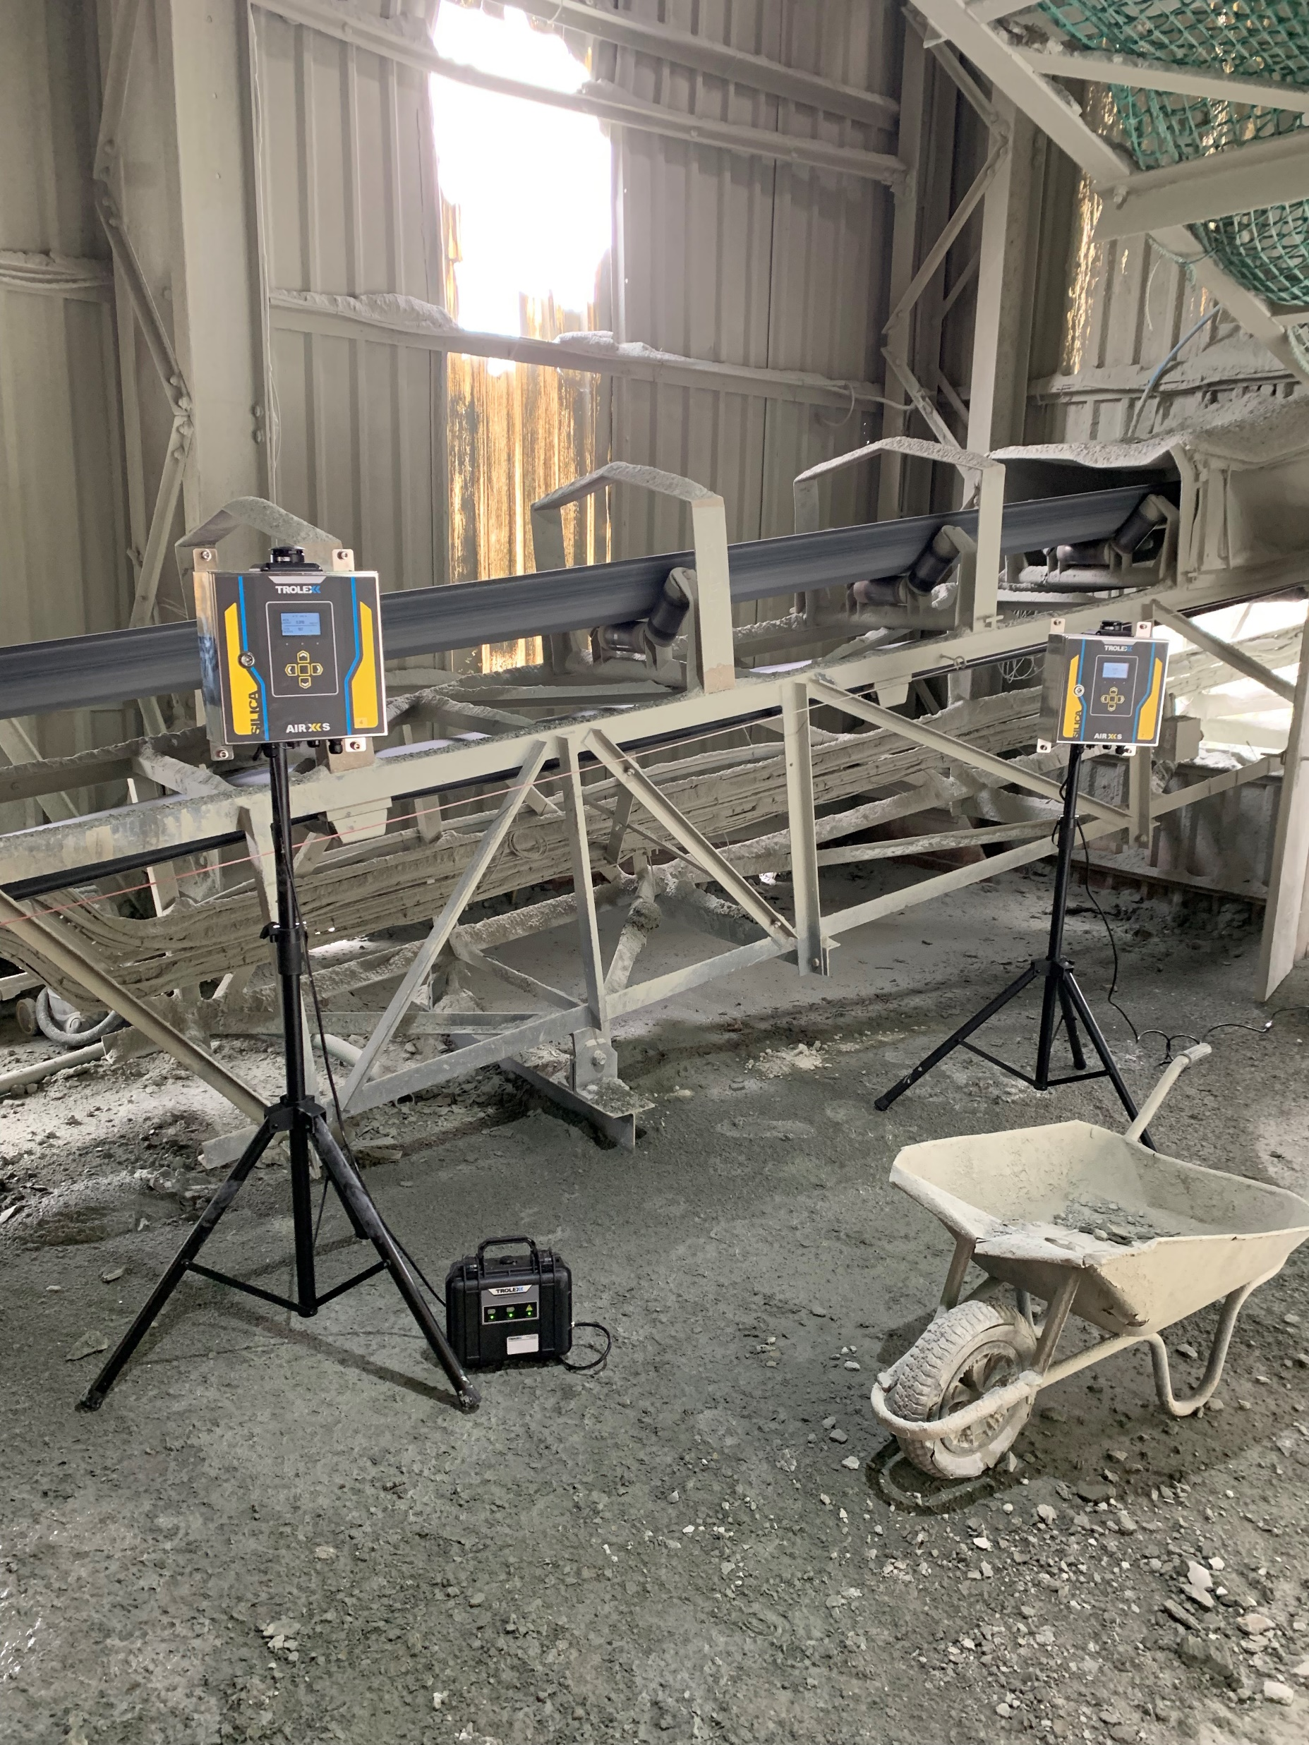
Real-Time RCS Detection
Key Installation Notes
Humidity may impact the aerodynamic size of some particles.
Device positioning should be considered relative to dust suppression systems or airborne mist or suppressants.
Device cleaning regimes may need to be considered depending on environmental dust loading.
Real-Time RCS Detection

Slide 14
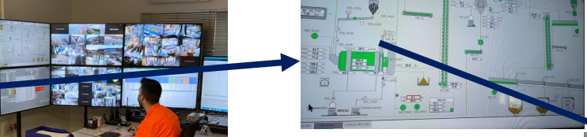
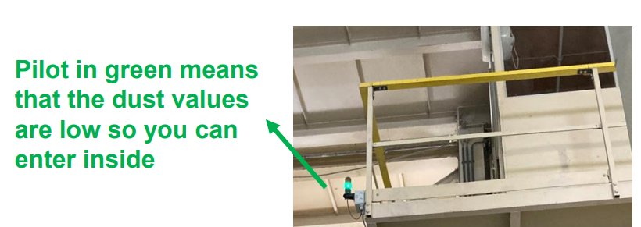
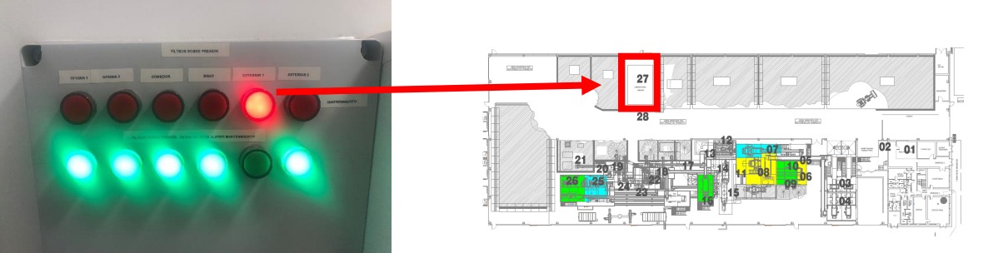
Real-Time RCS Detection
Key Installation Notes
Real-Time RCS Detection

Slide 15
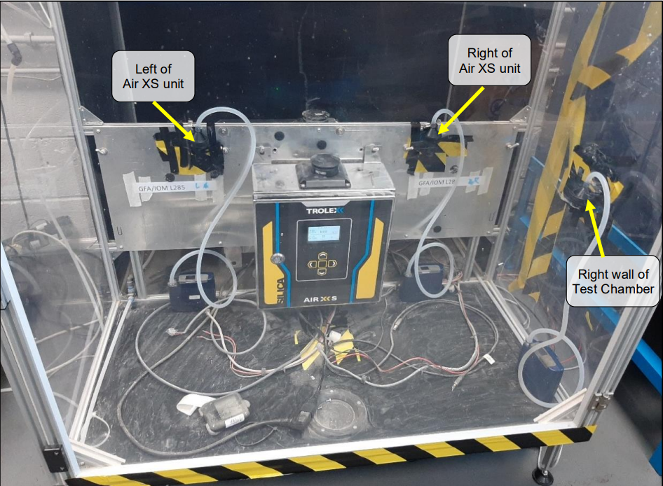
Real-Time RCS Detection
Device Testing and Benchmarking
Internal Lab Benchmarking
Site Stress Testing
Independent Verification
Real-Time RCS Detection

Slide 16
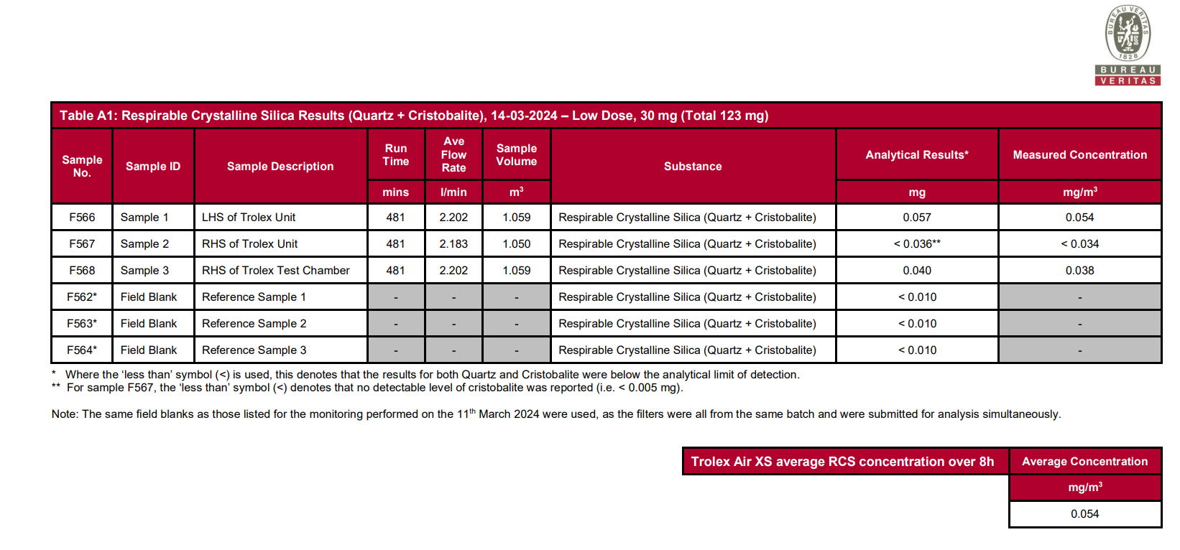
Real-Time RCS Detection
Device Testing and Benchmarking
Internal Lab Benchmarking
Site Stress Testing
Independent Verification
Real-Time RCS Detection

Slide 17
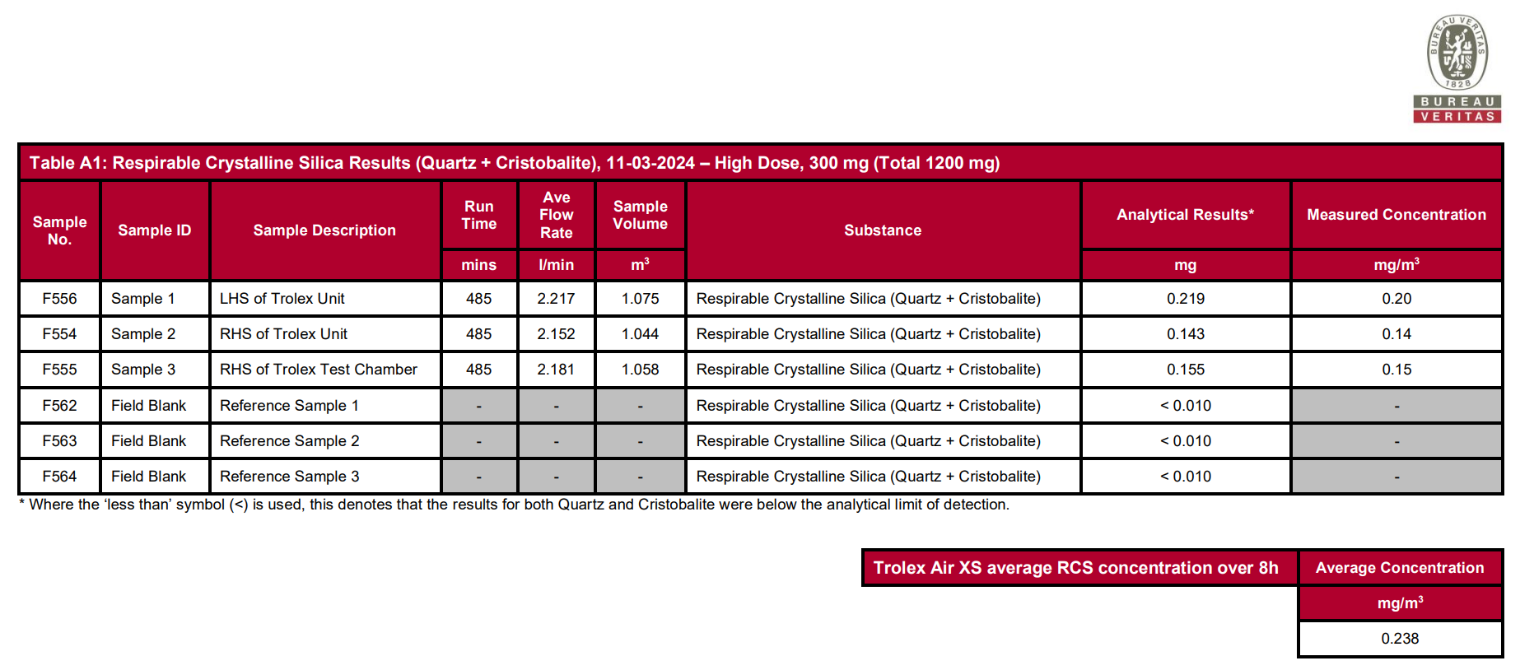
Real-Time RCS Detection
Device Testing and Benchmarking
Internal Lab Benchmarking
Site Stress Testing
Independent Verification
Real-Time RCS Detection

Slide 18


Real-Time RCS Detection
Device Testing and Benchmarking
Results-driven Soil Science professional with a diverse background spanning laboratory analysis, project management, and teaching. A proactive researcher dedicated to innovative solutions for environmental challenges, with a strong publication record in prestigious journals.
Internal Lab Benchmarking
Site Stress Testing
Independent Verification
Real-Time RCS Detection

