Slide 1
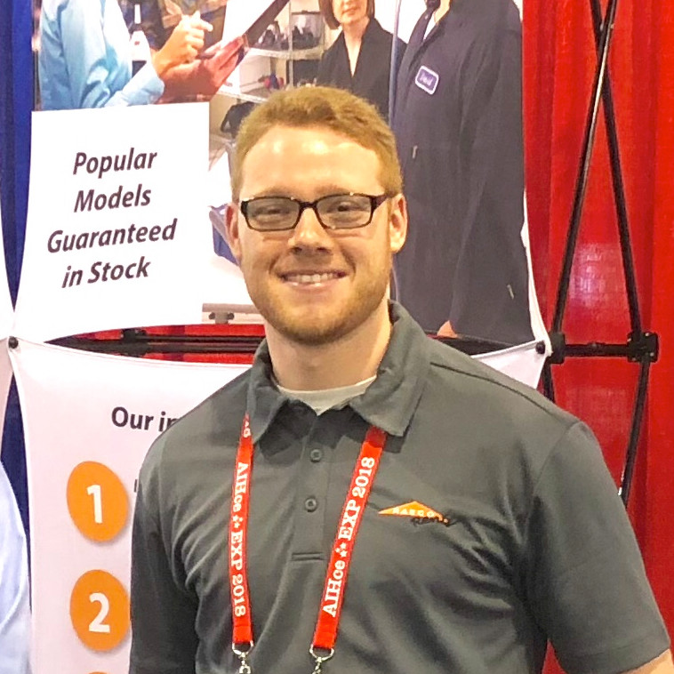
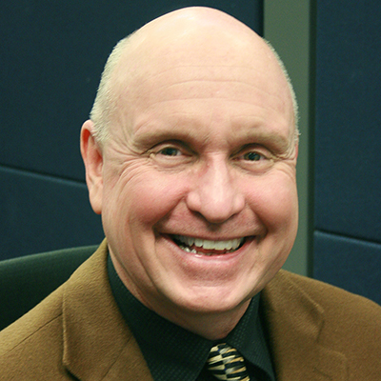
Presenter Introductions
Jordan Mikell Manager
Randy Walkowiak Salesperson
Jordan began his career as a Rental Specialist with RAECO Rents in 2017 with a focus on customer service and critical attention to detail
BS in Earth Systems, Society, and Environmental Sustainability from the University of Illinois at Urbana-Champaign
Enjoys playing music and disc golf in his spare time
Randy Walkowiak has had the privilege of supporting EHS Professionals for the past 11 years as a Salesperson at RAECO Rents.
Board Member for the Chicago Local Section of the American Industrial Hygiene Association AIHA. BS in Marketing from Northern Illinois University.

Slide 2
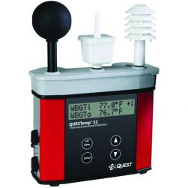
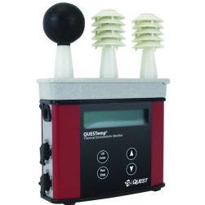
TSI QUESTemp Area Heat Stress Monitors
QT36 QT46 (waterless, humidity range 20-95%)
Wet Bulb sensor does not have a humidity range as it provides Wet bulb temperature to the WBGT indoor or outdoor formula calculations vs. the waterless Wet Bulb which is calculated from the dry bulb temperature and the humidity sensor (i.e., humidity sensor limitations are not applicable to the Wet Bulb sensor).
Notes:
BATTERY LIFE longer on QT36. 140 hours vs. 80 hours on QT 46. NO LONGER CERTIFIED INTRINSICALLY SAFE

Slide 3
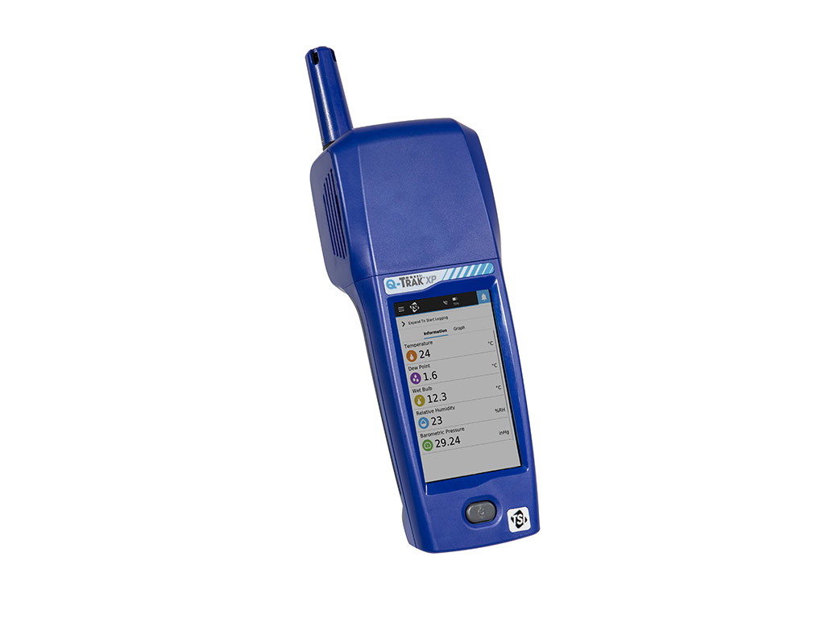
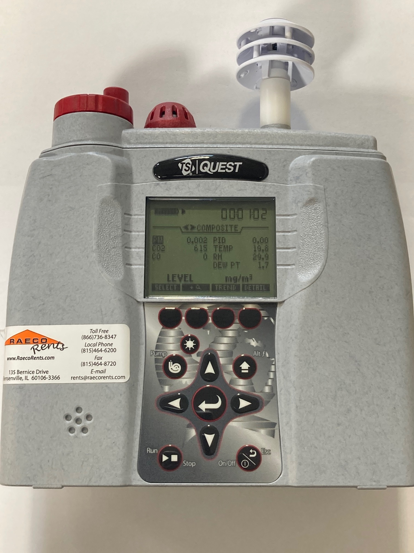
Combination Indoor Air Quality (IAQ), Particulate, and VOC Area Monitor
TSI/Quest
EVM-7/CO
TSI Q-Trak XP

Slide 4
Combination Indoor Air Quality (IAQ), Particulate, and VOC Area Monitor
EVM-7/CO
Log all data points simultaneously
Gravimetric sampling capability
Particulate selection (PM2,5. PM4, PM10, or TSP)
CO, CO2, and Photoionization detector (PID) to measure volatile organic compounds
Temperature and Relative Humidity
Uses Same DMS software as TSI/Quest Sound and Heat Stress Equipment
Q-Trak XP
TSI Instrument – Brand new to the market
Simultaneously measure PM1, PM2.5, PM10, and Total Dust
Same gas sensors as EVM-7 (CO/CO2, Temp, RH, VOC’s)
Color Touch Screen User Interface
View graphs of data in real time in addition to Min, Max, and TWA
Notes:
Contrast the two versions of software.
GOTCHA: EVM CO / PID false high readings. Press down on sensor bar. Delicate instrument DMS Software: Need to configure data to include PID results in report. Not included by default unless template is utilized
QTRAK is “passive” particulate sampler while EVM has built-in pump. If in need of highly accurate particulate readings, use EVM or Dusttrak GOTCHA: Q-Trak XP Negative readings. Check before sampling, do a zero cal outdoors before testing. Note: There is a setting to disable negative readings, currently not working. TSI looking into it GOTCHA: Comprehensive report with new software Trakpro Ultra. Can only get comprehensive Excel files. Graphs of each parameter need to be saved individually. I had issues saving those files too (had to save as a certain file type to get it to display on my computer, I think .png) CAN NOT SEND TRAKPRO FILES TO CUSTOMERS WHO REQUEST DATA DOWNLOAD – Excel only, and separate PDFs of graphs

Slide 5
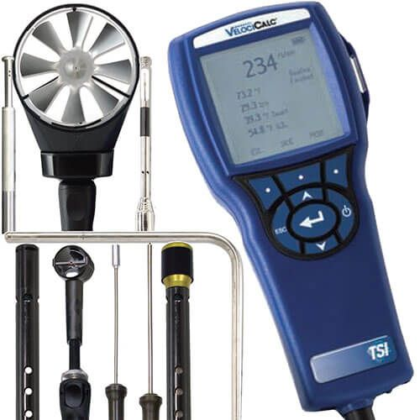
Multiparameter Meter with Interchangeable Probes
TSI VelociCalc 9565 commonly referred to as the Q-Trak. When used with the 982 IAQ Probe it measures CO, CO2, Temperature, and RH
Hotwire anemometer probes for measuring Velocity, Temperature, and Relative Humidity also available.
Straight (964) and Articulating (966) probes for Temp, Velocity, and RH
Rotating Vane (995) probe for Temp and Velocity

Slide 6
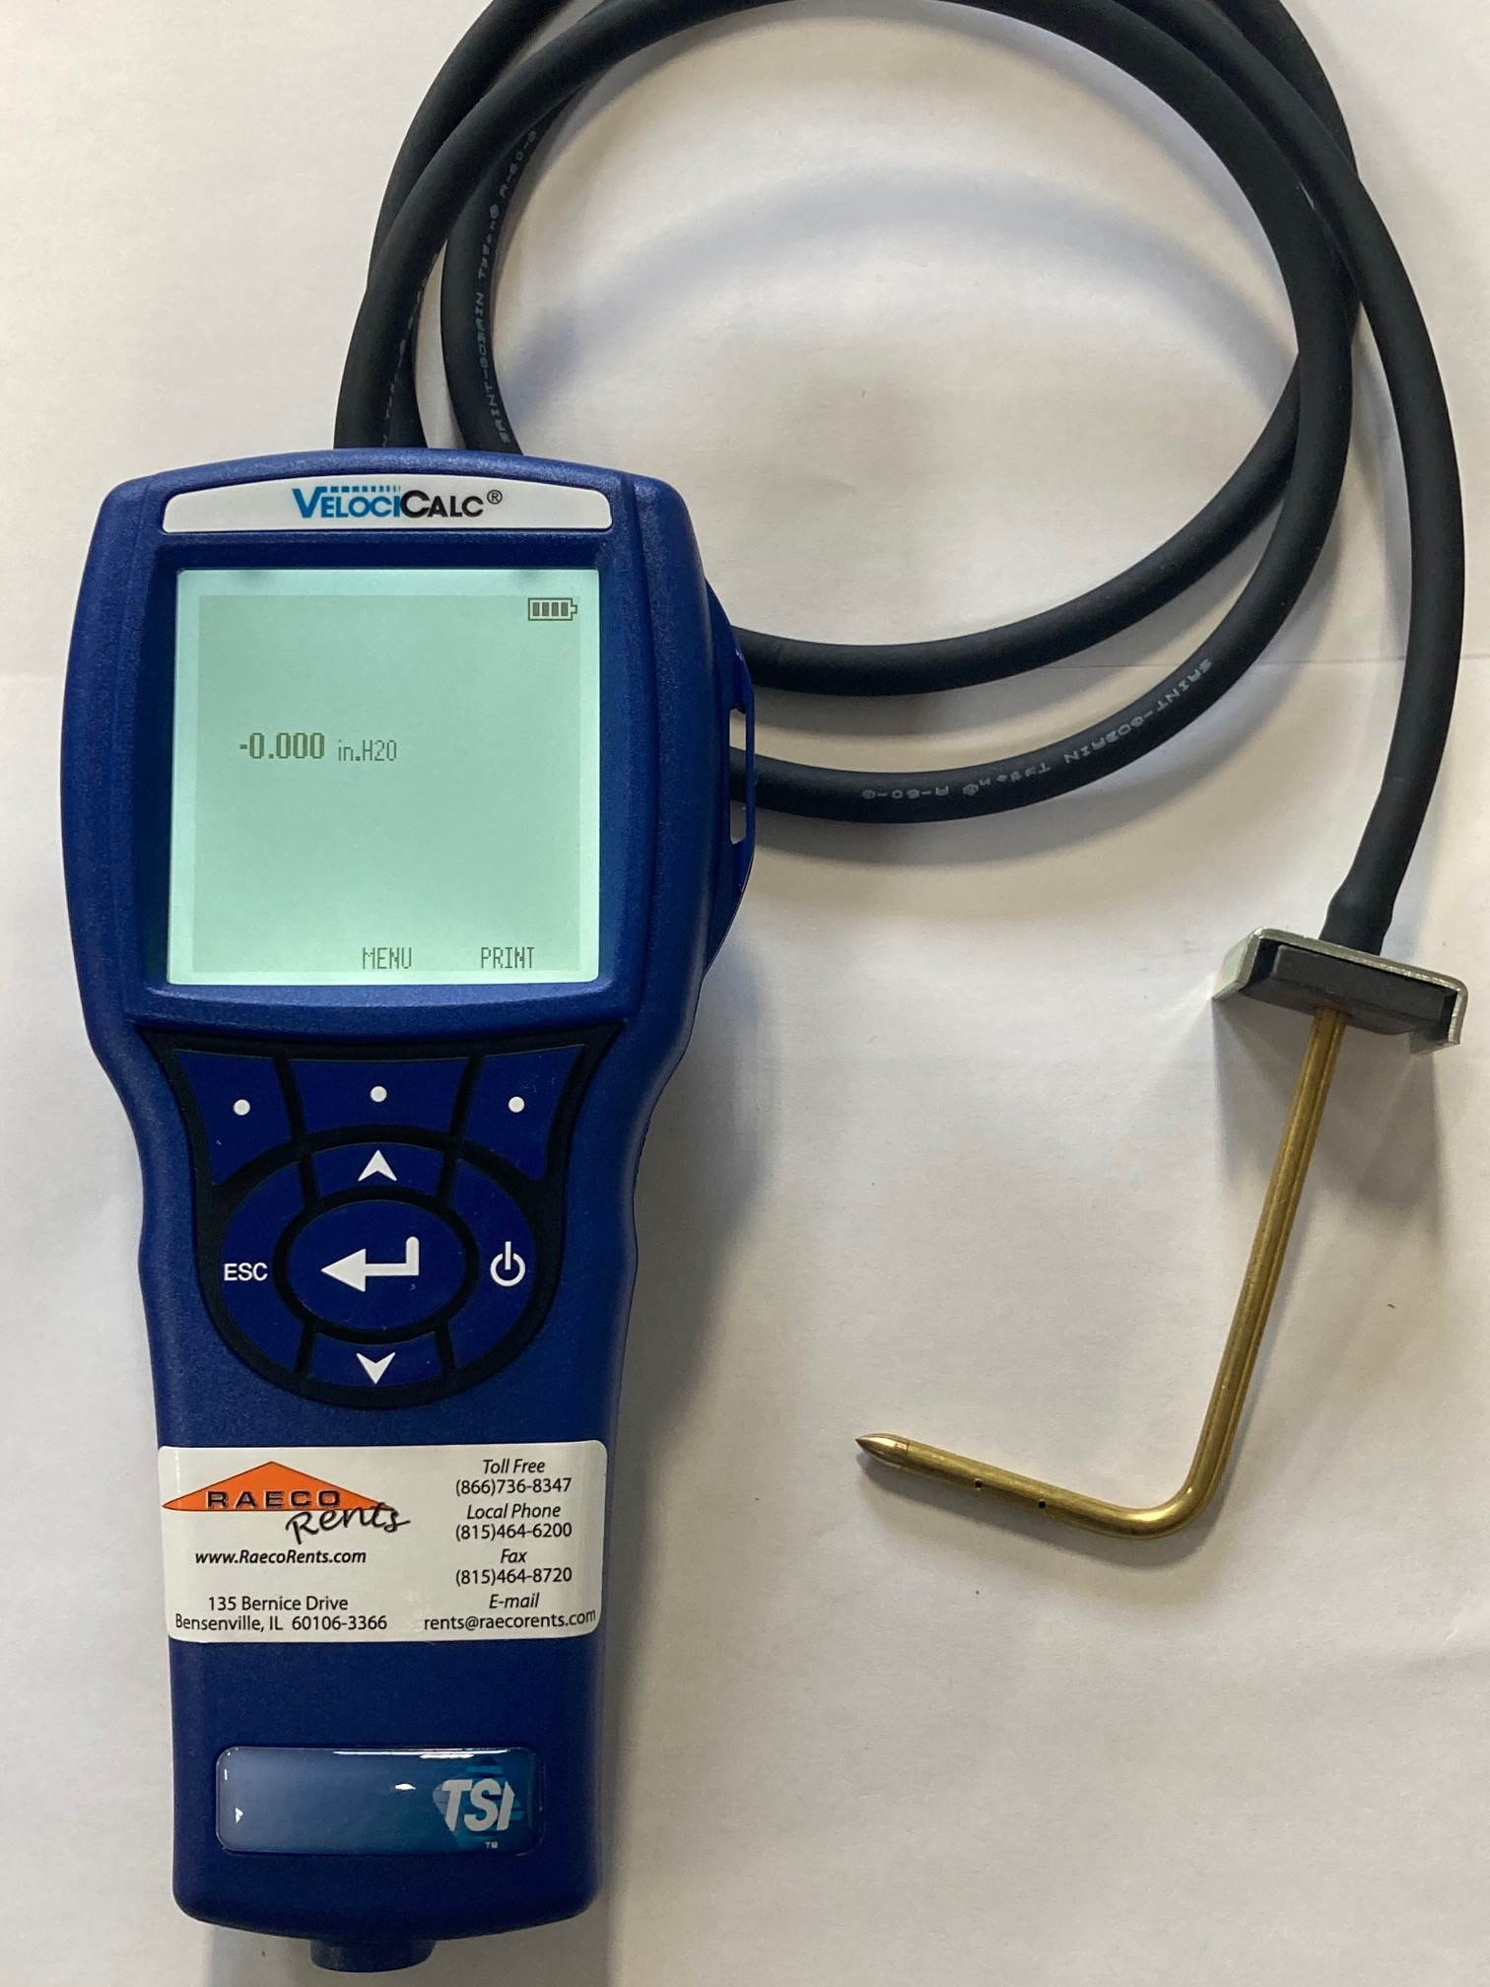
Multiparameter Meter with Interchangeable Probes
The more versatile TSI Velocicalc 9565-P has a built in differential pressure sensor.
Static and Differential pressure measurements
Tubing and Static Pressure Probe included in kit
Notes:
GOTCHA: Make sure you hit the enter button to prompt datalogging. Even "autosave" option needs to be manually started.
There is an “auto-save” datalogging option, but that does NOT log automatically. Still need to prompt the datalogging to start.

Slide 7
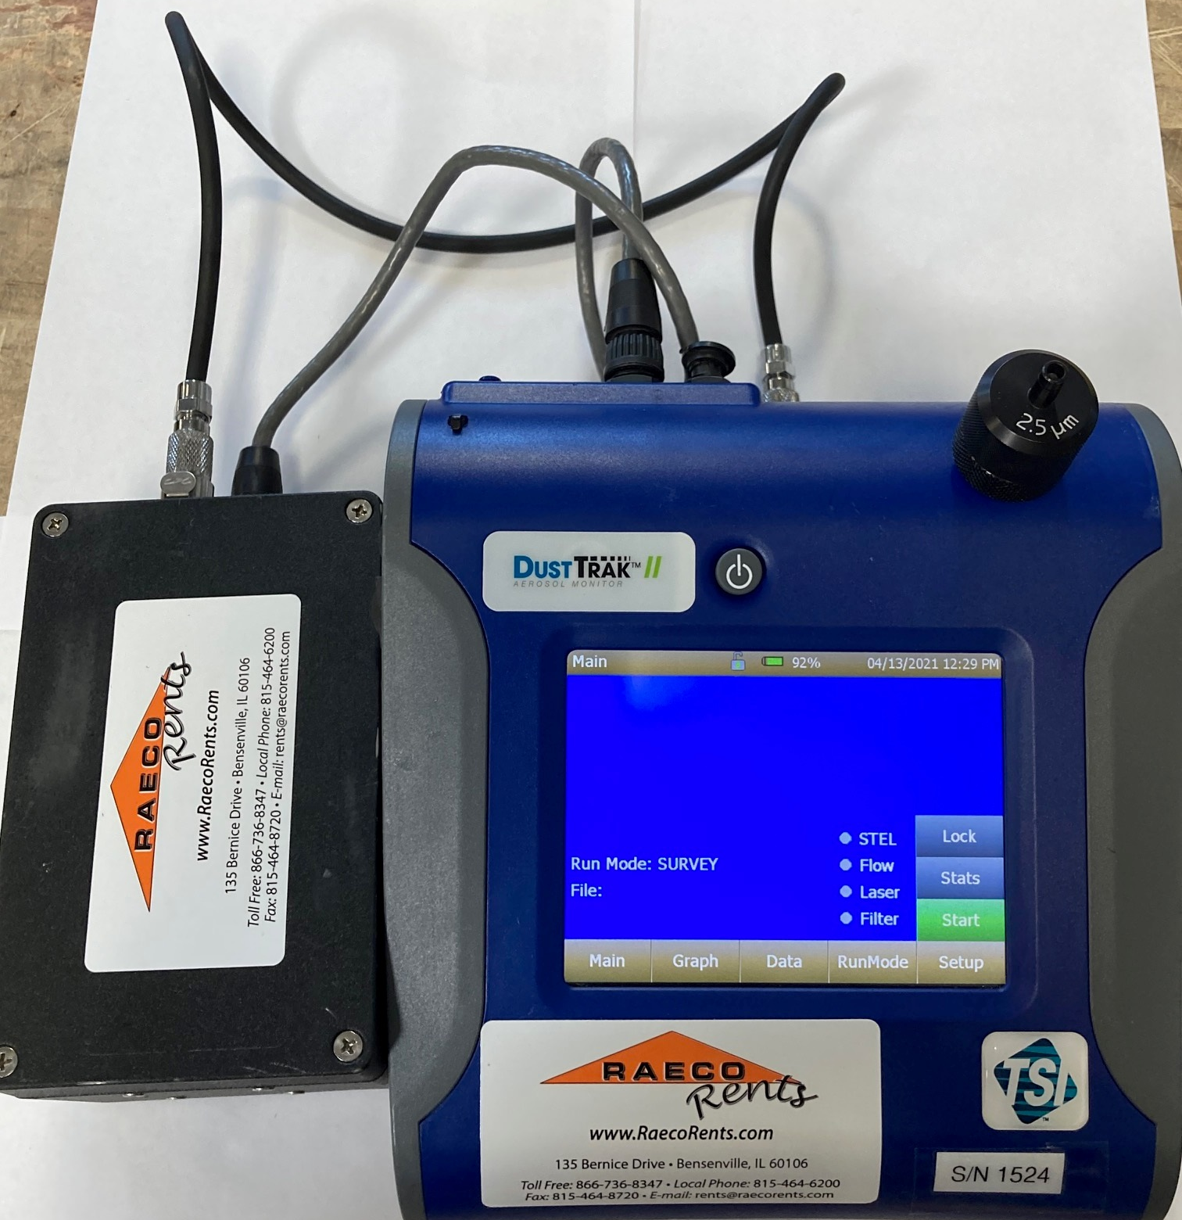
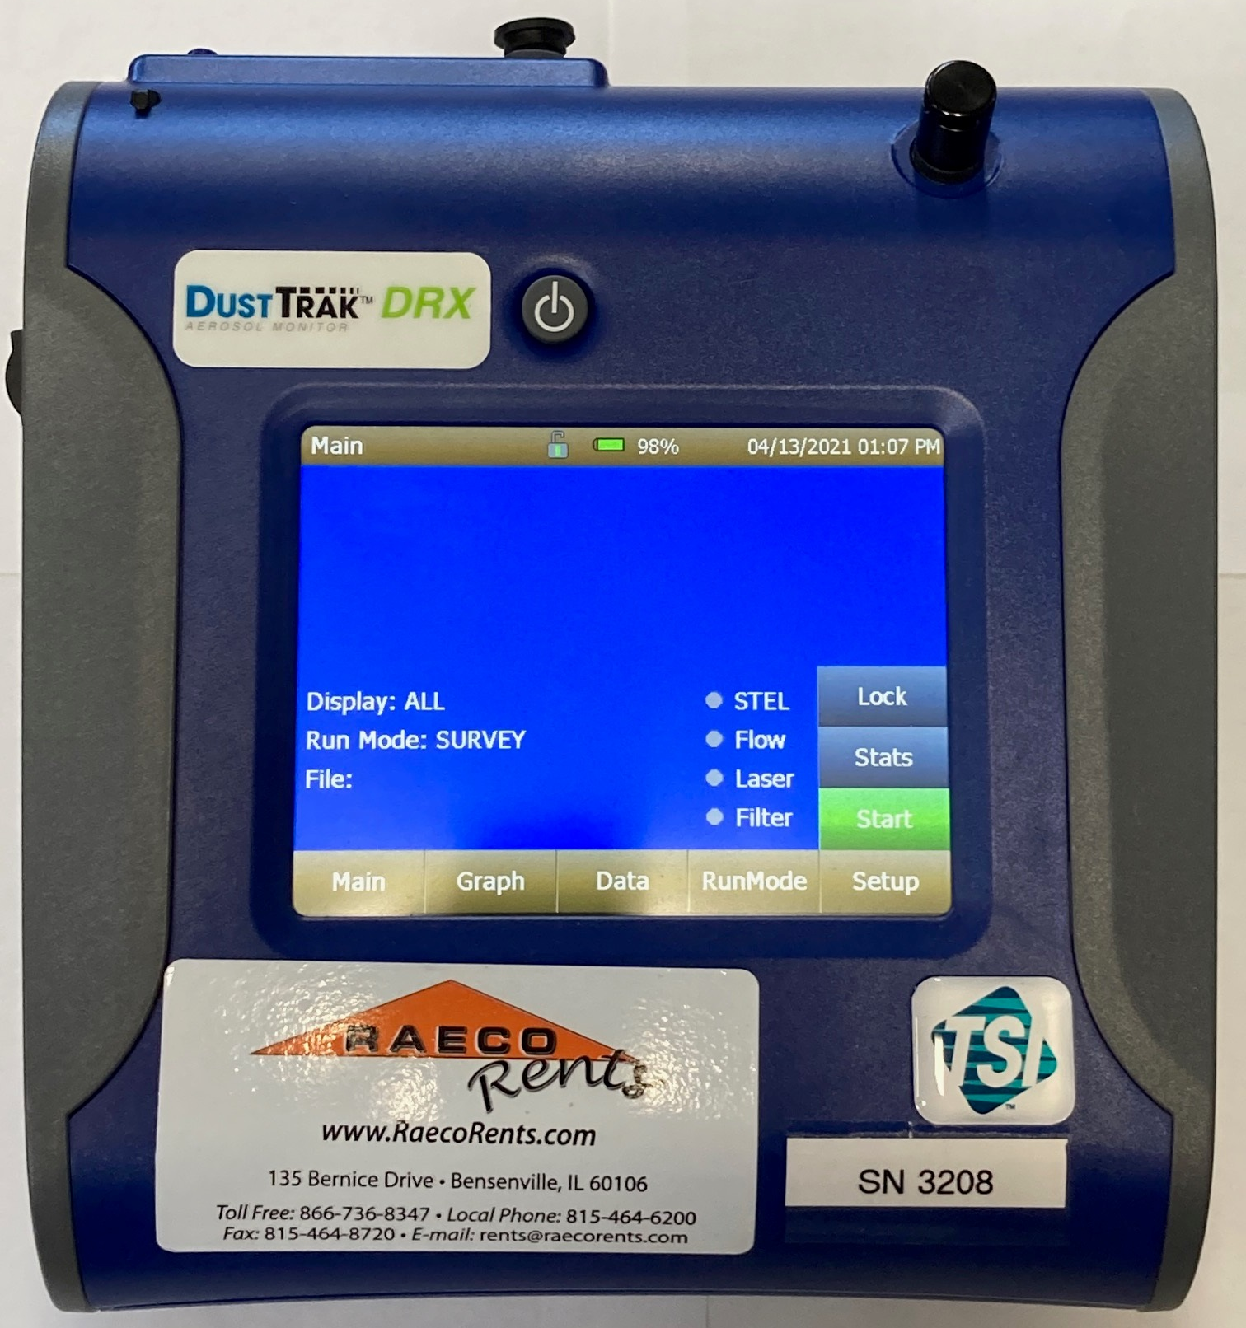
TSI Particulate Monitors – DustTrak II, DustTrak DRX, and Handheld Models
TSI DustTrak II vs. DustTrak DRX
Available in Standard and EP Option
Notes:
We have found the internal pump to be more than capable for extended periods.

Slide 8
TSI Particulate Monitors – DustTrak II, DustTrak DRX, and Handheld Models
Dusttrak II
Size selective measurement requires impactors
Can only measure one size at a time
PM1, PM2.5, PM4, and PM10
Internal cassette for gravimetric sampling
EP (External Pump) model available for long term projects
Dusttrak DRX
No impactors needed
Measure PM1, PM2.5, PM4, PM10, and total dust simultaneously
Internal cassette for gravimetric sampling (2-Piece Cassette)
Proper impactor must be used
EP (External Pump) model available for long term projects
Notes:
How I learned about the 2 piece cassette
GOTCHA - Survey mode does not log data Data downloaded via USB flash drive will not be timestamped properly. "Time elapsed" instead of date/time Failing zero cal / false high readings? Clean mirror, change filter, reset filter concentration

Slide 9
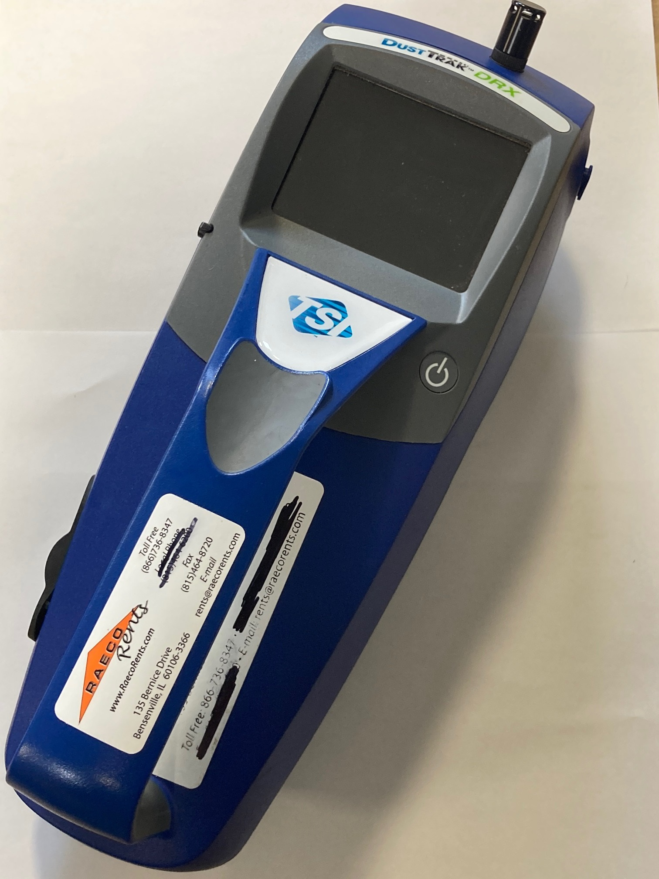
Portable Handheld Particulate Monitor for Area Monitoring
TSI DustTrak DRX 8534
No internal cassette for gravimetric sampling
Measure PM1, PM2.5, PM4, PM10, and total dust simultaneously
No Impactors needed
Notes:
Randy shared previously with AIHA that a spare battery is included with the 8534 at no additional cost.

Slide 10
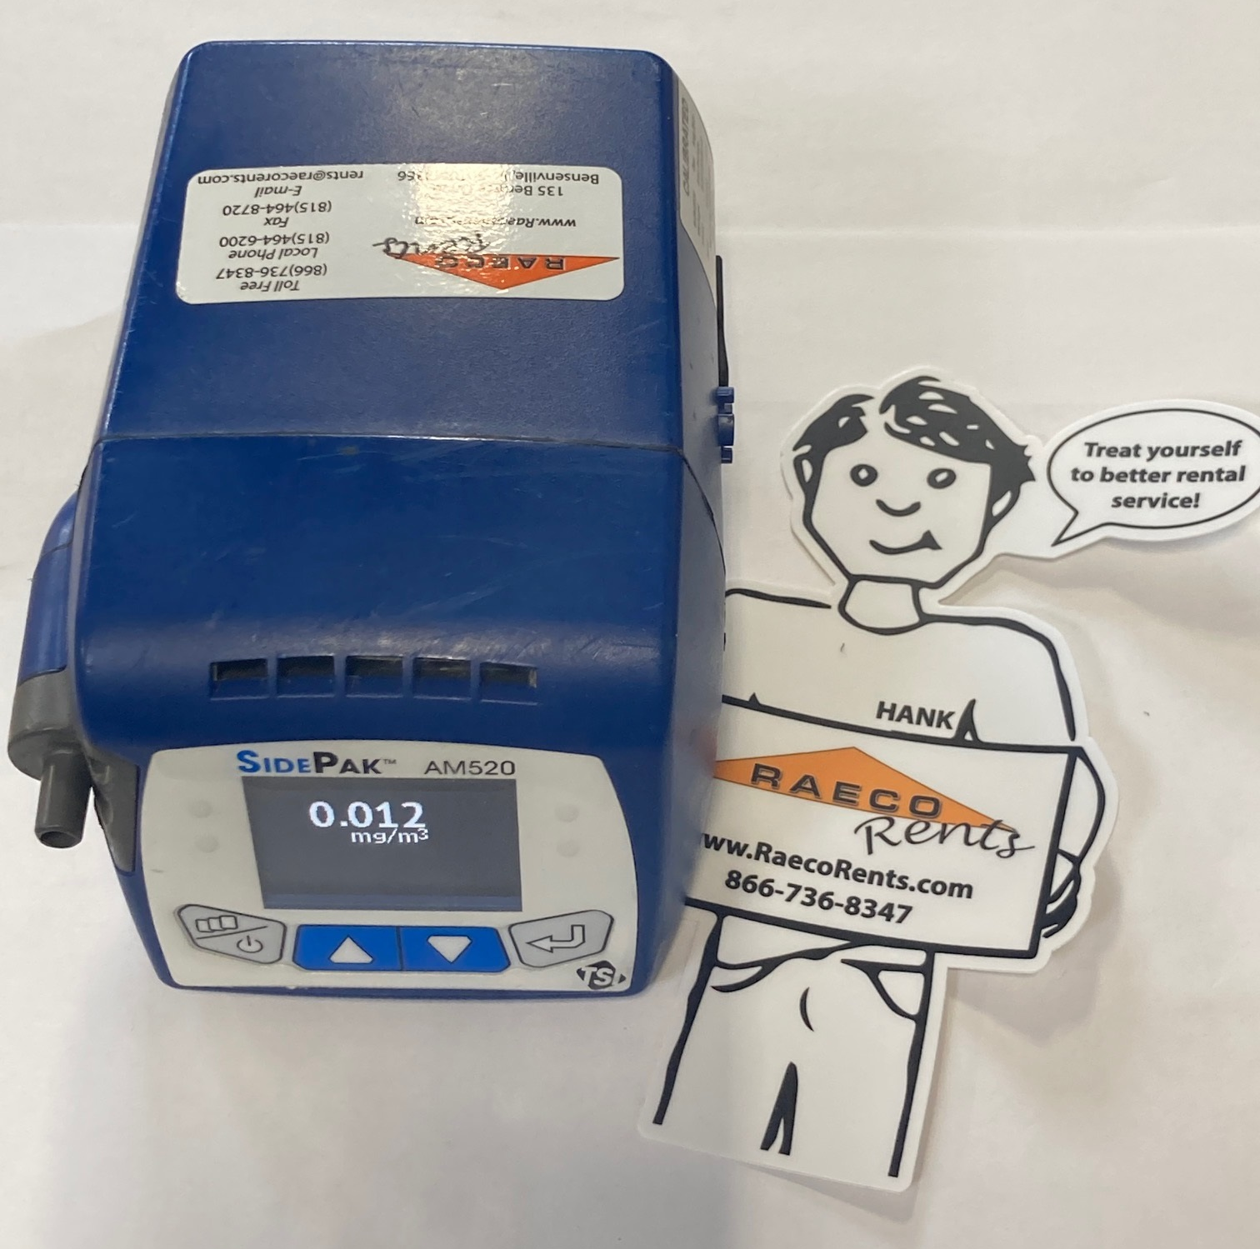
TSI Sidepak AM520 Real-time Aerosol Monitor, Personal/Wearable
TSI Sidepak AM520
Personal Pumped Monitor
Datalogging and Real-Time Measurements
Size Selective Impactors
Measure one size (or total dust)
RAECO Rents also owns two intrinsically safe TSI Sidepak 520i
Notes:
USES TRAKPRO 5 – Not standard Trakpro or Trakpro Lite

Slide 11
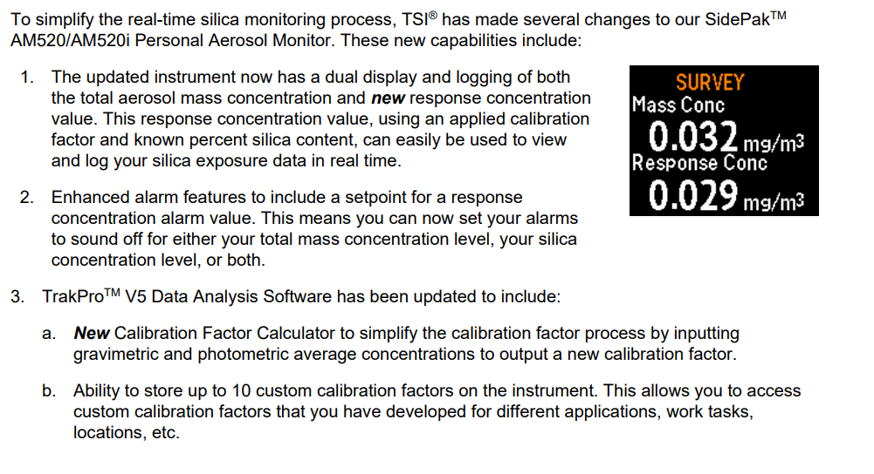
TSI Sidepak AM520 Real-time Aerosol Monitor, Personal/Wearable
Recent Firmware update to AM520:
Real Time Silica Exposure Data
Notes:
Calibration (correction) factors applied after gravimetric analysis for more accurate real time results. Real-time monitors are calibrated with Arizona road dust, other particulates produce a different response and this is why the calibration factor is needed

Slide 12
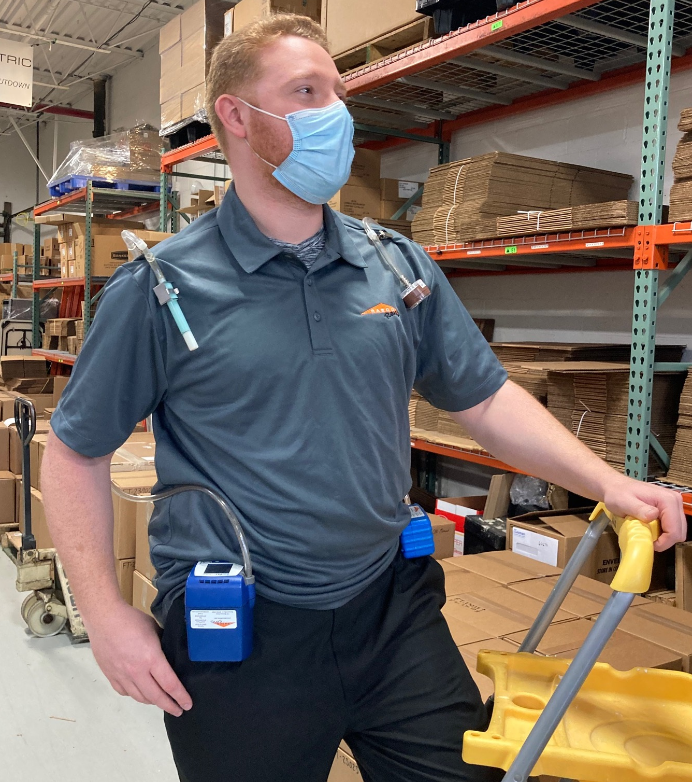
TSI Sidepak AM520 Real-time Aerosol Monitor, Personal/Wearable
Can be used in a multi-faceted study!
Gravimetric sample for lab analysis with a personal sampling pump
Real time particulate readings from the Sidepak AM520
If real time readings show a need for lab analysis, you’ll already have the job done! If real time total dust results are below thresholds, no need to waste money on lab fees.

Slide 13
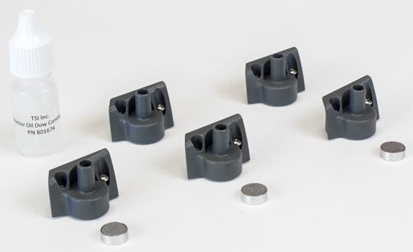
TSI Sidepak AM520 Real-time Aerosol Monitor, Personal/Wearable
PM1, PM2.5, PM5, PM10 Impactors
Internal impactor disc utilized only when using Size Selective Impactors
Flow must be calibrated at 1.7 LPM to ensure proper performance of impactors
Respirable cyclone can be used for respirable dust measurements

Slide 14
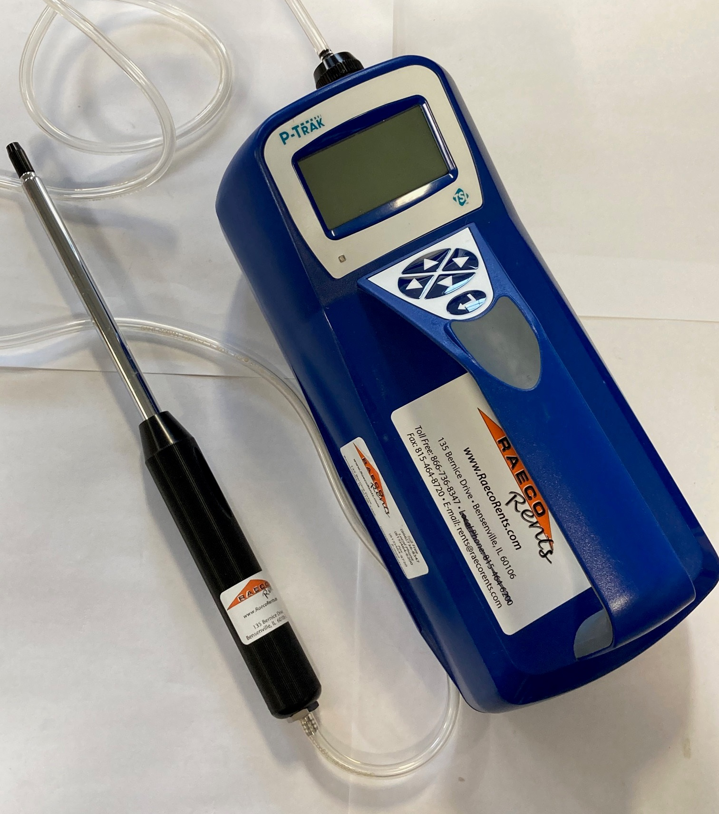
Ultrafine Particle Counter, Portable Handheld for Area Monitoring
TSI P-Trak 8525
Detects and counts ultrafine particles (0.02 to 1μm diameter)
Applications
Check office equipment
Cleanroom containment checks
Filter checks
Check fume hoods
Check safety cabinets
Vehicle emission migration
Combustion leaks
Control smoking areas
Notes:
GOTCHA: Low alcohol warning. Sometimes customers make this issue worse by flooding the unit with alcohol. If excess moisture OR excess alcohol gets into the unit, this message will be displayed. Requires a "Drying out" of the internals to get rid of the message. This applies to Portacounts as well
FILTER CHECKS: Randy Casino story

Slide 15
TSI Trakpro Software
Trakpro 4.7.2
P-trak 8525
Dusttrak II and Dusttrak DRX
Velocicalc / Q-Trak
Data Download with Trakpro 4.7.2
Trakpro 5
Only for the AM520 / AM520i currently
Data Download with Trakpro 5
Trakpro Ultra
- Only for Q-Trak XP currently

Slide 16
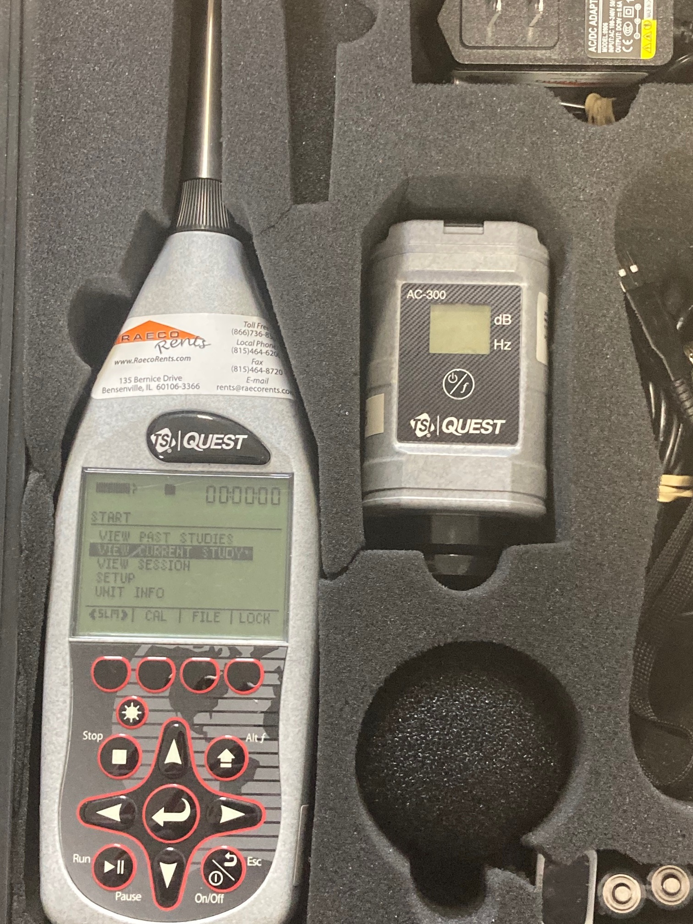
Sound Level Meter (SLM) with Sound Calibrator for Area Noise Mapping
TSI/Quest Soundpro and AC-300 Calibrator
Field Calibration with AC-300 at 114 dB
Datalogging
Octave Band Analysis (1/1 or 1/3)
Lavg vs Leq
These are actually the same measurement, but Leq ignores the threshold setting
CNEL
Community Noise Exposure Limit (Subject to Community Ordinance)
Boosts sample response at night to account for the “quietness” at those times
Notes:
GOTCHA: Sliding range in "view session". We get folks who think the Soundpro is broken because they aren't using the correct range
Lavg vs. Leq on Soundpro: DMS Manual states that Leq is the “true equivalent sound level measured over time. The term Leq is functionally the same as Lavg except that it is only used when the exchange rate is set to 3dB and the threshold is set to none.

Slide 17
Sound Level Meter (SLM) with Sound Calibrator for Area Noise Mapping
Type 1 and Type 2 Available
A, C, Z, and F Weighting
2 “virtual” meters for measuring with different settings
Set response time
F = Fast
S = Slow
I = Impulse*
* Impulse not recommended by TSI
Notes:
GOTCHA: Per TSI, “Impulse” response time rarely used, if at all. For gun range applications, use Type 1 with slow response, NOT impulse

Slide 18
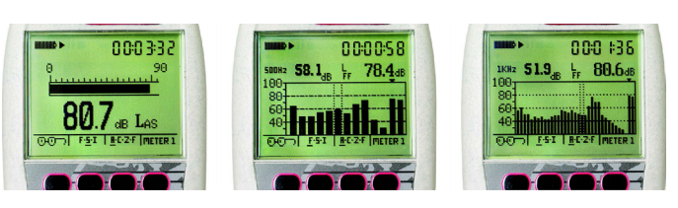
Sound Level Meter (SLM) with Sound Calibrator for Area Noise Mapping
Sound Pressure Level (SPL) Display
1/1 Octave Band Display
1/3 Octave Band Display

Slide 19
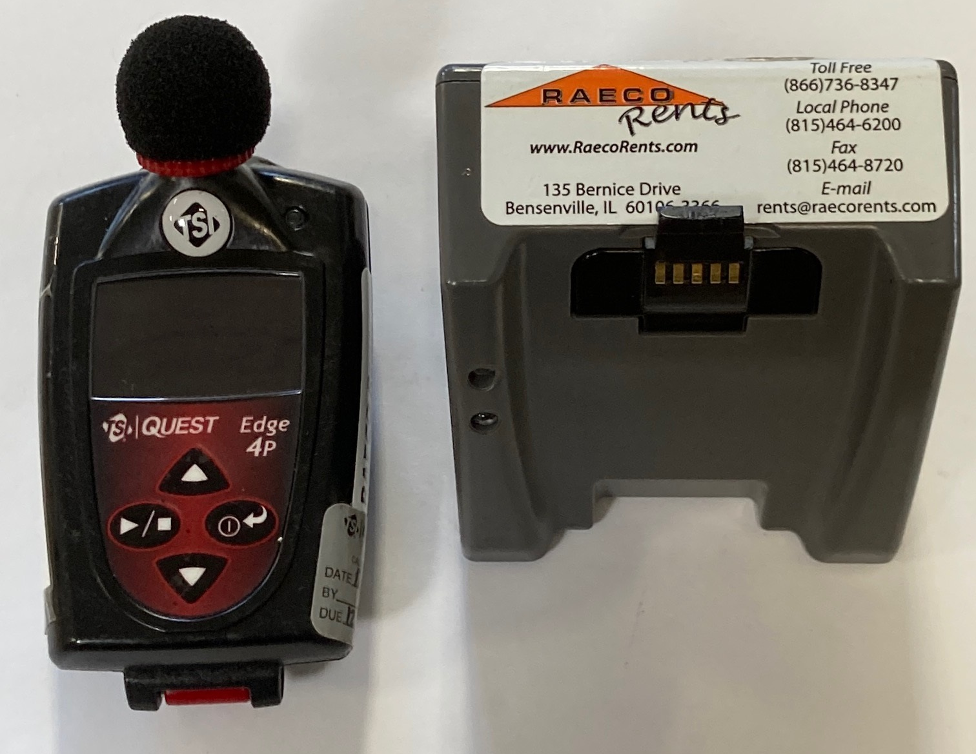
TSI/Quest Edge: Dosimeter with sound calibrator for Personal Sound Monitoring
TSI/Quest Edge Dosimeter
Type 2 Microphone
Edge 4 Plus
Bluetooth Capability
2 “virtual” dosimeters
Not Intrinsically Safe
Edge 5
3 “virtual” Dosimeters based on OSHA HC, OSHA PEL, and ACGIH Regulations
Intrinsically Safe
Notes:
Look out for 2-piece microphone! IF the “cage” is removed it exposes the microphone diaphragm. If the diaphragm is damaged, the microphone must be replaced.
Enter calibration mode manually (hit up and down arrow at the same time). Helps to speed up calibration process as well as calibrate dosimeters that don’t automatically enter calibration mode.

Slide 20
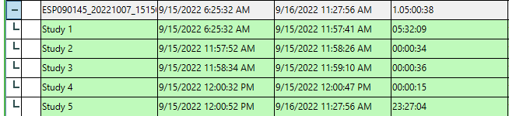
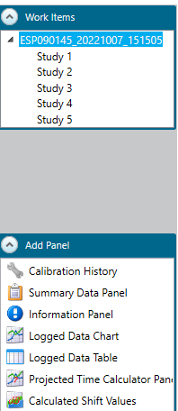
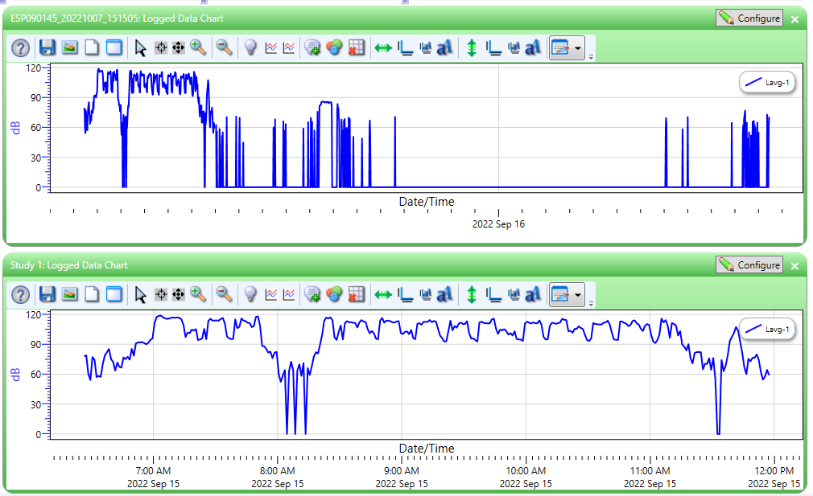
TSI/Quest Edge: Splitting up Study Data
Notes:
GOTCHA: Multiple studies on dosimeter. How to split up data in DMS

Slide 21
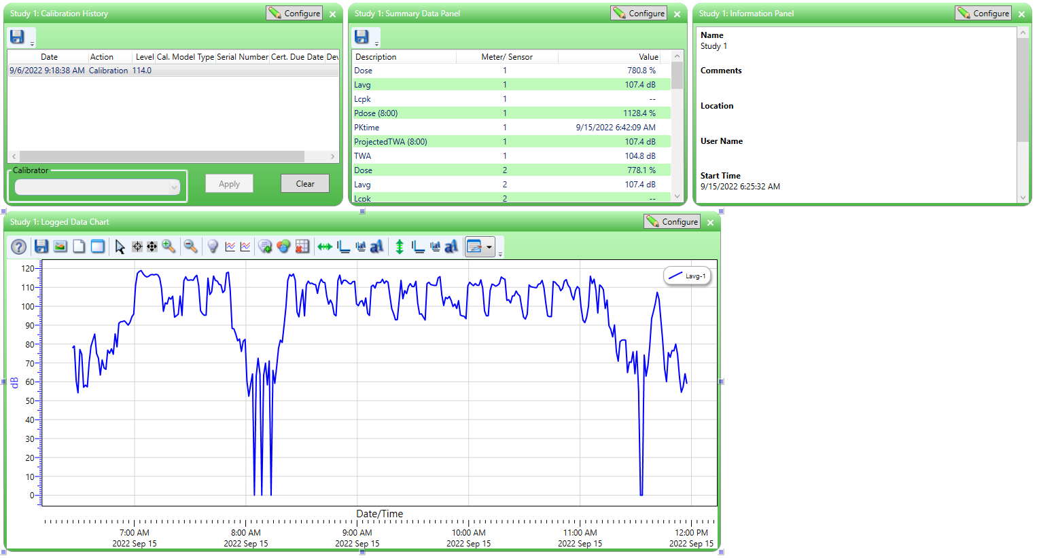
TSI/Quest Edge: Splitting up Study Data
Notes:
All Panels reflect Study 1 information
Configure -> Preferences -> Miscellaneous -> Uncheck “Skip Distribute Studies to Sessions Dialog”. With this option unchecked, all separate studies will be brought into the data finder as separate sessions.
Any info missing? Remember to configure panels!

Slide 22
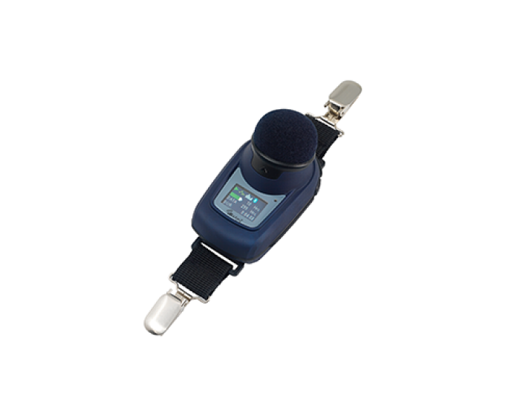
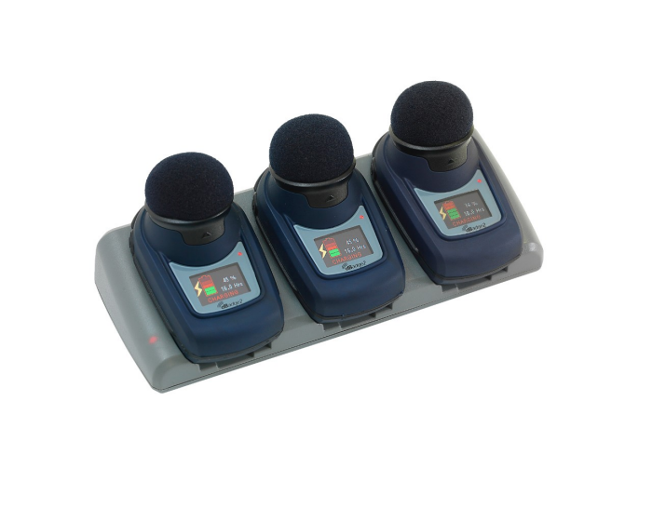

Casella dBadge personal noise dosimeter – now part of TSI
Notes:
One second logging available for railroad. Section 227.105 (d) Exposures to continuous noise greater than 115 dB(A) and equal to or less than 120 dB(A) are permissible, provided that the total daily duration does not exceed 5 seconds.
Monitor via Bluetooth connection with the Airwave mobile app

Slide 23
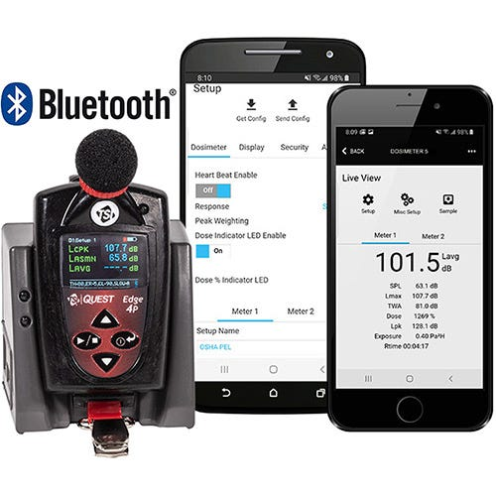
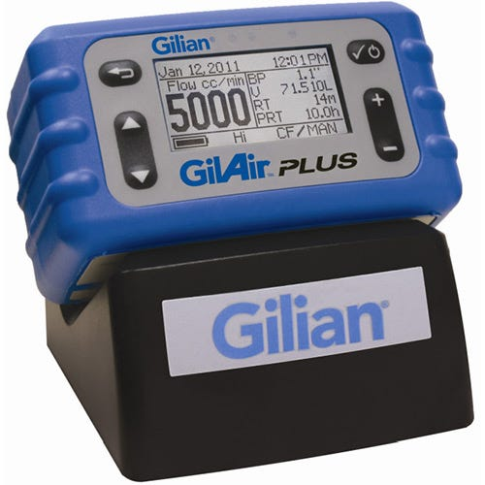
Performing I H Surveys at a (Social) Distance – Bluetooth Devices
Gilian Gilair Plus with Bluetooth
Casella dBadge2IS
Edge 4 Plus with Bluetooth
Introducing Bluetooth Enabled Edge 4 Plus and Gilair Plus | RAECO Rents

Slide 24
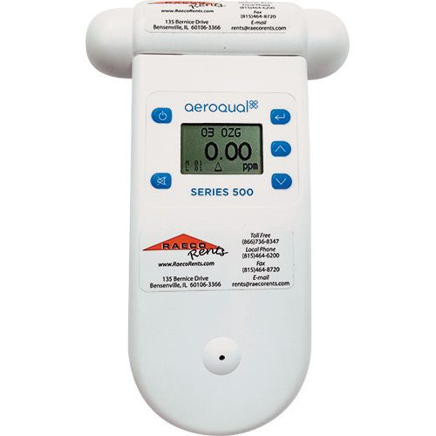
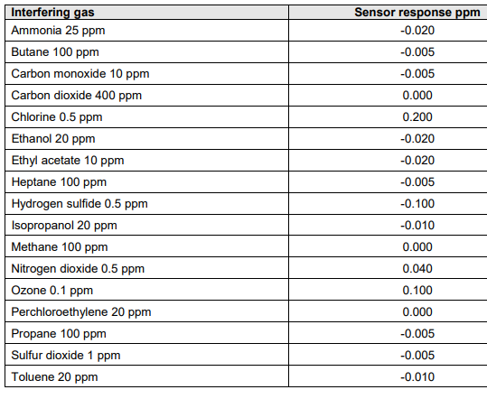
AeroQual Series 500 Handheld Ozone Monitor
The Aeroqual Series 500 portable monitor can measure Ozone concentrations from 0 to 10 ppm. The monitor comes with low range (0 to 0.5 ppm), and high range (0-10) Ozone sensors.
Notes:
Allow at least 10 minutes for the sensor to warm up and stabilize. This includes 3 minutes for a sensor warm up, and 7 minutes for a sensor stabilization (measurement will be flashing during this period)
While not in use, keep the monitor in “standby” mode to keep the sensor heated and prevent a buildup of contaminants by simply pressing the power button while in measurement mode. This also prevents the need for a warm up between samples.
When switching sensor heads, power off the unit first. Turn off the unit, switch sensor heads, and then power back on. Inserting/removing sensor heads while the monitor is on may damage the unit.
Many applications require measurement and control of very low ozone concentrations below 200 parts per billion. At such low concentrations, you need to consider the following sampling issues to successfully measure and control ozone.
Ozone is highly reactive. Ozone will rapidly react with organic compounds and surfaces such as walls, flooring, plastic testing chambers and people.
Ozone concentration gradients are common in rooms and are greatly influenced by air movement and mixing. Concentrations may be lower near walls and surfaces or in areas with low air flow.

Slide 25
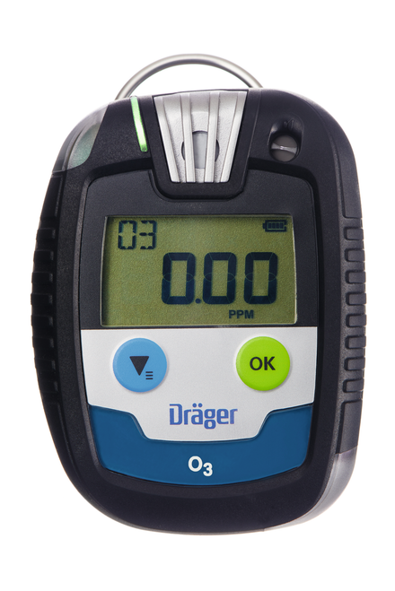
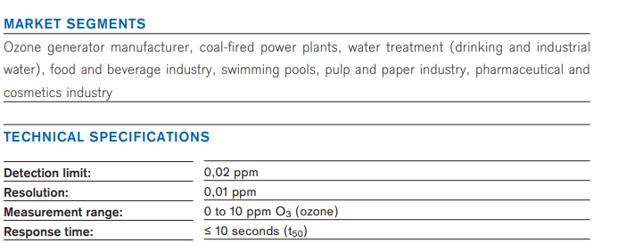
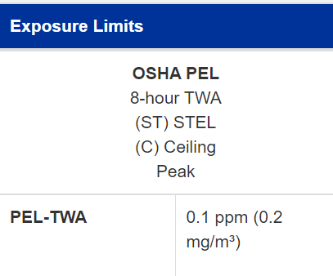
Drager Pac 8000 Personal Ozone Monitor

Slide 26
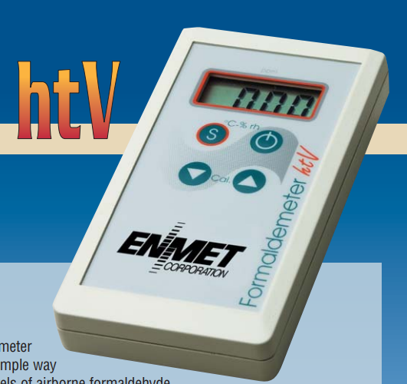
Enmet Formaldemeter HTV
Accurate measurements of airborne formaldehyde at low concentrations
Range: .05 – 10 ppm
Limit of Detection = 50 ppb
Resolution = 10 ppb or .01 ppm

Slide 27
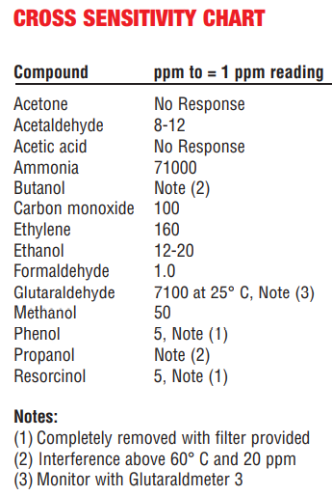
Enmet Formaldemeter HTV
Minimal cross-sensitivities
For comparison, RAE EC HCHO Sensor has 20% cross-sensitivity to CO
Field Calibration Standard – ensures accuracy at any time. Quick calibration process takes just 1-2 minutes
Automatically stores results of last 10 samples taken (Non-datalogging model)
Notes:
RAE vs. Enmet (more specific, less cross-sensitivity issues, higher resolution)

Slide 28
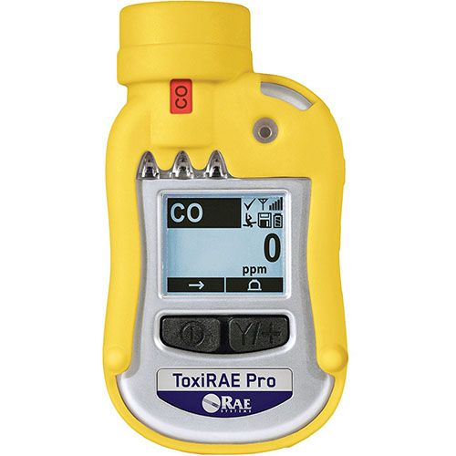
ToxiRAE Pro: Single-gas meter, Personal/Wearable
Diffusion style
Popular sensors include:
Carbon Monoxide CO
Carbon Dioxide CO2
Hydrogen Sulfide H2S
Nitric Oxide NO
Nitrogen Dioxide NO2
Chlorine Cl2
Ammonia NH3

Slide 29
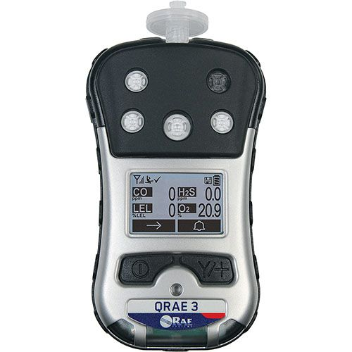
QRAE3: Four-gas meter, Personal/Wearable
Pump style – Standard Sensors
Carbon Monoxide CO
Oxygen O2
Hydrogen Sulfide H2S
Lower Explosive Limit LEL
Notes:
Emphasis on pump

Slide 30
ToxiRAE Pro and QRAE 3
Up to 3 months datalogging capacity at 1 minute interval (user configurable)
Up to 30 hours battery life on ToxiRAE Pro
Up to 11 hours battery life on QRAE3
User-defined alarm thresholds and modes
QRAE can sample through up to 98 feet of tubing
Sensors are easily replaceable in the field if needed
IP-65 Dust and Water Resistance
Suitable for almost any environment
0 – 95% Relative Humidity
-4° to 122° F Operating Temperature

Slide 31
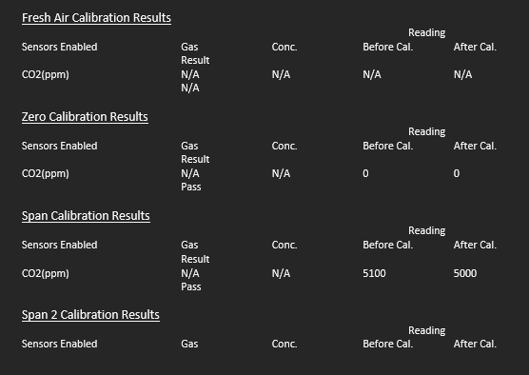
ToxiRAE Pro and QRAE 3
Pumped vs. Passive Sampling
Passive sampling can be used in many applications – when might a pump be needed?
Leak Detection
Confined Space
“Active” sampling in area monitoring
Calibration Certificate from ProRAE Studio II
Training Video: How to create a Calibration Cert for RAE Systems gas monitors - YouTube
Notes:
Software
Login as Admin to download data. PW = “rae”
Download calibration certificates directly from the instrument via software

Slide 32
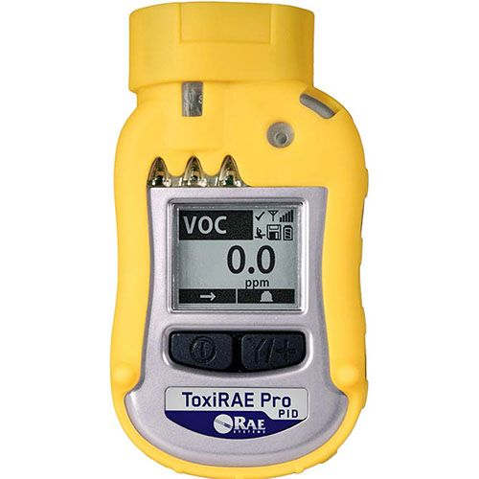
ToxiRAE Pro PID: Photoionization Detector (PID), Personal/Wearable
Personal Monitor
Detects Volatile Organic Compounds (VOCs)
User-defined measured gas selected from a list of compounds – Correction Factor
ToxiRAE Pro PID

Slide 33
RAE TN-114: Electrochemical, Catalytic, and NDIR Sensor Cross-Sensitivities
Cross sensitivities are often overlooked, but can have a significant effect on real-time monitoring results
Positive and negative cross-sensitivities
RAE Technical Note 114: Sensor Specs and Cross Sensitivities
* Carbon Monoxide – Charcoal Sensor filter.
Increasing response to VOC’s with used sensors

Slide 34
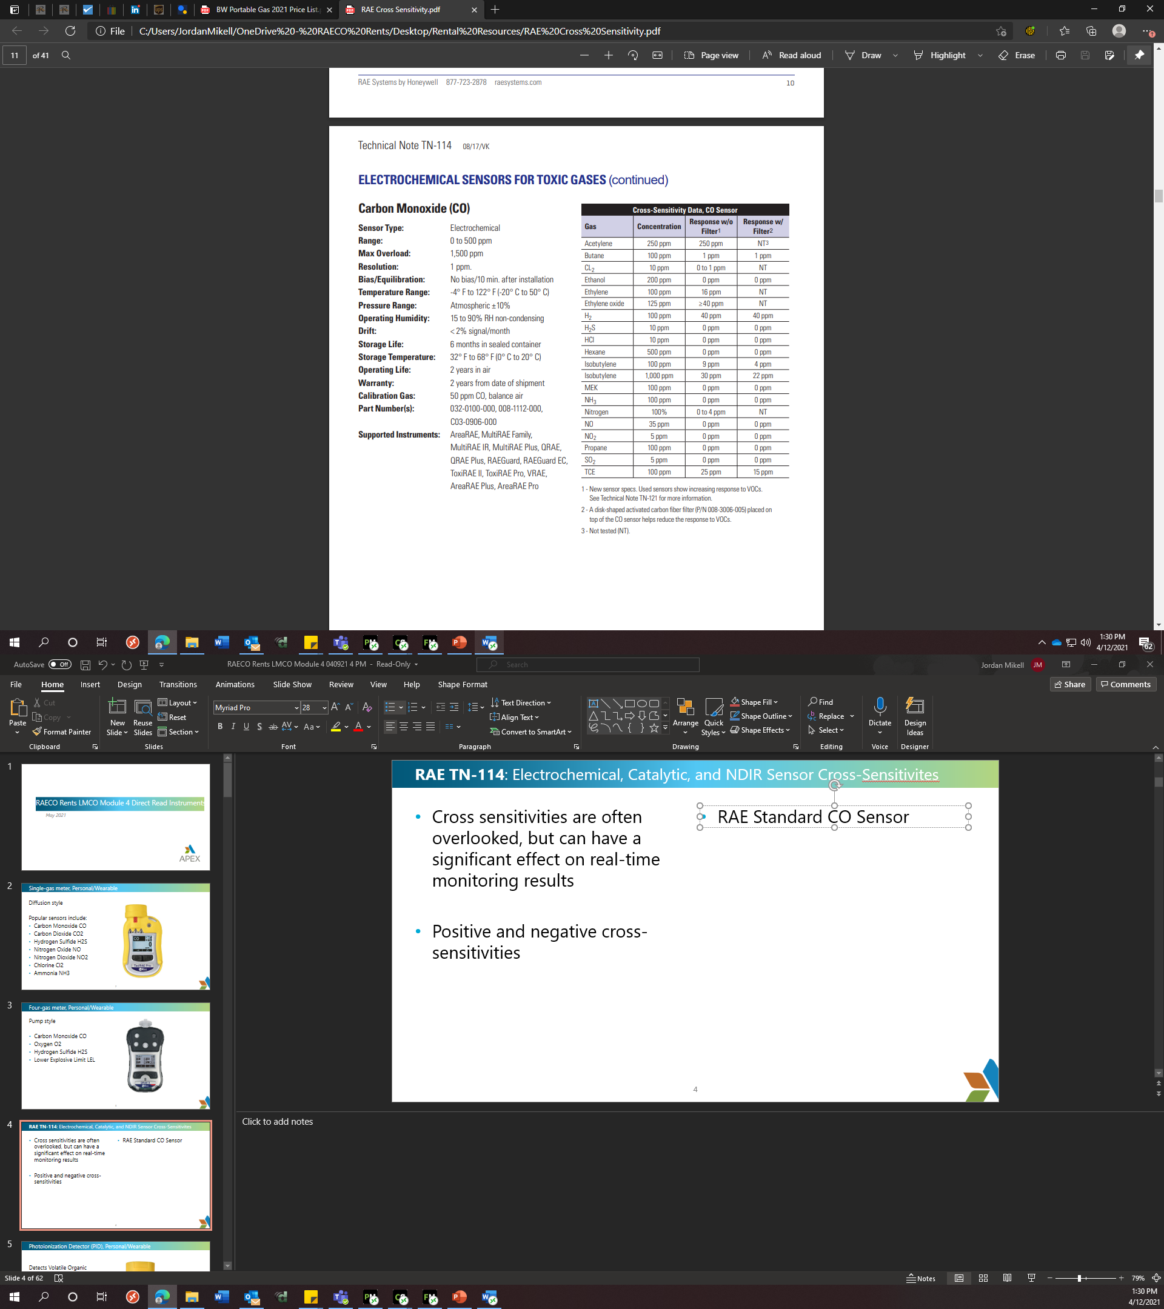
RAE TN-114: Electrochemical, Catalytic, and NDIR Sensor Cross-Sensitivities

Slide 35
RAE TN-114: Electrochemical, Catalytic, and NDIR Sensor Cross-Sensitivities
Carbon Monoxide Sensor has strong cross sensitivity to Hydrogen
Charging Batteries produces Hydrogen
RAE H2 Compensating CO Sensor – NOT NULL
Note that differences in temperature may cause a change in measured response

Slide 36

RAE TN-114: Electrochemical, Catalytic, and NDIR Sensor Cross-Sensitivities

Slide 37
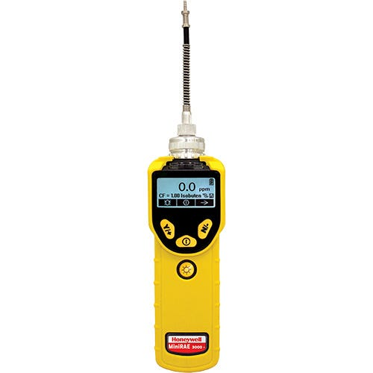
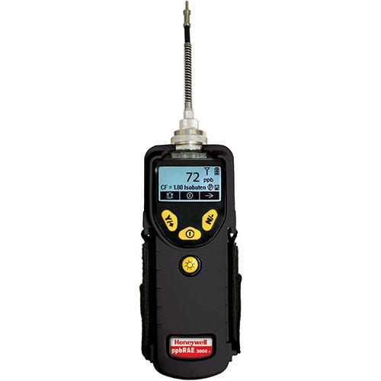
MiniRAE and ppbRAE: Photoionization Detector (PID), Portable Handheld
MiniRAE 3000
ppbRAE 3000

Slide 38
MiniRAE and ppbRAE: Photoionization Detector (PID), Portable Handheld
MiniRAE 3000
Resolution of .1 ppm
Can be used with 9.8, 10.6, or 11.7 eV lamp
Pumped
ppbRAE 3000
High Resolution of 1 ppb
Can be used with 9.8 or 10.6 eV Lamp
Pumped
Applications
• CBRNE
• Decontamination
• Environmental Cleanups/ Remediation
• Hazmat Response
• Indoor Air Quality
• Plant Shutdown & Turn-Around
• Urban Search & Rescue
• Venue Protection
• Worker Exposure

Slide 39
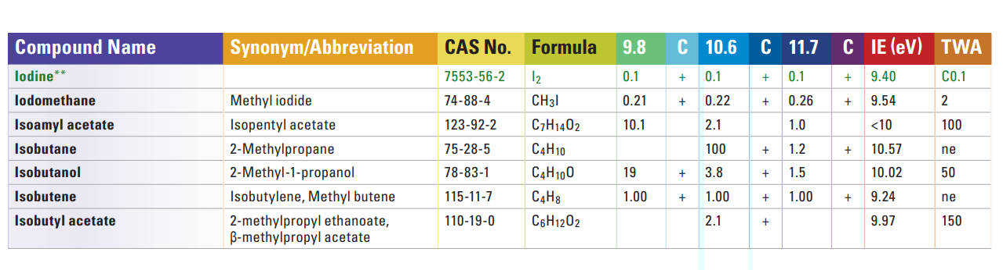
Photoionization Detector (PID), Portable Handheld
It is important to know that a PID in most cases is not providing a “specific” response
“Correction Factors” used to mitigate this issue
For best accuracy, use a lamp closest in IE (eV) to the compound you are detecting – lamp must be higher
Correction Factors: RAE TN-106
Notes:
11.7 Lamp challenge. Don’t keep in rental pool anymore due to lack of reliability and poor shelf life.

Slide 40
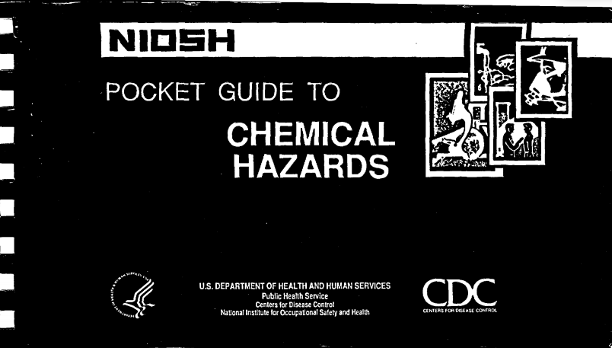
Photoionization Detector (PID), Portable Handheld
RAE Technical Note 106: PID Correction Factors and IP’s
NIOSH Pocket Guide to Chemical Hazards

Slide 41
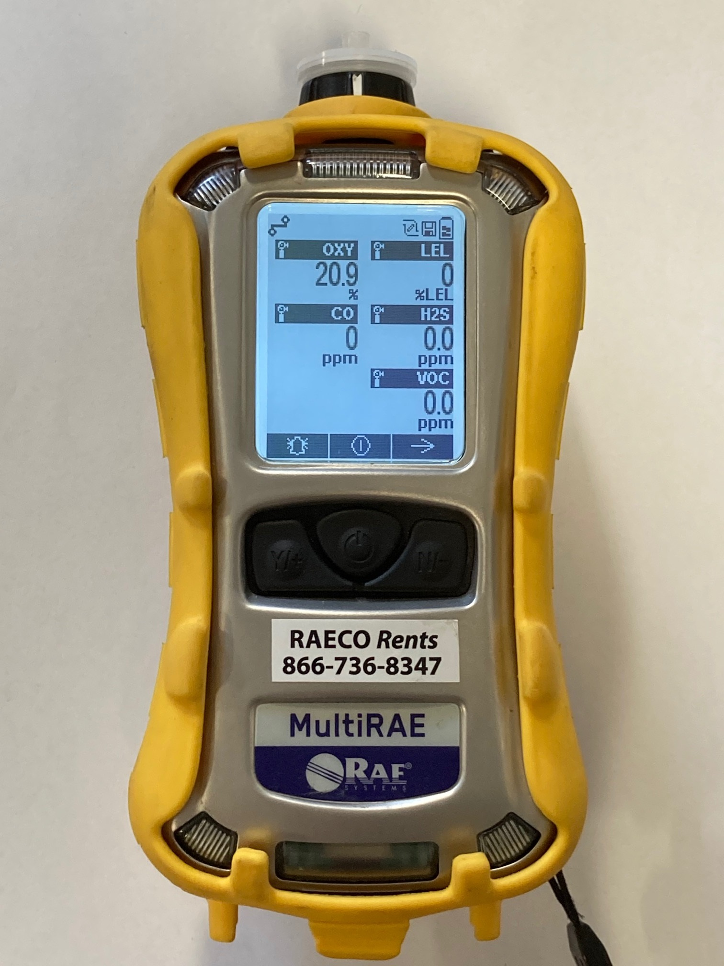
MultiRAE: Photoionization Detector (PID) and 4-Gas Monitor, Personal and Area
RAE Systems MultiRAE Family
Pump or Diffusion style
Include up to Six (6) gas sensors.
Popular sensors include:
Standard 4-Gas Sensors
CO, H2S, LEL, O2
CO/H2S “Combo” Sensor
PID Sensor for VOC’s
Carbon Dioxide CO2
Nitrogen Oxide NO
Nitrogen Dioxide NO2
Chlorine Cl2
Ammonia NH3
Notes:
GOTCHA: Negative readings or low positive readings in expected clean air/office environment. FRESH AIR CAL OUTDOORS

Slide 42
RAE Systems MultiRAE Family
MultiRAE Lite
10.6 Lamp, 1 ppm Resolution VOC’s
MultiRAE
10.6 Lamp, .1 ppm Resolution VOC’s
MultiRAE

Slide 43
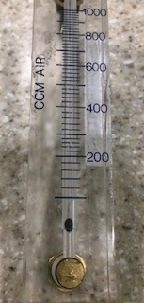
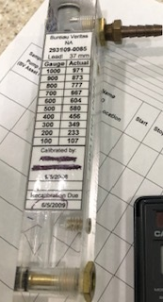
Flow Calibration – Rotameters
A Rotameter measures the flow rate within a closed tube.
Internal indicator floats within the tube and lines up with a gauge to determine flow rate
Rotameters are considered a secondary calibration standard
Must be calibrated to a primary standard annually at minimum in order to ensure accuracy

Slide 44
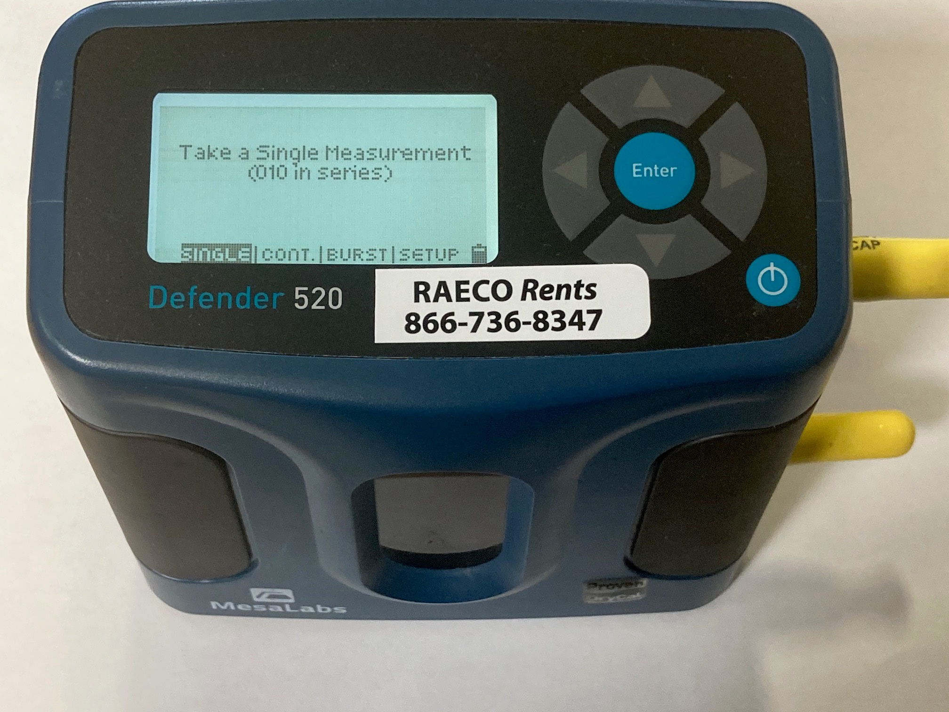
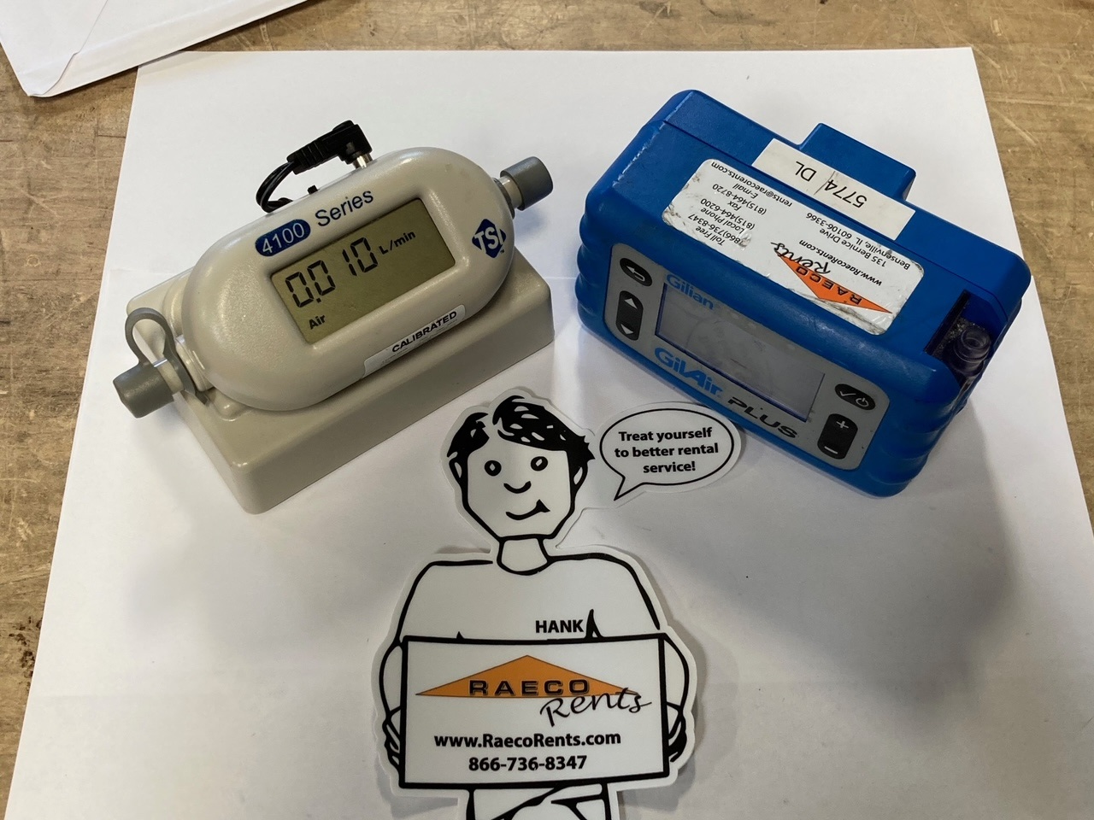
Flow Calibration - Primary Air Flow Calibration Standard
BIOS Defender 520 – Piston Drycal Technology
TSI 4146 with Gilian Gilair Plus
Video: Bios Defender Calibration Tutorial with Gilair Plus

Slide 45
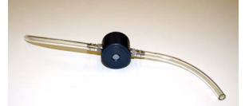
TSI 4146: Primary Air Flow Calibration Standard
Easy calibration – simply turn on the calibrator, hook up your sample train and run the pump in calibration mode
“Smartcal” cable compatible with Gilair Plus for automatic calibration
Flow range from .01 – 20 LPM
1 LPM = 1000 cc = 1000 mL
Dampening Module included for use with systems that do not have internal dampening chambers.
Reduces flow pulsation
Most modern sampling pumps have internal dampening

Slide 46
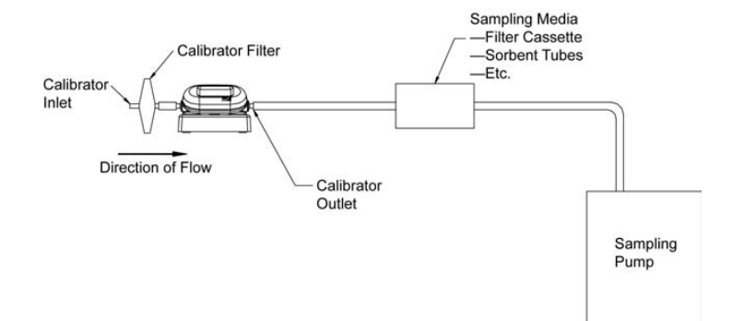
TSI 4146: Primary Air Flow Calibration Standard
Flow range from .01 – 20 LPM
1 LPM = 1000 cc
One calibration mode
Notes:
Issue with 4146 – if inlet and outlet are covered, flow rate is usually still displayed over 0, usually between .01 and .02 - For extremely low flow rates required with some tube sampling a different calibrator may work better.

Slide 47

BIOS Defender 520: Primary Air Flow Calibration Standard
3 different measuring modes. Averaged and actual flow rates provided
Single
Continuous
Burst
Model-specific flow ranges to fit your application
520L = 5 mL – 500 mL
520M = 50 mL – 5000 mL
520H = 300 mL – 30,000 mL
Measures Temperature and Pressure
Leak Test diagnostics to check functionality
Pressure port for devices that push air
Suction port for devices that draw air
Notes:
Diagnostic Leak Check to test functionality in setup menu – I prefer continuous mode because it provides a rolling average of flow.

Slide 48



Personal Air Sampling Pump Accessories - Cyclones
Cyclones
GK 2.69
4.2 LPM Respirable
37 mm Aluminum
2.5 LPM Respirable
Nylon Dorr-Oliver
1.7 LPM Respirable

Slide 49


Personal Air Sampling Pump Accessories
SKC PPI Calibration Adapter 225-389
SKC IOM Calibration Adapter 391-01

Slide 50

Slate Safety Band V2 personal heat stress instrument
Heart rate and accelerometry are used along with user profile inputs. GPS data is available, if enabled.
The user profile Physiology inputs:
Birthdate
Gender
Height
Weight

Slide 51

Slate Safety Band V2 personal heat stress instrument

Slide 52

Slate Safety Band V2 personal heat stress instrument
Stay Connected Anywhere with the SlateSafety Go Mobile App
Get a snapshot of your workforce’s biometric data and view nearby devices in cell-denied areas.

Slide 53



Ametek Brookfield - Mercury Vapor Analyzers
Jerome J405
Detection range of 0.5 to 999 ug/m3
Jerome J505
Detection range 0.05 to 500 ug/m3

Slide 54

Ametek Brookfield – Hydrogen Sulfide Analyzer
Jerome J605
Detection range 3 ppb to 10 ppm in three graduated ranges

Slide 55


SciAps XRF for Lead-based paint and alloy identification

Slide 56





SciAps XRF for Lead-based paint and alloy identification

Slide 57

SciAps XRF for Lead-based paint and alloy identification
X-550 Pb employs an X-ray tube
X-ray eliminates radioactive isotopes
Retains the same speedy response as the day it was born!
Coming soon: Lead in dust wipes and air filter app (NIOSH 7702)

Slide 58
SciAps XRF for Lead-based paint and alloy identification
Professional User Testimonials
“I’ve over 5000 hours with an XRF. We won’t be renting much because we bought a SciAps X550 Pb, Randy. By far the best XRF I’ve used. Speedy readings. Lightweight and reliable. And no inconclusive results!”
Chicagoland CIH Consultant
“What always blows my budget is the shipping cost because it is radioactive. Hoping because this isn’t the case for this unit shipping rates will be more reasonable.”
Senior Industrial Hygienist Consultant

Slide 59


Honeywell Analytics SPM Flex Single Point Chemcassette Tape-Based Gas Detector
Notes:
Ozone O3 ppb range 20-1000 ppb
Let Randy know if you want the single page detectable gas list

Slide 60

RAECO Rents Perimeter Monitoring Dust
Notes:
New lighter lithium battery advantages!
Yes the Lufft requires a Thiamis as well.

Slide 61

RAECO Rents Perimeter Monitoring Sound
Notes:
Ask Tim Nelson about his experience with outdoor Soundpro
Is a tripod REALLY needed?

Slide 62


ChemDAQ Inc Gas Monitors
SafeCide Portable Peracetic Acid Monitor
SafeCide Portable Hydrogen Peroxide Monitor

Slide 63


ChemDAQ Inc Gas Monitors
Notes:
STORY: Walkie Talkie issue
Sampling vs. IH mode. Sampling = “spot check”, IH = TWA

Slide 64


ChemDAQ Inc Gas Monitors

Slide 65



WaveControl
WaveControl SMP2 Meter with probes
WaveControl 5G WaveMon RF-60
Notes:
Mention medical implants. What is the RF of the sources of concern?

Slide 66


WaveControl Field Probes Guide
Electromagnetic Field Probes x| DC to 60 GHz (wavecontrol.com)
Notes:
Medical Implants – What field is the source producing?

Slide 69

ToxiRAE Pro: Single-gas meter, Personal/Wearable
Available Sensors on ToxiRAE Pro (1 of 2)

Slide 70

ToxiRAE Pro: Single-gas meter, Personal/Wearable
Available Sensors on ToxiRAE Pro (2 of 2)

Slide 71

QRAE3: Four-gas meter, Personal/Wearable
Available Sensors on QRAE 3

Slide 72
Randy notes
Order the slides with prominence to TSI products
Address walkie

Slide 73
Sound Level Meter (SLM) with Sound Calibrator for Area Noise Mapping
“A” Weighting
Most commonly used
Adjusts measurements to reflect the sensitivity of the human ear
Human Ear sensitive to sounds between 500 Hz and 6 kHz
“C” Weighting
Focuses more on low frequency sounds
Commonly used in peak impulse noise measurements
“Z” Weighting
Flat frequency response – actual noise
No weighting at all for the human ear
Often used in octave band analysis and determining environmental noise
“F” Weighting
Uncommon
Also flat frequency response, but attenuates at higher dB level than “Z” Weighting
Notes:
F weighting – could not find information on this outside of TSI/Quest manuals

Slide 74

Sound Level Meter (SLM) with Sound Calibrator for Area Noise Mapping

Slide 75
TSI/Quest Edge: Dosimeter with sound calibrator for Personal Sound Monitoring
Uses same AC-300 Calibrator as the Soundpro
Detection Management Software – Same as all other Quest instruments
Automatically logs each minute once the dosimeter run is started
View remaining battery life and real-time data on screen
Las
Lavg
Lmax
Ltwa
Dose

Slide 76

Photoionization Detector (PID) and 4-Gas Monitor, Personal and Area
Available Sensors on MultiRAE (1 of 2)

Slide 77
RAE Systems MultiRAE Family
Available Sensors on MultiRAE (2 of 2)

Slide 78
Datalogging with RAE Systems Instruments
Datalogging can be set to automatic or manual
User-defined datalogging intervals
Data and calibration certificates can be downloaded via ProRAE Studio II software on PC
Selectable data
Installed sensors can turned on/off
Min/Max/Avg/TWA variables can be turned on/off
ProRAE Tutorial: Data Download from ToxiRAE, QRAE and MultiRAE | RAECO Rents
How to create a Calibration Cert for RAE Systems gas monitors - YouTube

Slide 79
Direct Read Instrument, Gas Detection Considerations
Selection
Personal or Area Monitoring?
Operating range
Operating conditions
Cross-sensitivity
Accuracy
Data logging and Data download
Calibration
Zero
Span
Bump testing/Field verification

Slide 80
Calibration and Field Verification of Gas Monitors
Zero
Zero sensors using 20.9% O2 zero air
Can also conduct a “fresh air” calibration in outdoor ambient air
Note that “zero” on oxygen sensors is 20.9% based on O2 concentrations at sea level
Bump Test / Field Calibration
Bump test only validates that the sensor is responding to gas – It is not a calibration
The sensor can be bump tested for a Pass/Fail result or gas can be introduced to the sensor while viewing readings in real time to confirm proper functionality.
Span
Calibration introducing sensor to the appropriate gas
Use manufacturer recommended calibration gas

Slide 81
Flow Calibration
Keep flow rate error below ±5%.
Measure flow rate before and after sampling
If post-calibration is within 5% of the initial flow rate, the sample is valid. If it is outside this range, the sample must be voided.
Measure and record flow rate at least 5 times and take the average of the measurements
Calibrate with sampling train – do not connect pump directly to calibrator

Slide 82
Personal Air Sampling Pump Accessories - Cyclones
Cyclones use centrifugal force to remove specific size fractions of dust
Higher Flow Rate = Shorter Sampling Time
Flow rate is extremely important
If the flow rate isn’t set and calibrated properly, the right size “cut” will not occur.
As with all personal air sampling, the cyclone/tubing should be mounted in the breathing zone of the employee
Cyclone must be worn vertically and hang loose
If cyclone is tipped over, larger particles from the grit pot can pass through to the filter and drastically affect the weight of the sample.
Grit pot catches all of the larger particles not to be included in the sample

