Slide 1


AeroFit & Quantifit2 Respirator Fit Testing
Presented by: Booth Armstrong

Slide 2

Why Do We Fit Test?
Protect the health of employees
Poor fit is the largest contributor to poor protection (Grinspun et al. 2009)
Ensures respiratory protection effectiveness.
Prevents workplace exposure to harmful airborne particles.
Builds confidence, morale, and safety culture among employees.
Compliance with OSHA and other safety regulations.

Slide 3
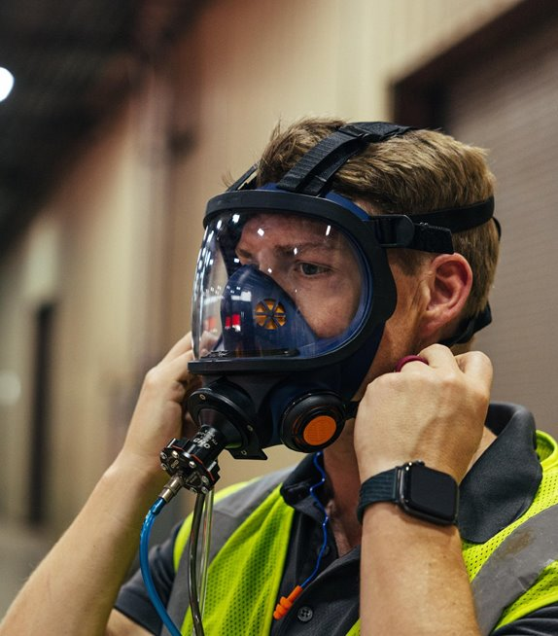
Who Can Fit Test?
Competent Individual?
Qualified Individual?
Program Administrator?
Anyone?

Slide 4
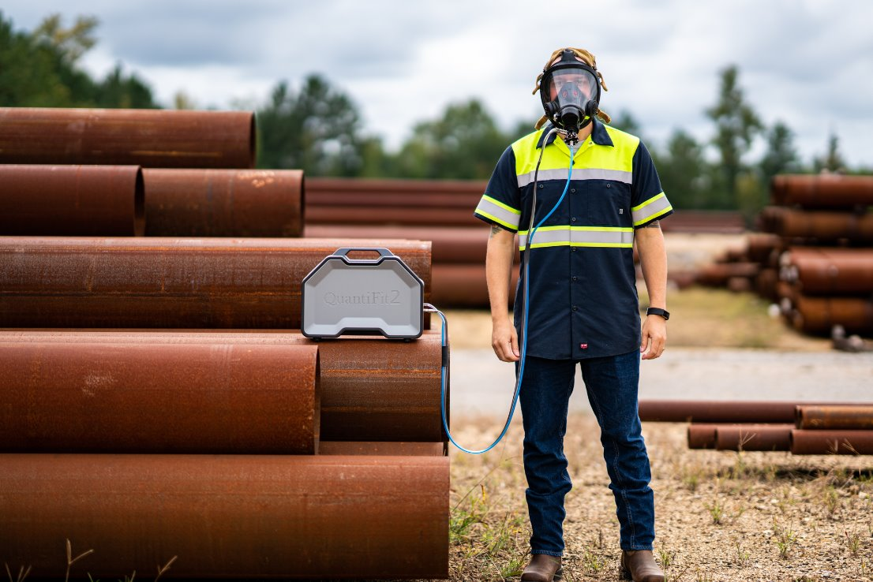
When to Fit Test?
As part of the initial respirator selection
Where an untested facepiece is already in use

Slide 5
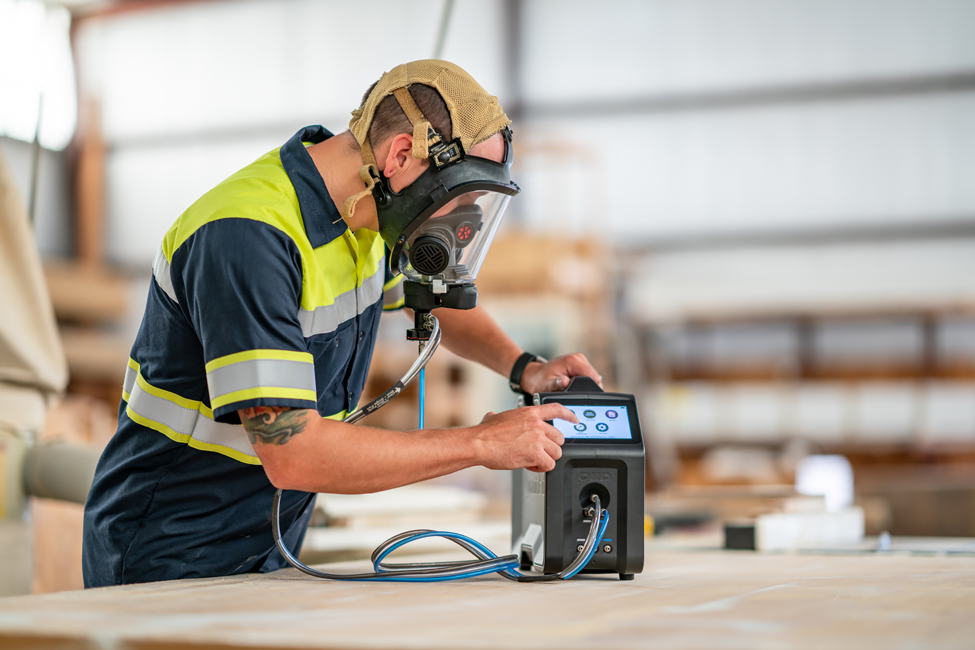
How About a Repeat Test?
When the wearer:
Loses or gains significant weight (+/- 20lbs or 9kg)
Undergoes any substantial dental work
Develops any facial changes (scars, moles, etc.) around the face seal area
At the regulated time interval (typically annually)

Slide 6
OSHA 1910.134 Appendix A
CNP
Ambient Aerosol CNC
OHD QuantiFit2
Air is the challenge agent
Uses a Controlled Negative Pressure to directly measure respirator leakage
OHD AeroFit
Aerosol is the challenge agent
Calculates the ratio of external particles to the particles in the mask

Slide 7
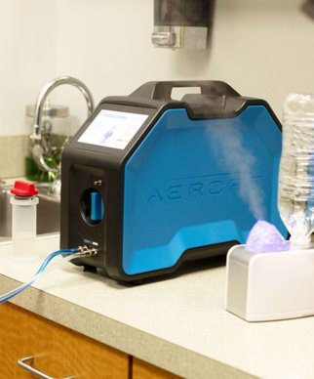
Condensation Nuclei Counting
Uses laser technology to measure aerosol concentrations inside and outside the respirator.
Respirator must be equipped with high efficiency filters.
The idea is that because few particles penetrate a high efficiency filter, any found inside the respirator can be attributed to face seal leakage.
Measures the concentration of particulates in the respirator while the test subject is performing a series of exercises.
The ratio of this concentration in the breathing zone to the ambient particulate concentration is the Fit Factor.

Slide 8
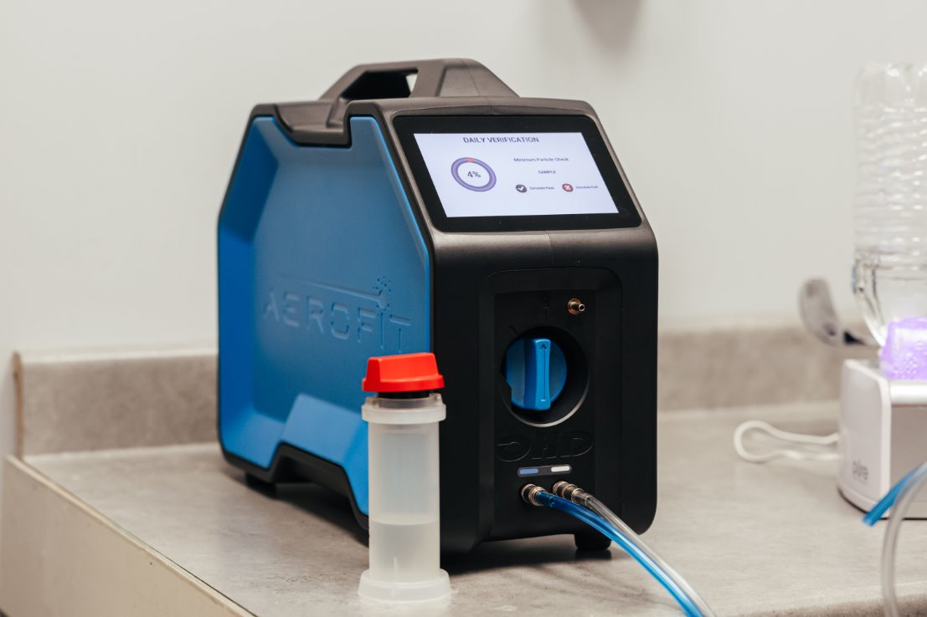
CNC
Benefits:
Can fit test any tight-fitting respirator
Limitations
Environmental requirements
Consumables
Test subject should not eat or smoke for
30 minutes before testing
Key Advancement
Replacing qualitative testing methods when testing FFR/N95 respirators

Slide 9
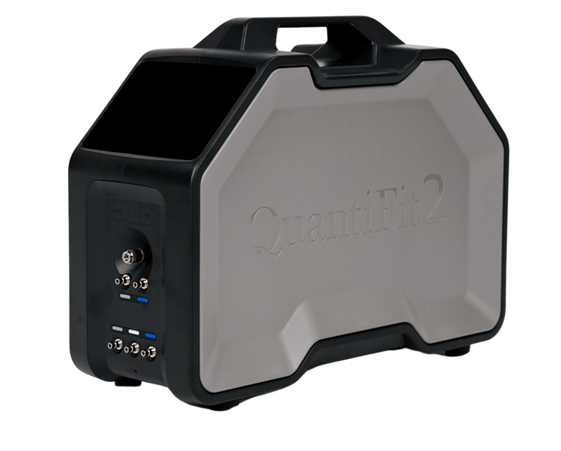
Controlled Negative Pressure
Uses Controlled Negative Pressure technology directly related to a scientifically validated modelled breathing rate to measure respirator leakage.
Respirator must be equipped with fit test adapters.
The idea is that once a controlled pressure is achieved within the respirator facepiece, any air that is removed is the result of leakage.
CNP precisely measures leak rate in cc/min after a series of exercises.
The ratio of this leak rate to the modelled breathing rate is the Fit Factor.

Slide 10
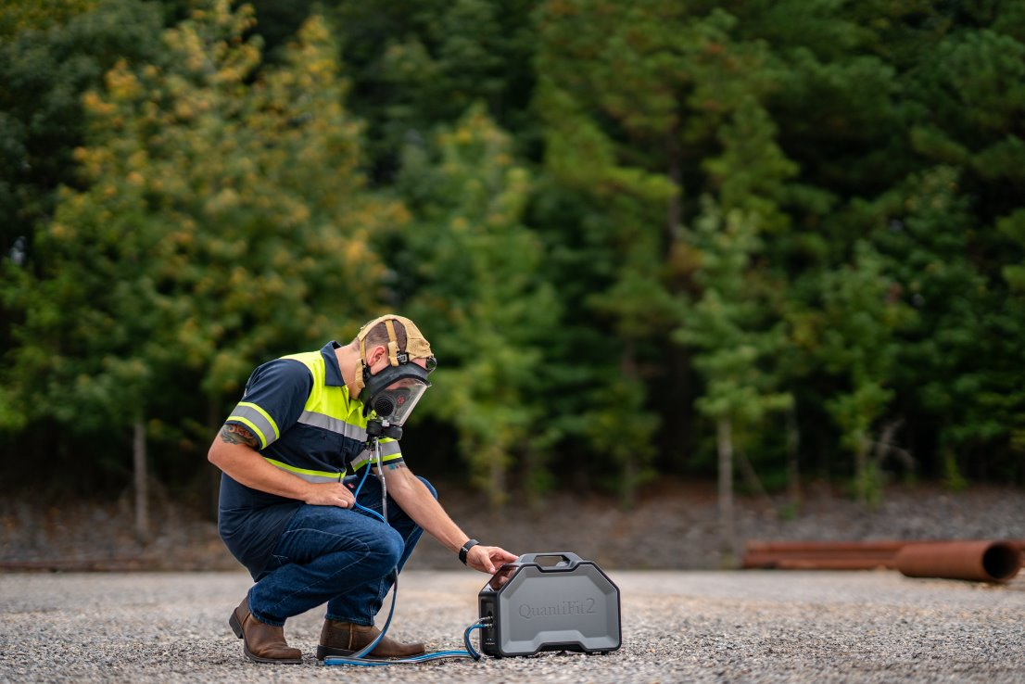
CNP
Benefits:
No Environmental Requirements
Highly Portable
Battery Power
Limitations
Cannot fit test Filtering Facepiece Respirators
Key Advancement
The most efficient testing method for quantitatively testing respirators with elastomeric /rubber seals

Slide 11
AeroFit & QuantiFit2 Product Demonstration
User Interface
Respirator Selection Process
Inputting Test Subjects
Record-Keeping Features
Fit Test Reporting Capabilities: QuantiFit2, Logic PC Software, LogicCloud

Slide 12
Additional Solutions
OHD LogicCloud:
Automatic scheduling of employees withnotifications
Centralized data
Advanced reporting
OHD Pre-Paid Calibration Packages & Extend Warranties

Slide 13

Thank you!

