Slide 1
Perimeter Dust Monitoring
Tom Douglas
Health & Safety Technical Sales Specialist
TSI Incorporated

Slide 2
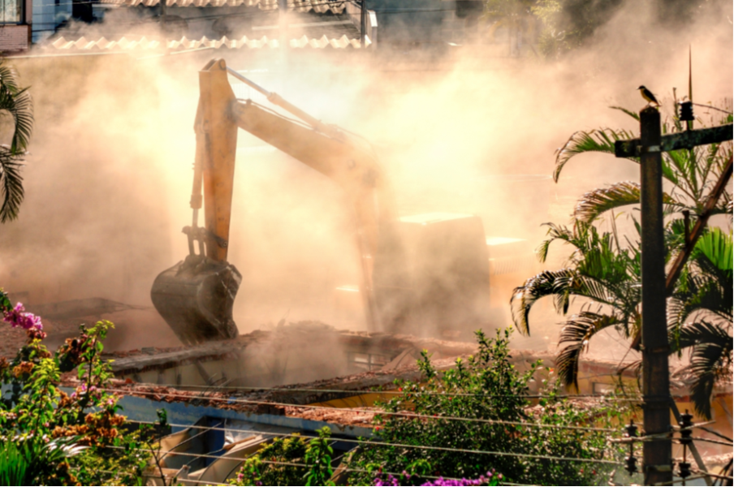
Agenda
Introduction
Reasons for dust monitoring
Considerations for your project
Available technologies
Project examples
Q&A
1

Slide 3
Reasons for perimeter dust monitoring
Protect human health from exposure
Determine need and evaluate effectiveness of dust controls
Minimize risk of community exposure
Establish/ foster community confidence

Slide 4
Reasons for perimeter dust monitoring
Construction
  Earth moving activities, construction, demolition Site Remediation
Mining
Brownfields, Superfund sites
Rapid response/ environmental clean up
  Oil spills, structure fires, wild fires
Community complaints

Slide 5
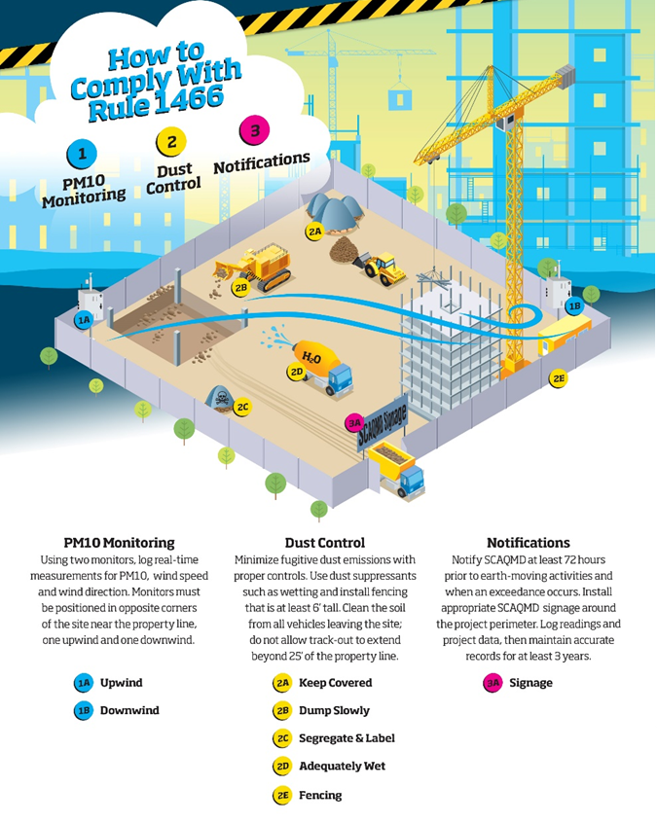
Regulations
Federal
  EPA, OSHA
State/County/Local
  DER-10 (New York)
  Rule 1466 (Southern California)

Slide 6
Considerations for your project
Data considerations
Instrumentation selection
Maintenance
Budgeting

Slide 7
Considerations for your project
Data considerations
  How do you want to collect and see your data?
  How often do you need to see it?
  Who needs access to your data?
  Where do we need to monitor on our site?
  How accurate do you need to be?
  What alerts/actions are required?

Slide 8
Considerations for your project
Instrumentation selection
  Does it need to be FRM/FEM?
    Is near reference acceptable?
    Does it correlate well to FRM/FEM?
  What are expected concentration ranges?
    Will you max out an instrument?
    Will you be missing data?
  How will you power units?

Slide 9
Considerations for your project
Who is responsible for maintaining the equipment?
  Can it be done in the field?
  Does equipment need to be swapped?
  Should we have extra units on hand?
Budget considerations (rent vs own)

Slide 10
Available technologies
Dust deposition gages
Gravimetric sampling
Direct read particulate monitors

Slide 11
Available technologies
Federal reference method/ Federal equivalent method
Near-reference monitoring
Low cost sensors

Slide 12
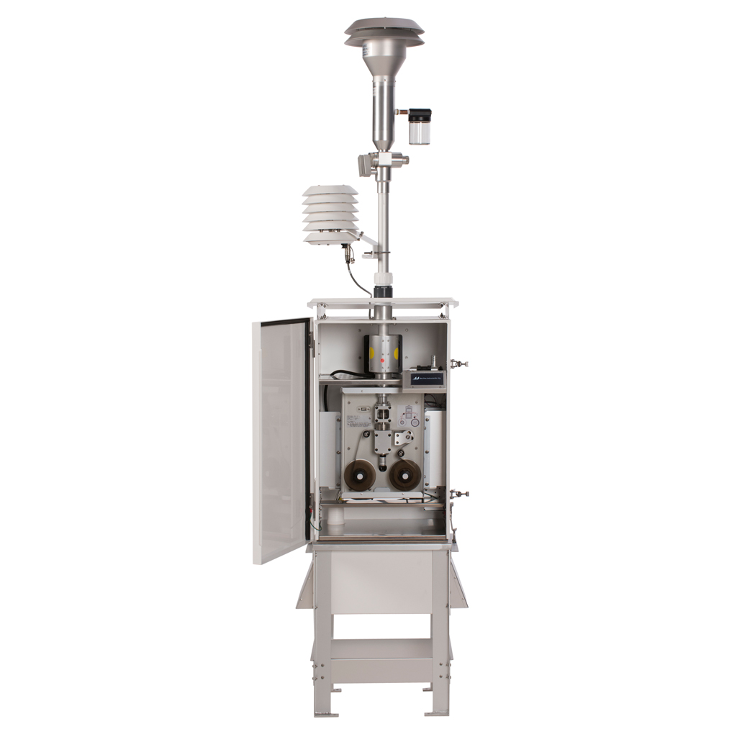
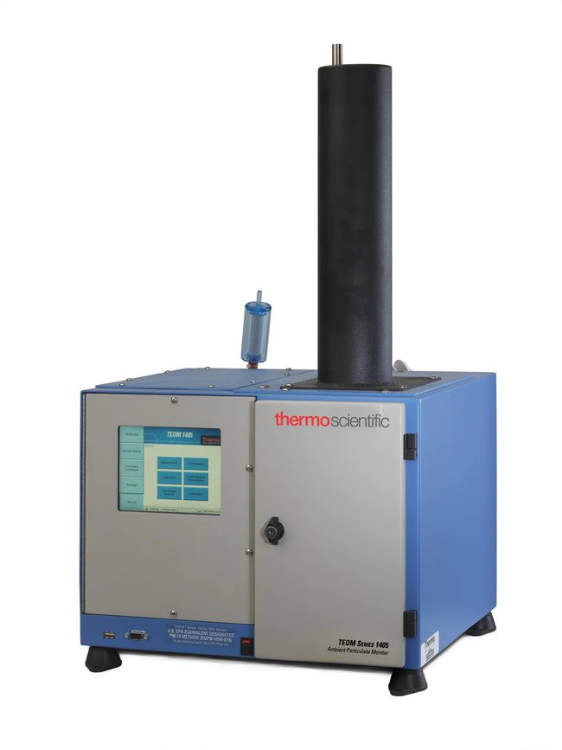
Federal reference method
U.S. EPA-approved equivalent methods are typically expensive, designed for permanent siting, and need a power source
E-BAM
  Met One, Sibata, Teledyne
TEOM
  Thermo Scientific

Slide 13
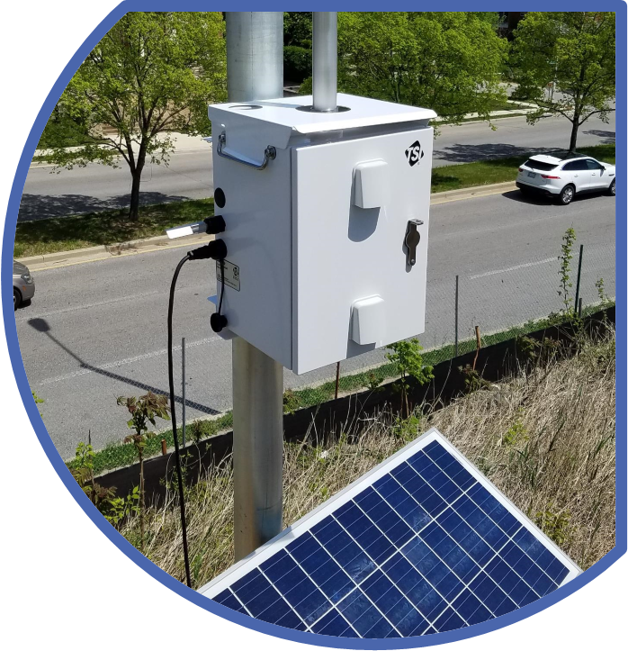
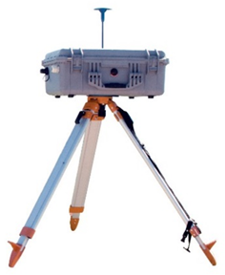
Near reference monitoring
Alternative methods allow for less expensive and more mobile instrumentation
Laser photometers
  TSI DustTrak
  Aeroqual DustSentry
  Casella Dust Guardian

Slide 14
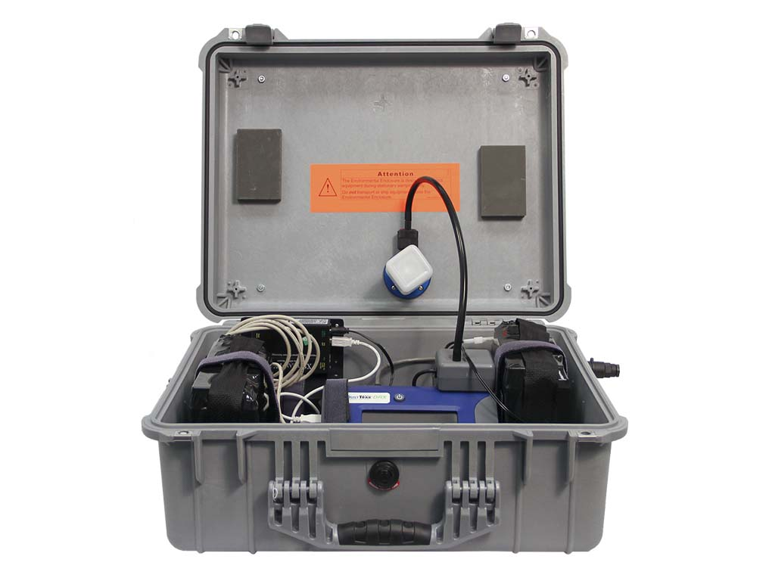
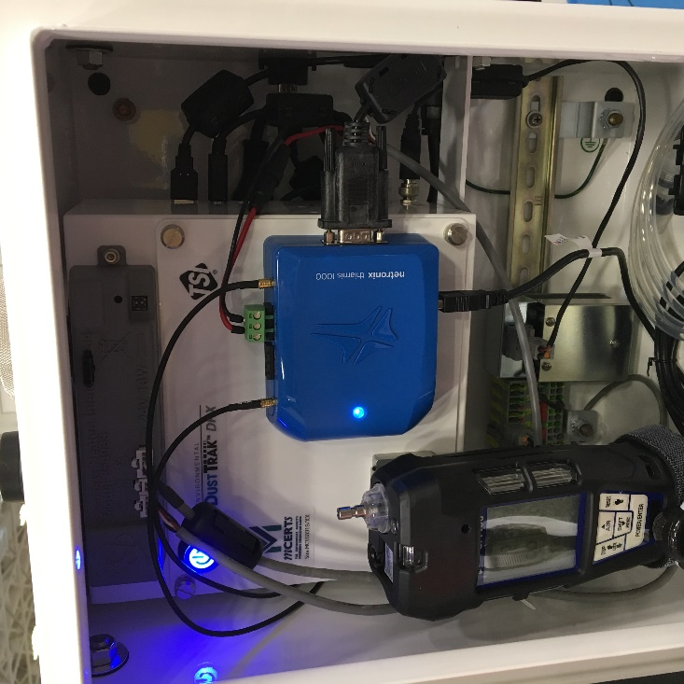
Near reference monitoring
DustTrak DRX Desktop vs Environmental

Slide 15
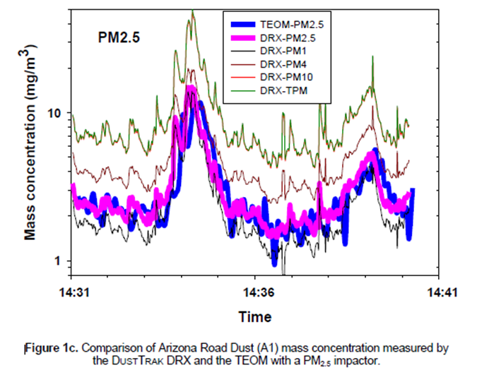
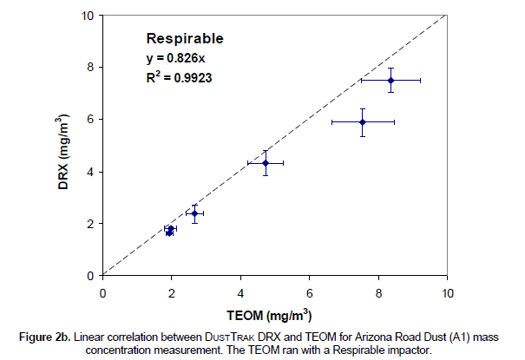
Near reference monitoring
DustTrak DRX vs TEOM

Slide 16
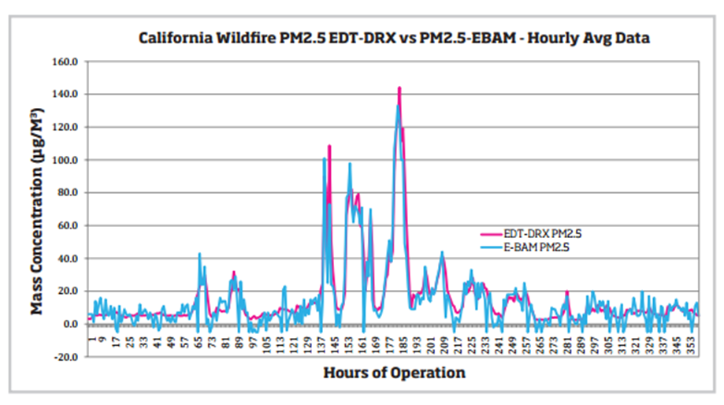
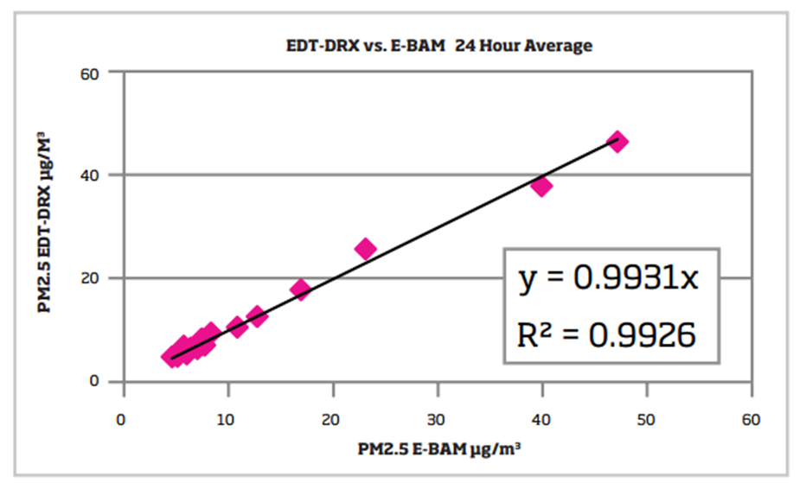
Near reference monitoring
DustTrak DRX vs EBAM

Slide 17
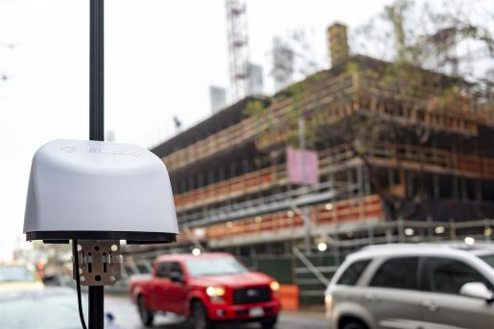
Low cost sensors
Optical particle sensors
  BlueSky
  PurpleAir
  Clarity
  AQ Mesh

Slide 18
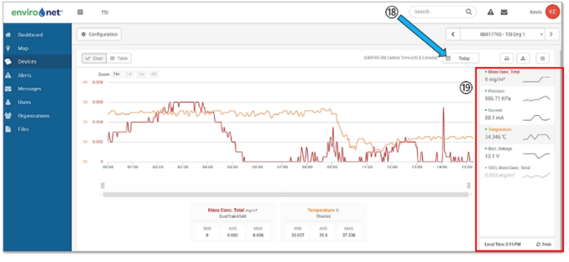
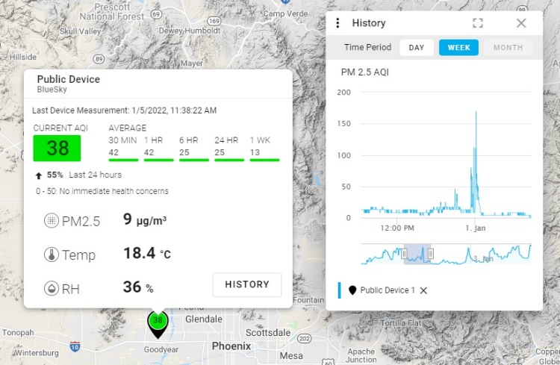
Tracking your data
Cloud based solutions
  Netronix™ Cloud Data Management System
    Automatically calculates the difference between upwind and downwind monitors
    Sends alerts if you have an exceedance
  TSI Link
17

Slide 19
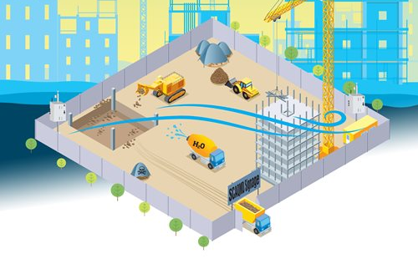
Potential site set up
(2) continuous direct-reading real time ambient monitors
Identical in make and model, settings, calibration, correction, and correlation factors
18

Slide 20
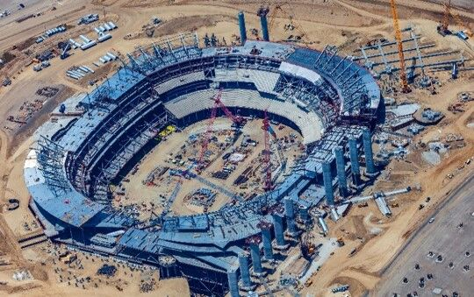
Project example
Hollywood Park, Inglewood CA
Citadel EHS monitored air quality using TSI’s DustTrak™ 8533 Monitors
Monitors also incorporated useful accessory options:
  Netronix™ Cloud Data Management System for real-time communication and alerts
  Solar Power Solution for uninterrupted power supply
Read more about this project:
www.citadelehs.com/featured-projects/
19
Notes:
Turner Construction Company is one of the largest construction management companies in the nation, overseeing multi-billion dollar projects. We were contacted by them to provide air quality monitoring services at Hollywood Park—the project scope revolved around particle pollution monitoring to stay in accordance with the South Coast Air Quality Management District’s standards.
Our team of air quality permitting, plus health & safety experts provided monitoring devices (Dust Trak aerosol monitors, security enclosures, Netronix datalogger, solar panels) while assessing the site conditions. We set up the Dust Trak system to record in five-minute intervals at one upwind location and four downwind locations. All data is then downloaded into a database, where 24-hour rolling average PM 10 concentrations are calculated for each site and compiled into a monthly air quality report. Since April 2017, our team has provided continual, ongoing monitoring services for the client.

Slide 21
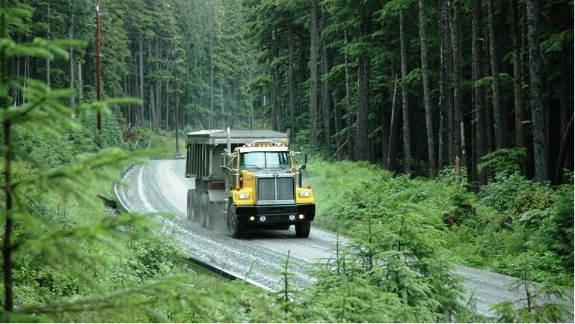
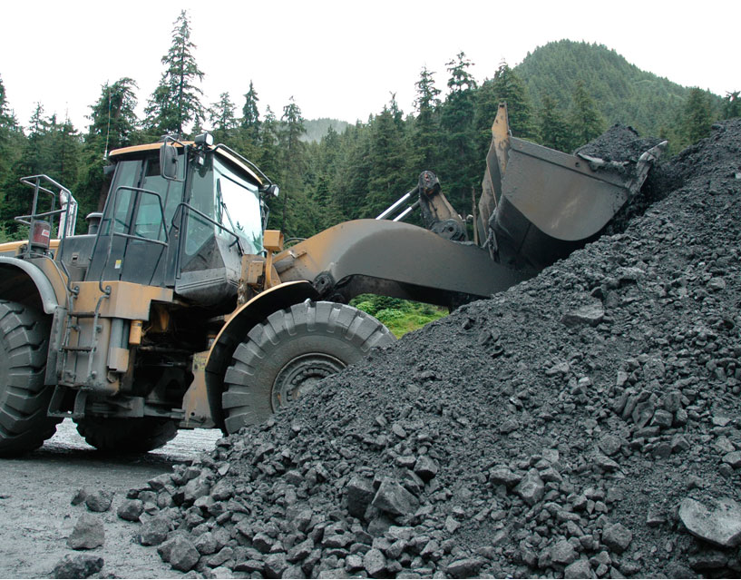
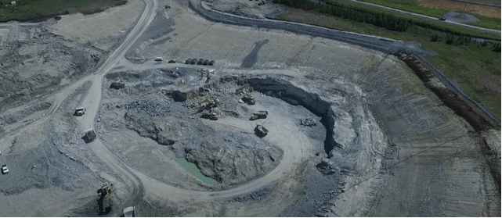
Project example
HECLA Greens Creek Mine AK
Juneau AK had concerns about major debris from their tailings piles drifting into the near by creek
Used DTE and Netronix solution to monitor, record, provide data for the local regulators and setup alerts for their watering trucks

Slide 22
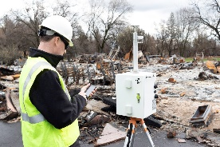

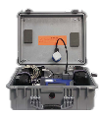
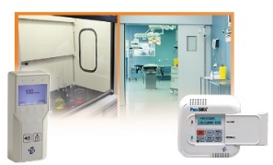
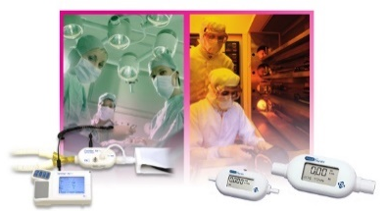
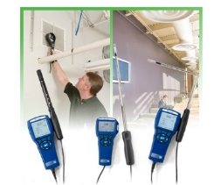

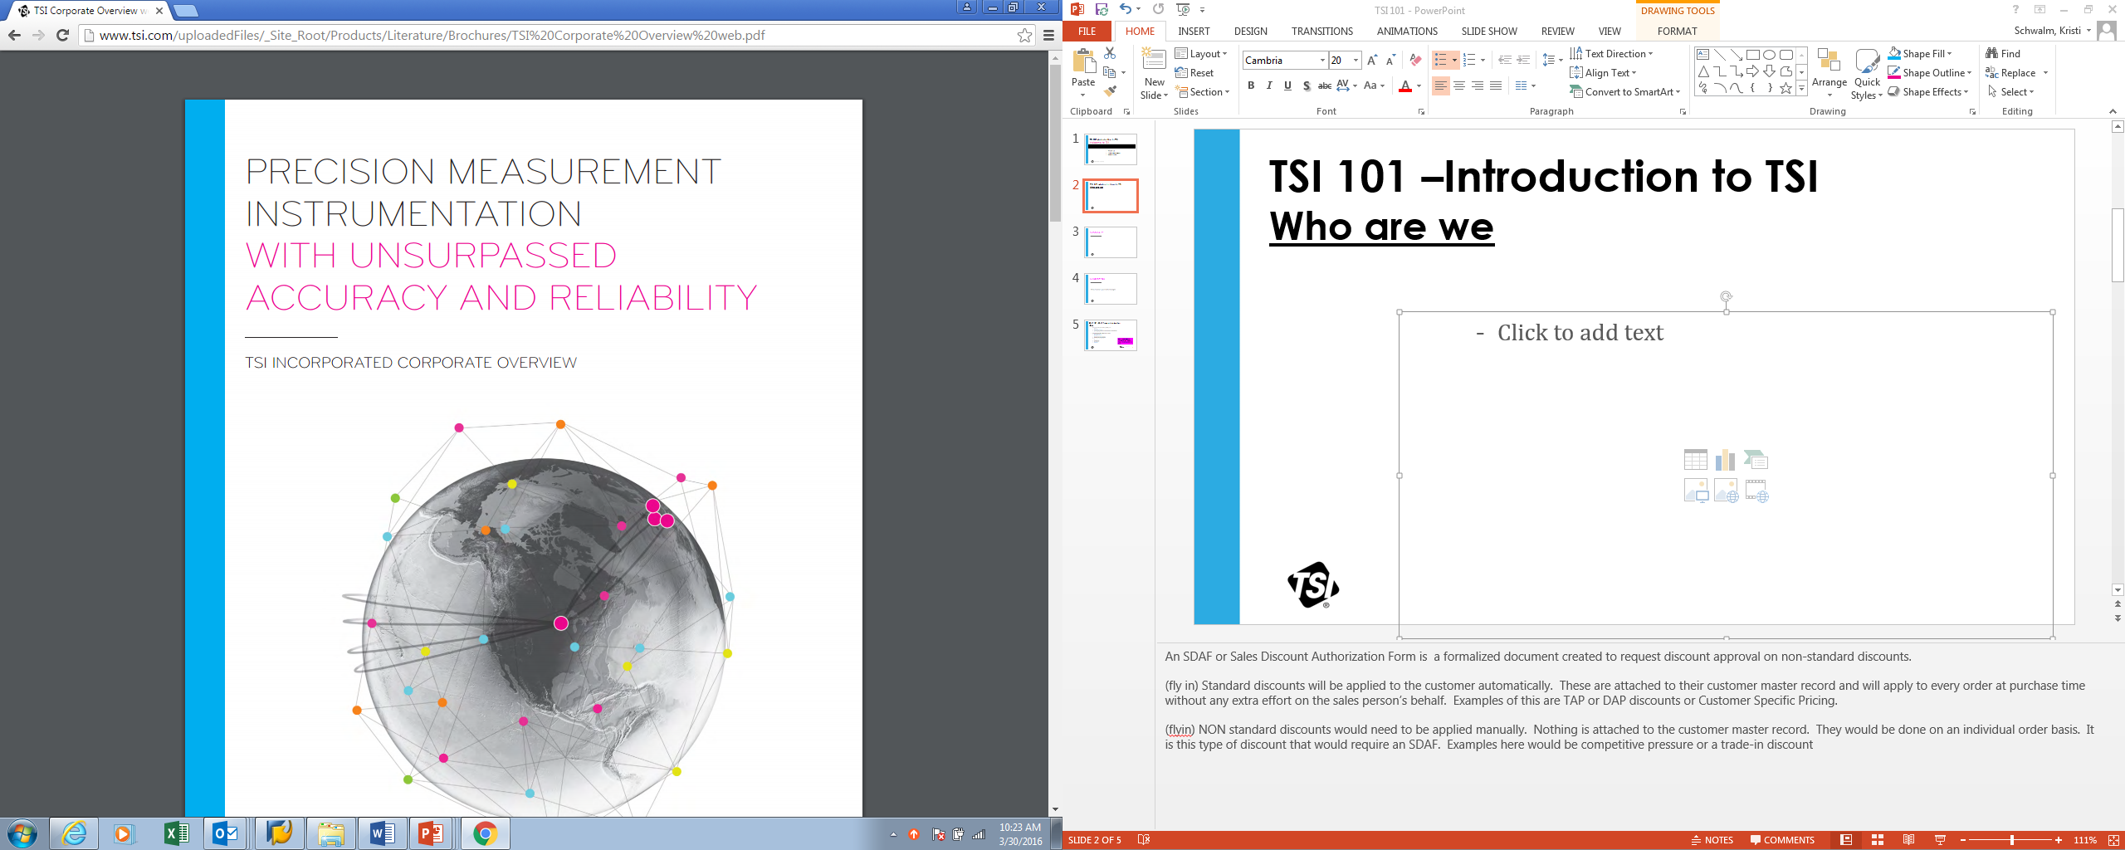
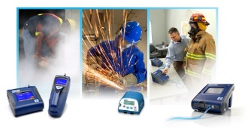
About TSI Incorporated
TSI is a Particle Science & Engineering Company
  Particle research, environmental monitoring, respiratory protection, fluid mechanics, airflow and air pressure, and other fields and applications
Many well-known brands
DustTrak®
TSI BlueSky™
PortaCount®
TSI Quest™
TSI SidePak™
DICKEY-john®
MSP®
Alnor®
21

Slide 23
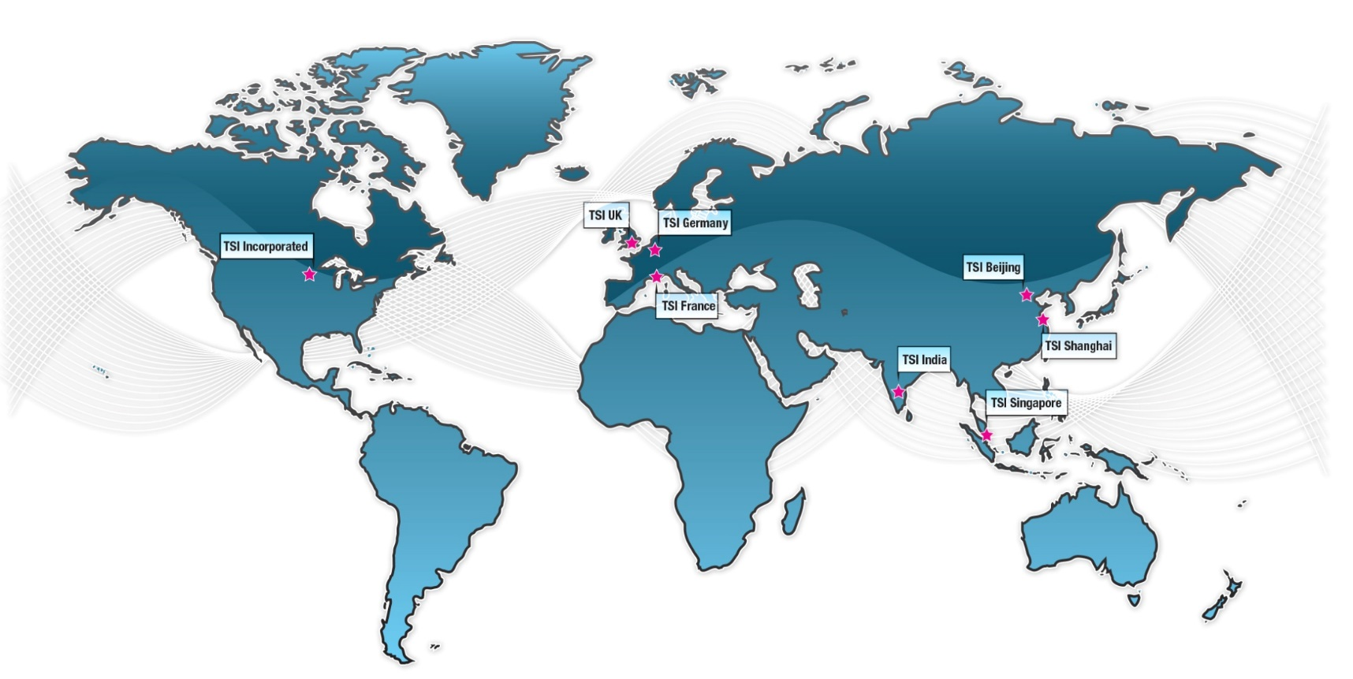

TSI Global Locations
TSI UK
TSI Germany
TSI Incorporated
TSI Beijing
TSI France
TSI India
TSI Shanghai
TSI Singapore
22
Notes:
The TSI Corporate headquarters is located in Shoreview, MN.
And we have field offices throughout Europe and Asia in the countries of Germany, the United Kingdom, France, China, Singapore and India.

Slide 24
Questions
Contact info
Tom Douglas
602-245-3313
tom.douglas@tsi.com
https://www.linkedin.com/in/tomdouglas10/

