Slide 1
Thank You for Attending Today’s Webinar:
Maximize Personal Noise Measurement:
Accuracy, Applications & Industry Insights
Your Host
Hunter Wack Business Development RAECO Rents hunterw@raecorents.com
Featured Speakers
Dusty Ott, CIH
SKC Inc

Slide 2
Mastering Noise Monitoring: Best Practices and Leveraging Modern Technology for Industrial Hygienists
Dusty Ott, CIH – SKC Inc.
17 April 2025

Slide 3
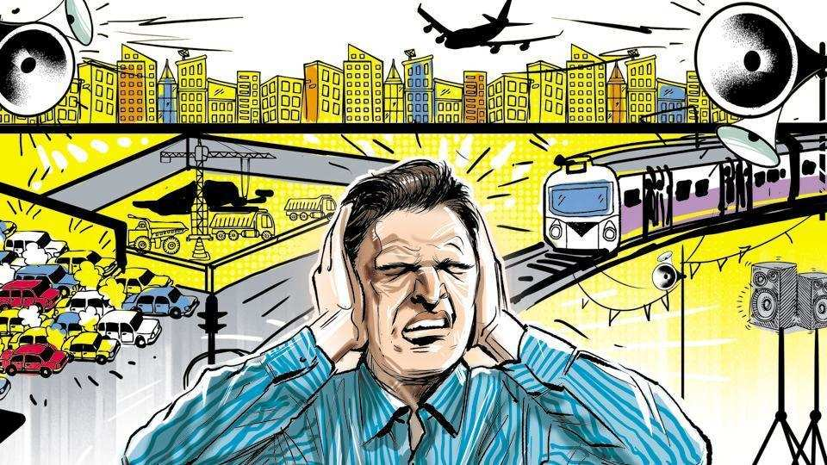
Setting the Stage: Why accurate Noise Measurement Matters for IH’s
Provide practical insights and guidance's on conducting effective noise monitoring
Understanding key concepts to ensure accurate assessments and regulatory compliance
Utilizing modern dosimeter and software features to rock your world

Slide 4

Webinar objectives: Enhancing your Noise Monitoring Expertise
Understand best practices in personal noise dosimetry across industrial settings
Clear up common noise monitoring misconceptions (e.g.,TWA, Lavg, Leq, Lpk, Lmax, hearing protection use)
Learn advanced setup features of the SKC Noise Chek for efficient data collection
Gain skills in analyzing and interpreting noise data using intuitive software

Slide 5
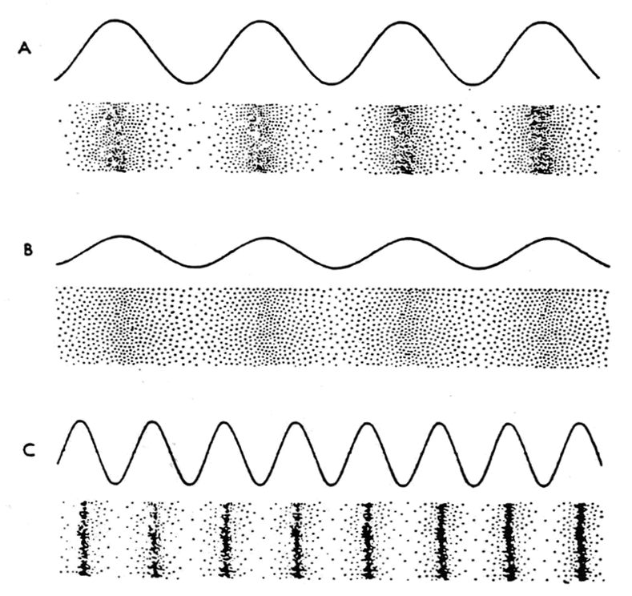
The Basics of Sound: Pressure Waves
Sounds are pressure waves generated by vibrating objects releasing acoustic energy
A sound wave is comprised of compression and rarefaction of air molecules
Main key characteristics of sound:
Amplitude in dB
Loudness
Frequency in Hz
Pitch

Slide 6
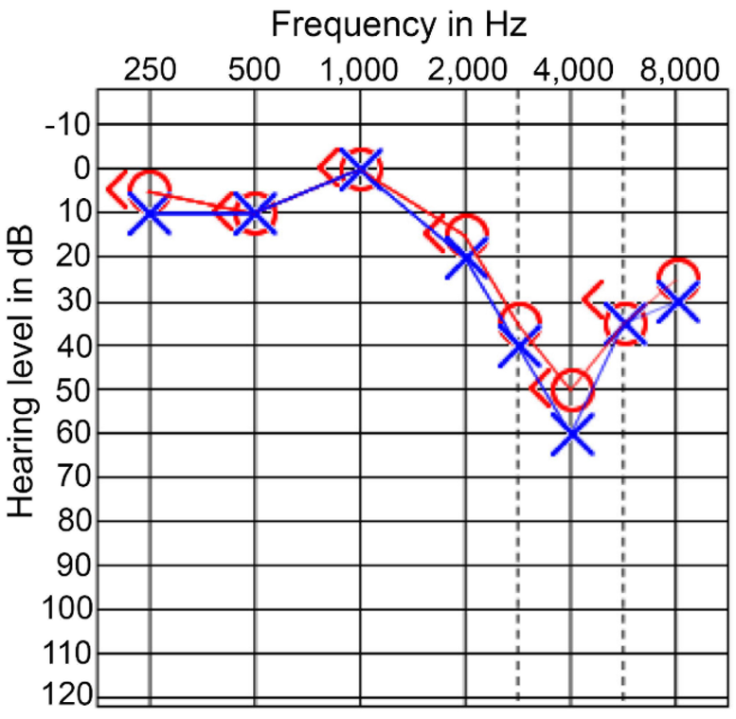
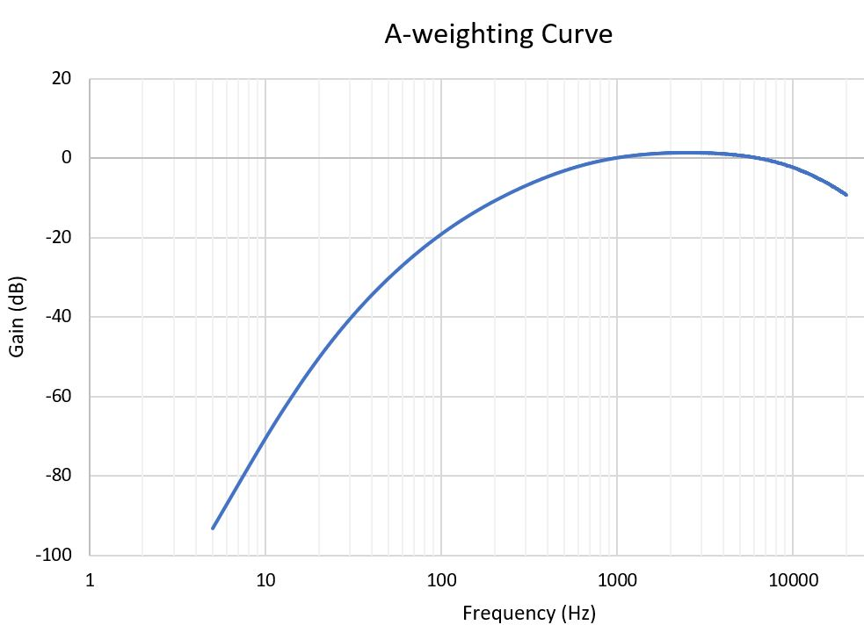
Frequency and Human Hearing
Frequency: Number of sound waves per second, measured in Hertz (Hz), and its perception as pitch.
Range of human hearing:
20 Hz to 20 kHz
Greatest sensitivity to speech sounds (~250 Hz to 8000 Hz).
An A-weighting filter adjusts the measurement:
De-emphasize frequencies we don't hear well (lower frequencies)
Emphasize those we do
Shaped to mimic human hearing

Slide 7
Frequency and Human Hearing (cont’d)
Frequency Range | What It Represents
85 – 300 Hz | Fundamental pitch (especially in male voices)
300 – 3,000 Hz | Core intelligibility (consonants and vowels)
3,000 – 8,000 Hz | Clarity, sharpness, and sibilance (e.g., "s", ”t”, "f", "th")

Slide 8
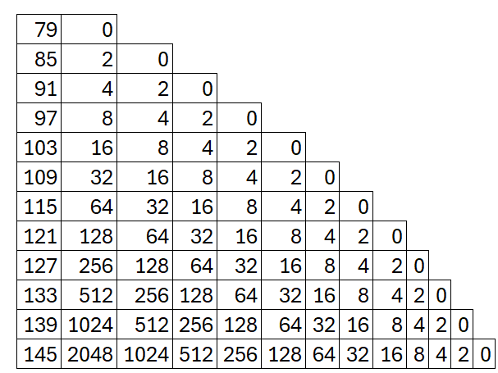
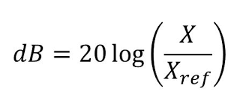
Sound Pressure Level and the Decibel Scale
Sound Pressure is measured in Pascals (Pa)
Humans hearing threshold is 0 dB or .00002 Pa
Sound Pressure Level is measured in decibels (dB)
The dB is a logarithmic function of the ratio of the sound pressure to the reference pressure.
6 dB increase = 2x loud
85 dB = .35 Pa
91 dB = .70 Pa
10 dB Perceived Loudness
85 dB = .35 Pa
95 dB = 1.12 Pa (3.4x as loud)

Slide 9
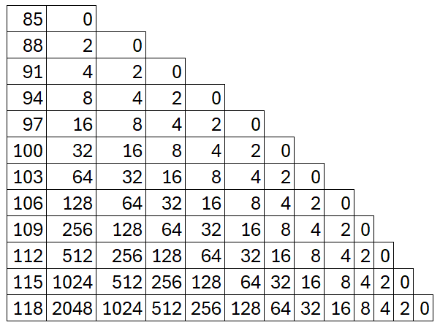
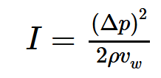
Sound Intensity and the Decibel Scale
Sound Intensity
Measured in Watts / m²
Intensity is how much energy is being transmitted
3 dB increase = 2x intense

Slide 10

Sound Pressure and Sound Intensity
6 dB increase
2x Sound Pressure
4x Sound Intensity
Sound Pressure
How loud the music feels at your spot in the crowd
Sound Intensity is
How much sound energy is coming from the speakers and traveling through the air toward you — the power of the wave, not just how it feels.

Slide 11

Key Noise Metrics for Industrial Hygienist: Leq, Lavg and TWA
Time-Weighted Average (TWA): A single number representing the average noise exposure level over a standard 8-hour workday. This value is used for compliance sampling
Level Average (Lavg): If present continuously, would generate the same amount of energy as the varying levels that are present in the environment measured in decibels. (Assumes a 5 dB exchange rate and threshold)
Level Equivalent (Leq): The constant sound level that would deliver the same total sound energy over a given period as the actual fluctuating sound. Note the assumption of a 3 dB exchange rate for sound level meters when averaging to Leq.

Slide 12
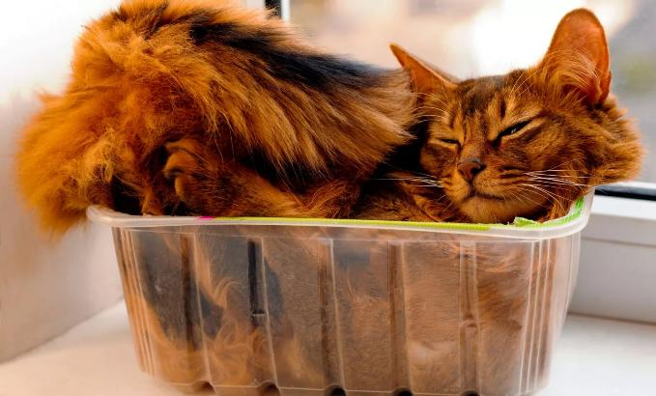
Key Noise Metrics: TWA
This is a level average with an assumed fixed sample period of 8 hours
It represents a constant sound level lasting 8 hours that would result in the equivalent sound energy as the noise that was sampled (no matter how long)
TWA always averages the sampled sound over an 8-hour period, starting at zero and growing
Measurement times:
<8 hours: TWA will be lower than Lavg
=8 hours: TWA is equal to Lavg
>8 hours: TWA will be higher than Lavg
Squishing a 12 hour reading into 8 hours

Slide 13
Key Noise Metrics: Lavg
The average sound level measured over the run time of the measurement
If present continuously, it would generate the same amount of energy as the varying levels that are present in the environment
When thresholds are used, the average does not include any sound below the threshold
Lavg is calculated with a 5 dB exchange rate when using noise dosimeters under OSHA standard

Slide 14
Key Noise Metrics: Leq
This is the true equivalent sound level measured over the run time
Leq is functionally the same as Lavg, except that it is only used when the exchange rate is set to 3 dB and the threshold is zero
If a 3 dB exchange rate is used (as with ACGIH standards), reports will show Leq instead of Lavg
Noise Graph will look different depending if you use a 1 second, or 60 second logging duration

Slide 15
Clarifying Lpk for Impulse Noise Assessment
Peak Level (Lpk): The highest unweighted, fast response sound level measured during the sample period.
Lpk is crucial for assessing impulse or impact noise.
OSHA limit of 140 dB for Peak Level.

Slide 16
Understanding Lmax for Ceiling Level Monitoring
Maximum Level (Lmax): The highest weighted slow level measured during the sample period.
Lmax pertains to the ceiling level to prevent instantaneous hearing damage.
OSHA limit of 115 dBA for Lmax.
Address the common confusion between Lpk and Lmax, highlighting their different weighting and response characteristics.

Slide 17

Understanding Dose, Criterion, Threshold and Exchange Rate
Dose: The percentage of allowable daily noise exposure. A 100% dose corresponds to the Permissible Exposure Limit (PEL)
Criterion Level: The sound pressure level (SPL) that, if present continuously for eight hours, would result in a maximum allowable exposure
90 dBA for OSHA
Threshold: The sound pressure level below which measured values are not included in the dose calculation
80 dBA for OSHA Hearing Conservation Action Level
Exchange Rate: The increase in sound level that corresponds to a halving of the allowable exposure time
5 dB for OSHA and MSHA, and 3 dB for ACGIH

Slide 18
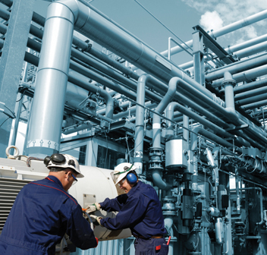
Understanding the Regulatory Landscape: OSHA and MSHA
Occupational Noise Exposure Standard set at a 90 dBA TWA (8 hours)
Hearing Conservation Program Includes:
Noise Monitoring
Audiometric tests
Hearing protectors
Education and training
Record keeping
AL of 50% PEL (85dBA*) triggers HC
One main difference is MSHA does not allow age correction

Slide 19
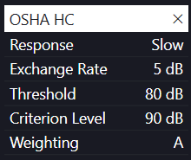
Hearing Conservation Program
Enrollment in HC Program
AL of >= 85 dB
Dose of >= 50%
Must use a threshold 80 dB
Type 2 Dosimeter +- 2 dB
Conservative @ 83 dB
Compliance @ 87 dB

Slide 20
Hearing Conservation Program cont’d
Enrollment in HC Program
Corrected AL or >= 87 dBA
Dose of >= 66%
Must use a threshold 80 dB
Following a Standard Threshold Shift (STS)
Loss of 10 dB or more across 2k, 3k, and 4k Hz compared to their baseline survey

Slide 21
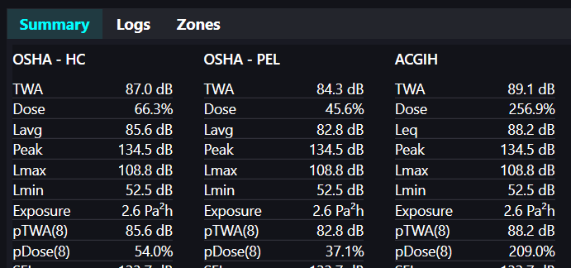
Hearing Conservation Program cont’d
Exposure at or above 87 dBA
Dose at or above 66%

Slide 22

Pre-Survey Prep: Instrument Checks and Calibration
Check the dosimeter battery before each survey. Don’t forget!!
Pre- and Post- calibration process must be performed (114 dB @ 1000 Hz)
Ensures data accuracy
Identifies instrumental drift
Automatic calibrator recognition
Ensure wind screen is secured and in place prior to sampling
Acoustically transparent
10-12 mph wind

Slide 23
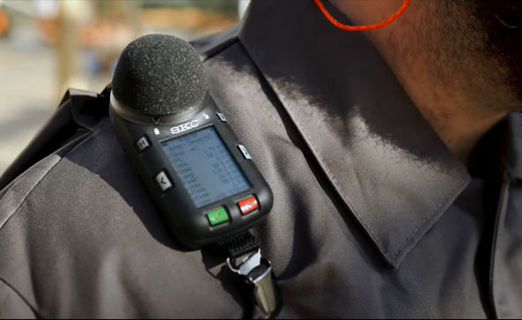
Proper Dosimeter Placement and Worker Communication
Correct dosimeter placement:
Typically on the shoulder, close to the ear and secured to the workers clothing
Inform the worker:
Purpose of the monitoring and
How the dosimeter works
Helps ensure cooperation and prevents tampering
Periodically check the placement periodically throughout the workday to ensure it remains in the correct position.

Slide 24
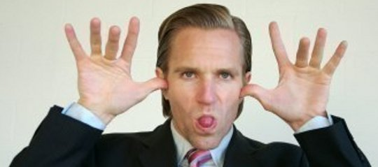
Additional Considerations
Employee behavior
Removing dosimeters
‘Helping’
Sabotage of measurements
Incorrect assumptions about tasks
Wind interference >10-12 mph
Not observing the worker during the monitoring period

Slide 25
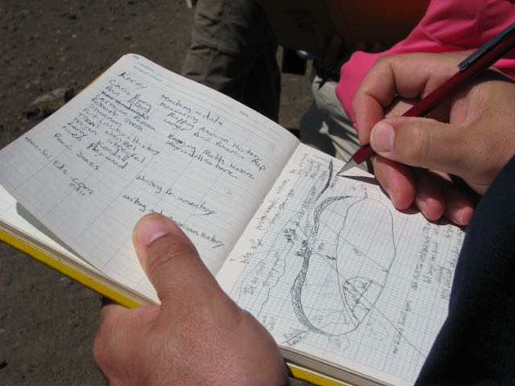
Real-Time Date Backup: Manual Note Taking
Paper and Pencil don’t run out of battery
‘OG’ but still a good-e
Include drawings or pictures of workplace
Do your best, we are not all Michelangelo
If you can draw it, you can explain it
Notes provide valuable contextual information and can help in data interpretation
Once you get back to the office, you can “upgrade” your drawings/notes on a computer

Slide 26

Enhanced Documentation with Technology
Bluetooth enabled phones/tablets
Wirelessly connect to the app to view information real time
Take screenshots of live data to include in digital field notes
Take pictures of the task and/or environment to augment your notes
More information can lead to more meaningful post-sampling discussions

Slide 27
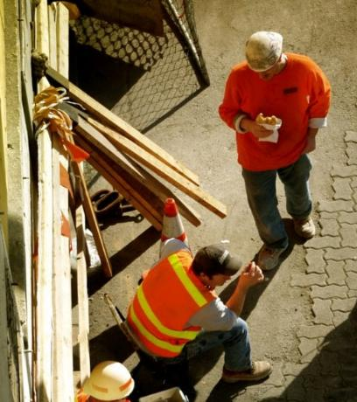
Best Practices for Monitoring During Lunch Breaks
Varying perspectives on monitoring during lunch breaks
Considering whether workers remain in the work environment or go to a quiet break room.
Different policies between different companies
Continuous monitoring
Pausing/stopping
Best practice depends on the potential for noise exposure during the break and company policy

Slide 28
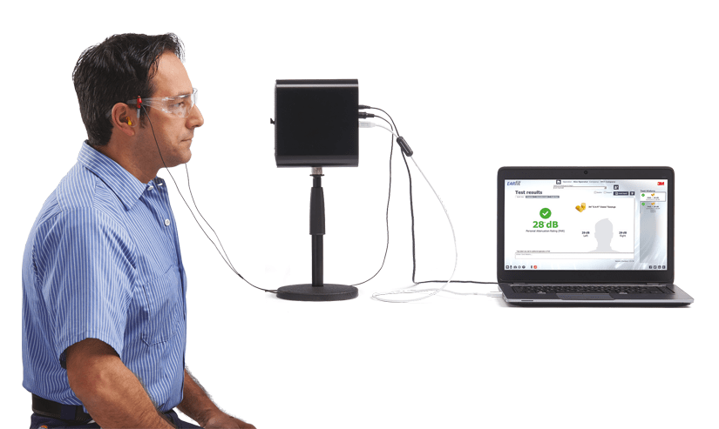
The Differences in Hearing Protection NRR and PAR
Noise Reduction Rating (NRR):
Laboratory-derived numerical estimate of how much the hearing protector can reduce noise exposure
Personal Attenuation Rating (PAR):
Actual amount of noise reduction a specific individual achieves when wearing a particular hearing protector
Users are ‘fit tested’ for various HPDs
Commonly referred to as ‘Best Practice’

Slide 29

Understanding the Limitations of NRR and Real-World Attenuation
NRR often overestimates the real-world attenuation:
Fit of the Hearing Protector
Consistency of use
Individual ear canal size and shape
Workplace conditions
Common Formula
(NRR-7) / 2

Slide 30
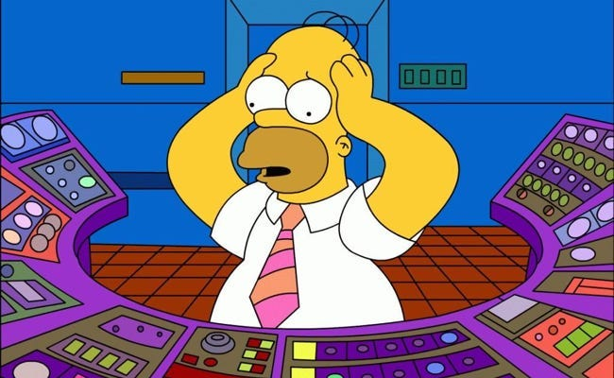
Different Methods to Determine NRR from OSHA
The 50% safety factor adjusts labeled NRR values for workplace conditions and is used when considering whether engineering controls are to be implemented.
Estimated dBA exposure = 98 dBA - [(25-7) × 50%] = 89 dBA
Estimated Exposure (dBA) = TWA (dBC) - [NRR x 50%]
Estimated Exposure (dBA) = TWA (dBA) - [(NRR - 7) x 50%]
However, when assessing the adequacy of the hearing protection for hearing conservation (HC) purposes, CSHOs should only subtract 7dB from the NRR.
Exposure for PPE/ HC enforcement = 98 dBA - (25-7) = 80 dBA
Estimated Exposure (dBA) = TWA (dBC) - NRR
Estimated Exposure (dBA) = TWA (dBA) - (NRR - 7)

Slide 31


Dual Hearing Protection: When and How Much Reduction?
Dual hearing protection (earplugs and earmuffs) is required when noise levels exceed a certain threshold (e.g., 105 dBA under MSHA)
Noise reduction from earplugs and earmuffs is not additive
33dB + 29dB 62dB
Earmuffs over earplugs provide a maximum of 5 dB additional attenuation to the higher-rated device

Slide 32
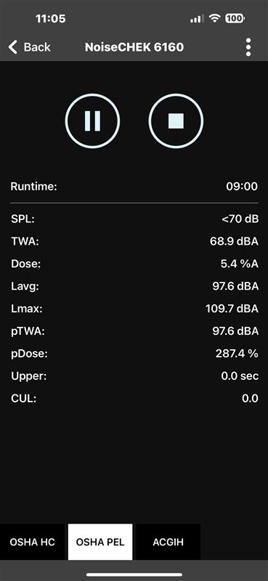
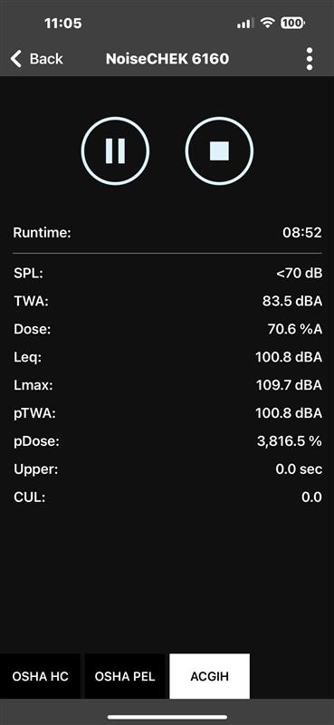
Leverage Mobile App Connectivity for Remote Monitoring
Mobile Bluetooth apps allow for remotely monitoring without interrupting the employee
Convenience and time-saving aspects, especially in hard-to-reach areas
Information that can be viewed
Ability to capture and store screenshots of data directly from the app for easy documentation.

Slide 33
Introduction to Noise Analysis Software Capabilities
Basic Overview
Setup Screen
Schedule
History
Summary
Logs
Stationary
Zoom in/out
Isolating
What If
Zones
Threshold/Lawn Care
Reporting

Slide 34

Identifying Noise Sources with Sound Event Recording
Dosimeter automatically records short audio clips when noise levels exceed a pre-set threshold
Auto-record at ___ dB
10 second recording of the noise that was at or above the threshold
This feature can help identify specific noise sources
Provides valuable context for understanding the worker's noise exposure
These recordings can facilitate conversations with workers about noise hazards
Consider a conversation with HR prior to using this feature

Slide 35
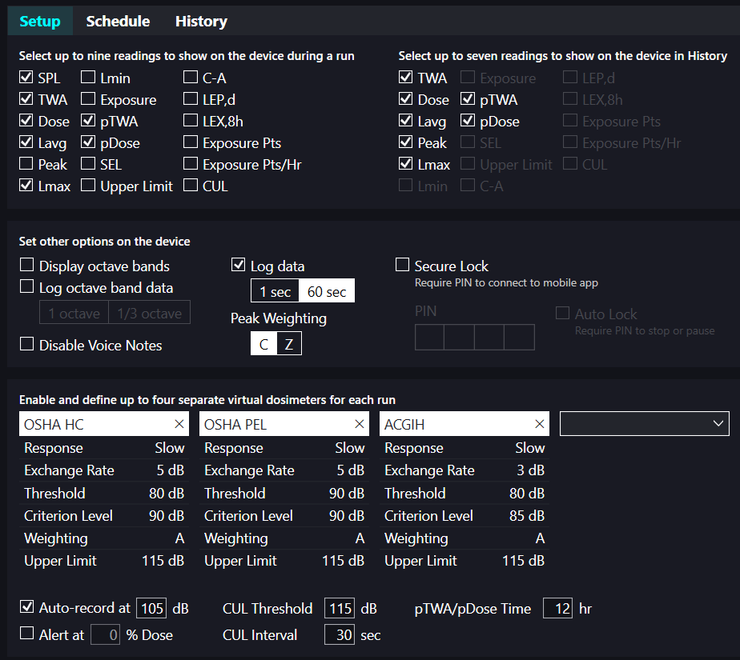
Introduction to Noise Analysis Software Capabilities
Overview of the features available in modern noise analysis software
Ability to download data, program dosimeter settings, and store survey history
Preset regulatory setups, security settings, and level triggering configuration

Slide 36
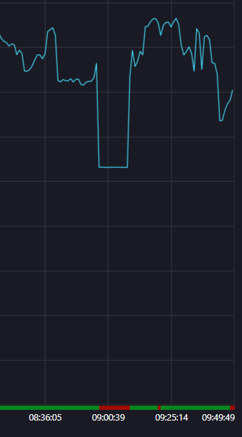
Interpreting the Moving vs. Stationary Indicator
What is moving vs. stationary?
Stationary indication can suggest potential issue
Dosimeter being removed
‘Nap time’ for employee
Non-representative conditions
Possible to identifying potentially invalid data

Slide 37
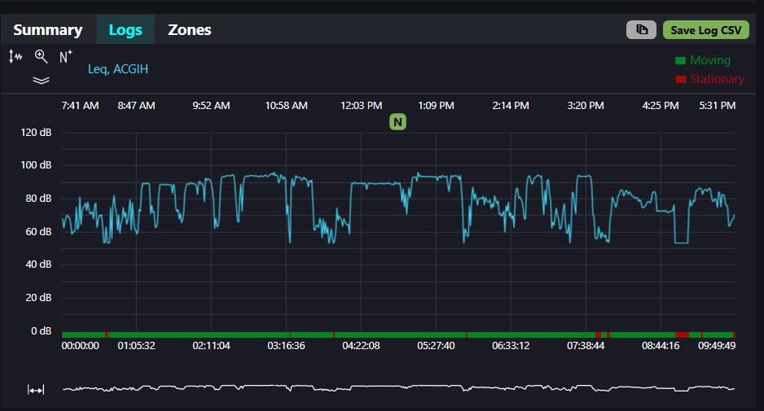
Visualizing Exposure Data with Graph and Reports
Software has the ability to generate comprehensive graphs and reports of noise exposure data.
Option to overlay data with different parameters for detailed analysis.

Slide 38
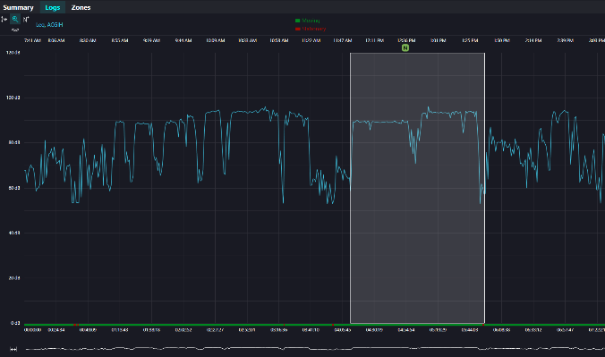
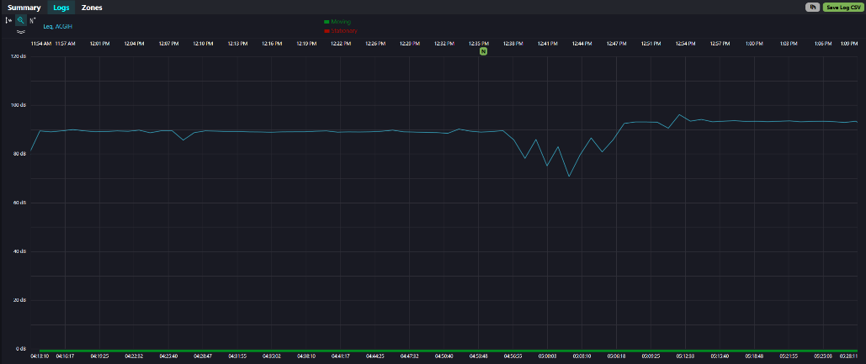
Zooming in and viewing specific data
Software tools can zoom in to specific timeframes within the monitoring data.
Smooths the graph to understand the data better
Quickly and easily zoom in and out

Slide 39
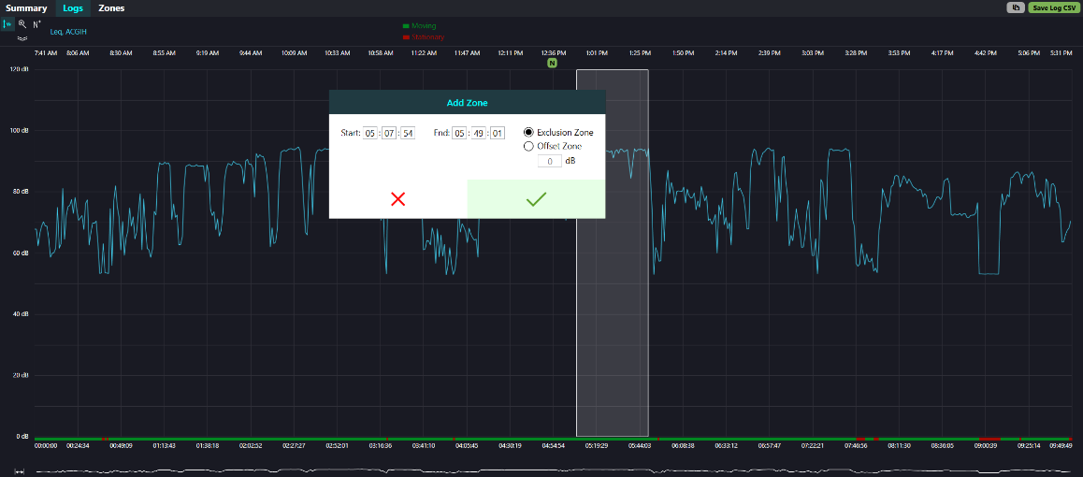
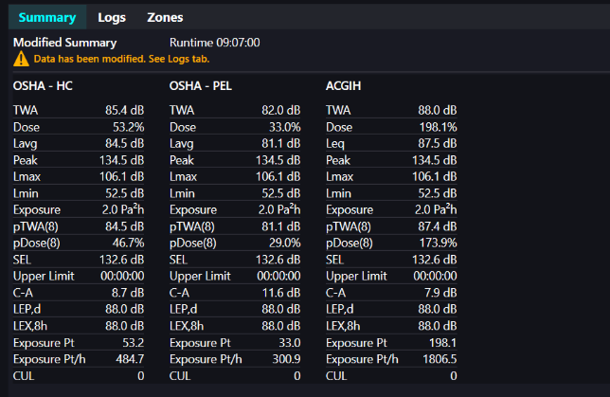
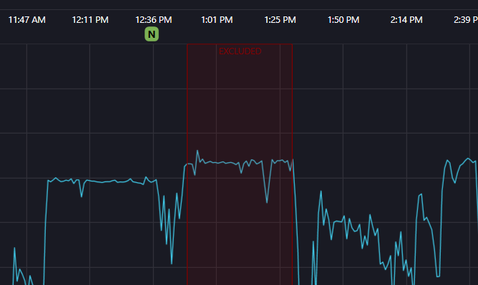
Isolating and Omitting Data Sections for Refined Analysis
Use software tools to isolate specific timeframes within the monitoring data.
Omitting non-work-related noise events (e.g., lunch breaks in quiet areas, personal activities) for a more accurate assessment of occupational exposure.
This is not deleting data but rather excluding it from specific analyses.

Slide 40
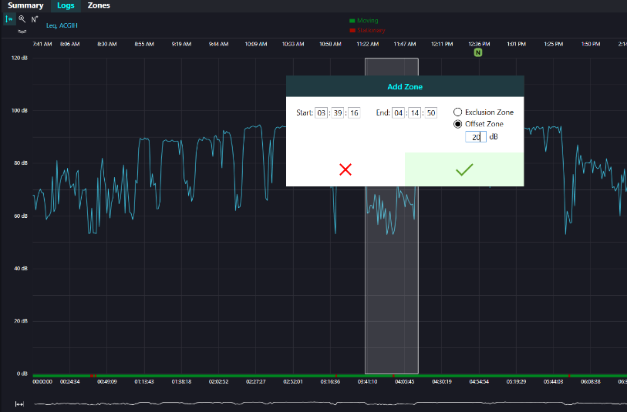
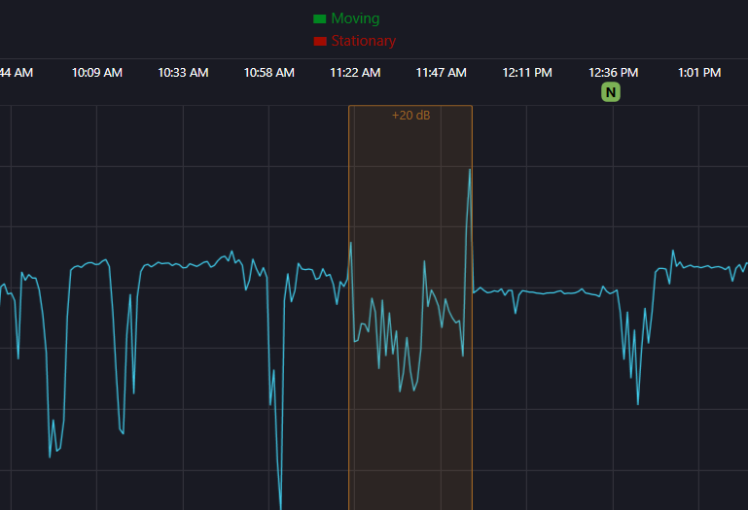
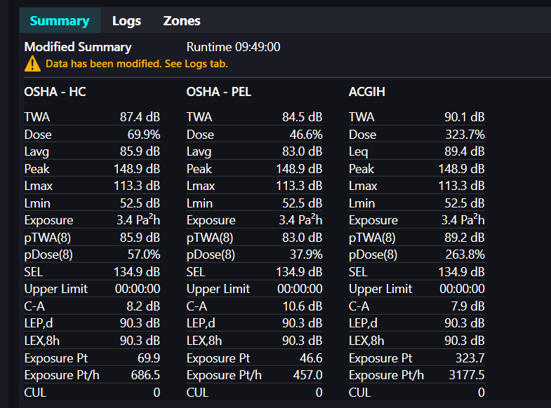
Conducting “What if” Analysis to Evaluate Scenarios
During "what-if" analysis, users see the impact of removing specific noise events on the overall exposure levels.
Provide examples, such as assessing the effect of a loud, short-duration event or the impact of removing a lunch break spent in a noisy area.

Slide 41
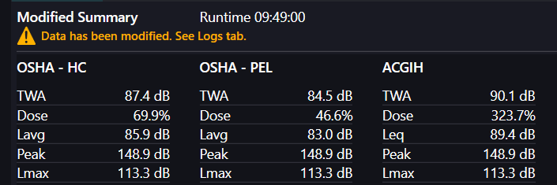
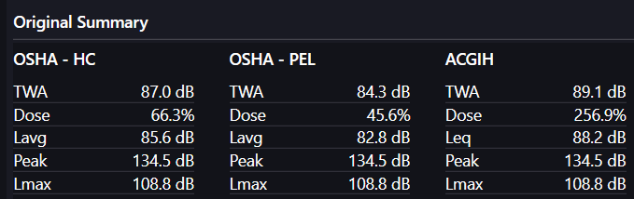
Ensuring Transparency in Reporting Omitted Data
Reporting practices show both the original and the omitted data in the final report
Clearly document the reasons for omitting any data sections to maintain transparency with workers and regulatory agencies

Slide 42
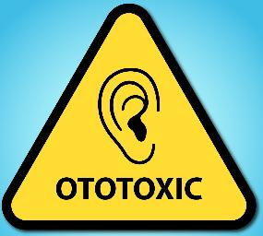
Ototoxic Chemicals
Ototoxins are substances toxic to the ear, particularly the cochlea or auditory nerve. These can be physical (noise), biological, or chemical.
Workers can be exposed to ototoxic chemicals through inhalation, ingestion, or skin absorption. Examples include solvents (toluene, styrene), asphyxiants (carbon monoxide), and metals (lead).
Combined exposure to noise and ototoxins can have interactive effects (additive or synergistic), meaning the combined effect on hearing can be worse than the sum of individual effects.
Ototoxic substances may exacerbate noise-induced hearing impairments even when noise levels are below permissible limits.
It's crucial to identify potential ototoxic chemicals in the workplace, possibly by reviewing Safety Data Sheets (SDS).
Control measures should address both noise and ototoxin exposure using the hierarchy of controls (elimination, engineering, administrative, PPE).
OSHA and NIOSH have published a Safety and Health Information Bulletin (SHIB) on preventing hearing loss from chemical (ototoxicity) and noise exposure.
Industrial hygiene professionals are increasingly considering chemical exposures alongside noise reports to understand the full scope of hearing hazards. Some workplaces may maintain a list of identified potentially ototoxic chemicals.
Key Takeaway: When assessing noise exposure with dosimetry, remember that the presence of ototoxic substances can increase the risk of hearing loss, even if noise levels appear to be within regulatory limits. Consider chemical hazards as a contributing factor in hearing conservation programs.
Notes:
Chemical-Induced Hearing Loss | Noise | CDC

Slide 43

Any Questions?

Slide 44
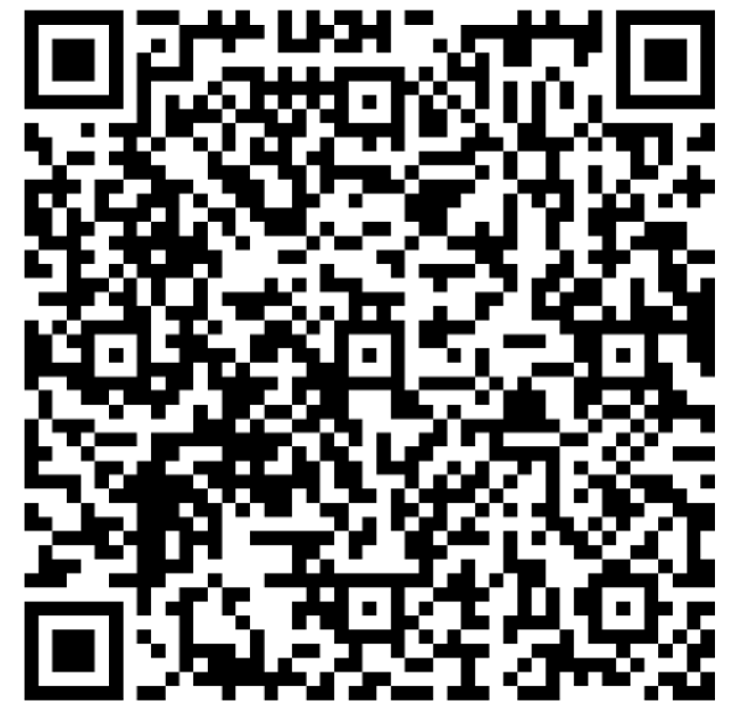
Thank You for Attending Today’s Webinar:
Maximize Personal Noise Measurement:
Accuracy, Applications & Industry Insights
Featured Speakers
Dusty Ott, CIH
SKC Inc
Your Host
Hunter Wack Business Development RAECO Rents hunterw@raecorents.com

Slide 45


THANK YOU!
Here’s how to contact me:
E: dott@skcinc.com
P: 724.678.1096
www.skcinc.com
FOLLOW US!

