Slide 1


Thank You for Attending Today’s Webinar:
How to use an XRF Handheld for sampling lead paint and more
Your Host
Matt DeLacluyse Operations Manager RAECO Rents mattd@raecorents.com
Featured Speaker
Tim Johnson Business Development SciAps tjohnson@sciaps.com

Slide 2
What you already know
Toxic elements are everywhere
Food
Water
Toys
Soil
Paint

Slide 3
Analysis techniques for these elements
Laboratory
AA
ICP
ICP-MS
Typical turn around time – 1-2 weeks

Slide 4
In the field
Handheld XRF
Many models on the market
Near instantaneous results
Don’t have to disturb the material

Slide 5
Handheld XRF for lead paint
Only 2 HUD-accepted models currently on the market
Typically use radioactive source
Cd-109
Co-57
Cost of owning prohibitive
Somewhat difficult to rent due to regulatory and stock concerns

Slide 6
Why is it tough to rent?
Radioactive sources must be replaced
Half-life of Cd-109 is 461 days
Half-life of Co-57 is 272 days
Many shipping companies will not accept due to radioactive materials

Slide 7
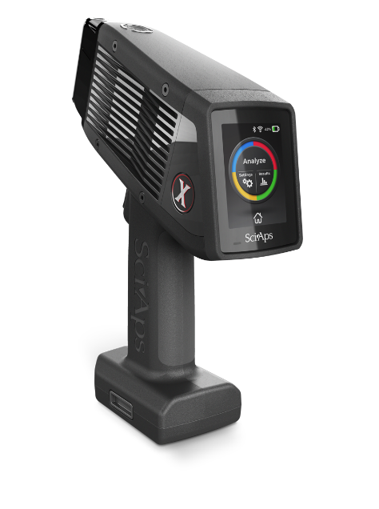
The solution
SciAps X-550
The only HUD-accepted lead paint analyzer that does not contain radioactive material

Slide 8
Why the X-550 Pb?
No radioactive materials
HUD accepted PCS sheets at 0.5, 0.7, and 1.0 mg/cm² with no inconclusive ranges
Fewer regulatory burdens
Can do soil, alloy identification and lead paint using the same instrument

Slide 9
So how does it work?
X-Ray tube
Uses either Au or Rh anode to produce the X-rays.
No proximity button to fail

Slide 10
I think I have heard this before
Innovex released a tube-based analyzer with a PCS around 2006
PCS had large inconclusive range
Sold to Olympus who no longer produces it

Slide 11
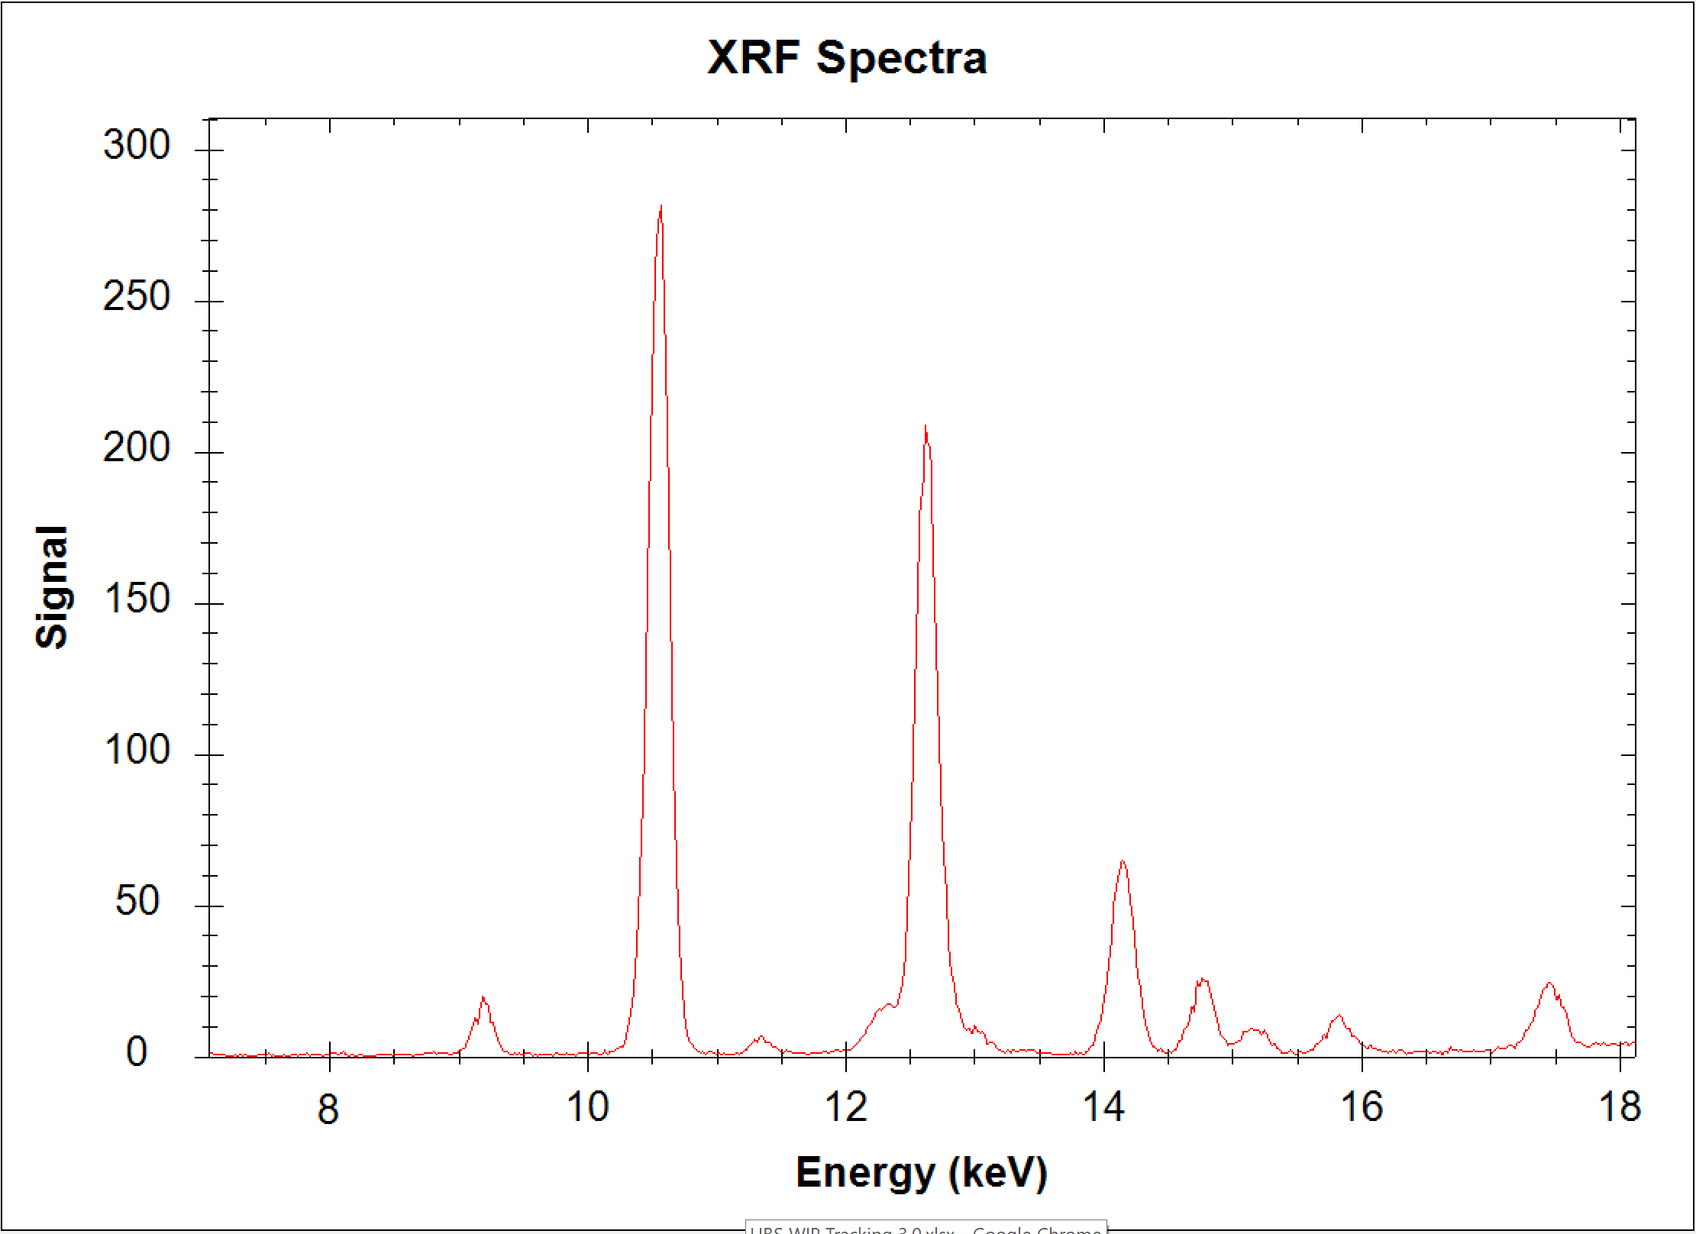
New Technology Brings Improved Performance
SDD gives smoother baseline
Use of L-gamma improves x-ray escape 300X

Slide 12
What the heck is a PCS?
Performance Characteristic Sheet
Shows how well the instrument is able to determine lead concentrations in paint on different substrates and at different depths
Run by a 3rd party
Filed and published with United States Department of Housing and Urban Development

Slide 13
Why would I care about a good PCS?
The PCS shows if there is an inconclusive range.
If the reading falls in the inconclusive range, a paint chip must be sent to the lab.
AND THEN YOU WAIT

Slide 14
Are radioactive materials a big deal?
All instruments on the market are well-shielded and should be safe
QUESTIONS THOUGH:
How old is the source in the instrument you are trying to use?
Are you ok with a 30 second analysis time?

Slide 15
How can this help me?
One analyzer for most of your elemental analysis
Only carrying one case instead of one to look for lead paint, and another to analyze the soil.
Same analysis speed no matter the age.
No proximity switch, so irregular shaped objects can be analyzed.

Slide 16
What does OSHA say about this?

Slide 17
OSHA
OSHA does not recognize any amount of lead as being safe
OSHA does not recognize any handheld technique as being confirmatory for lead-free
Handheld XRF can be used to help determine the level of PPE required

Slide 18
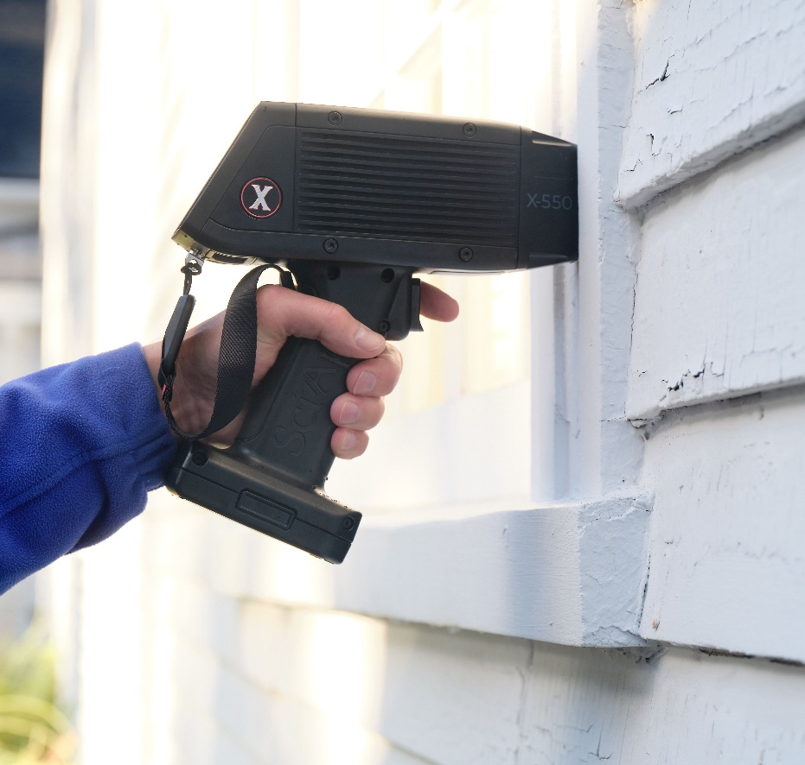
Is it really that easy?
100 year old church in Massachusetts
One click on the trigger
Analysis time of 6 seconds

Slide 19
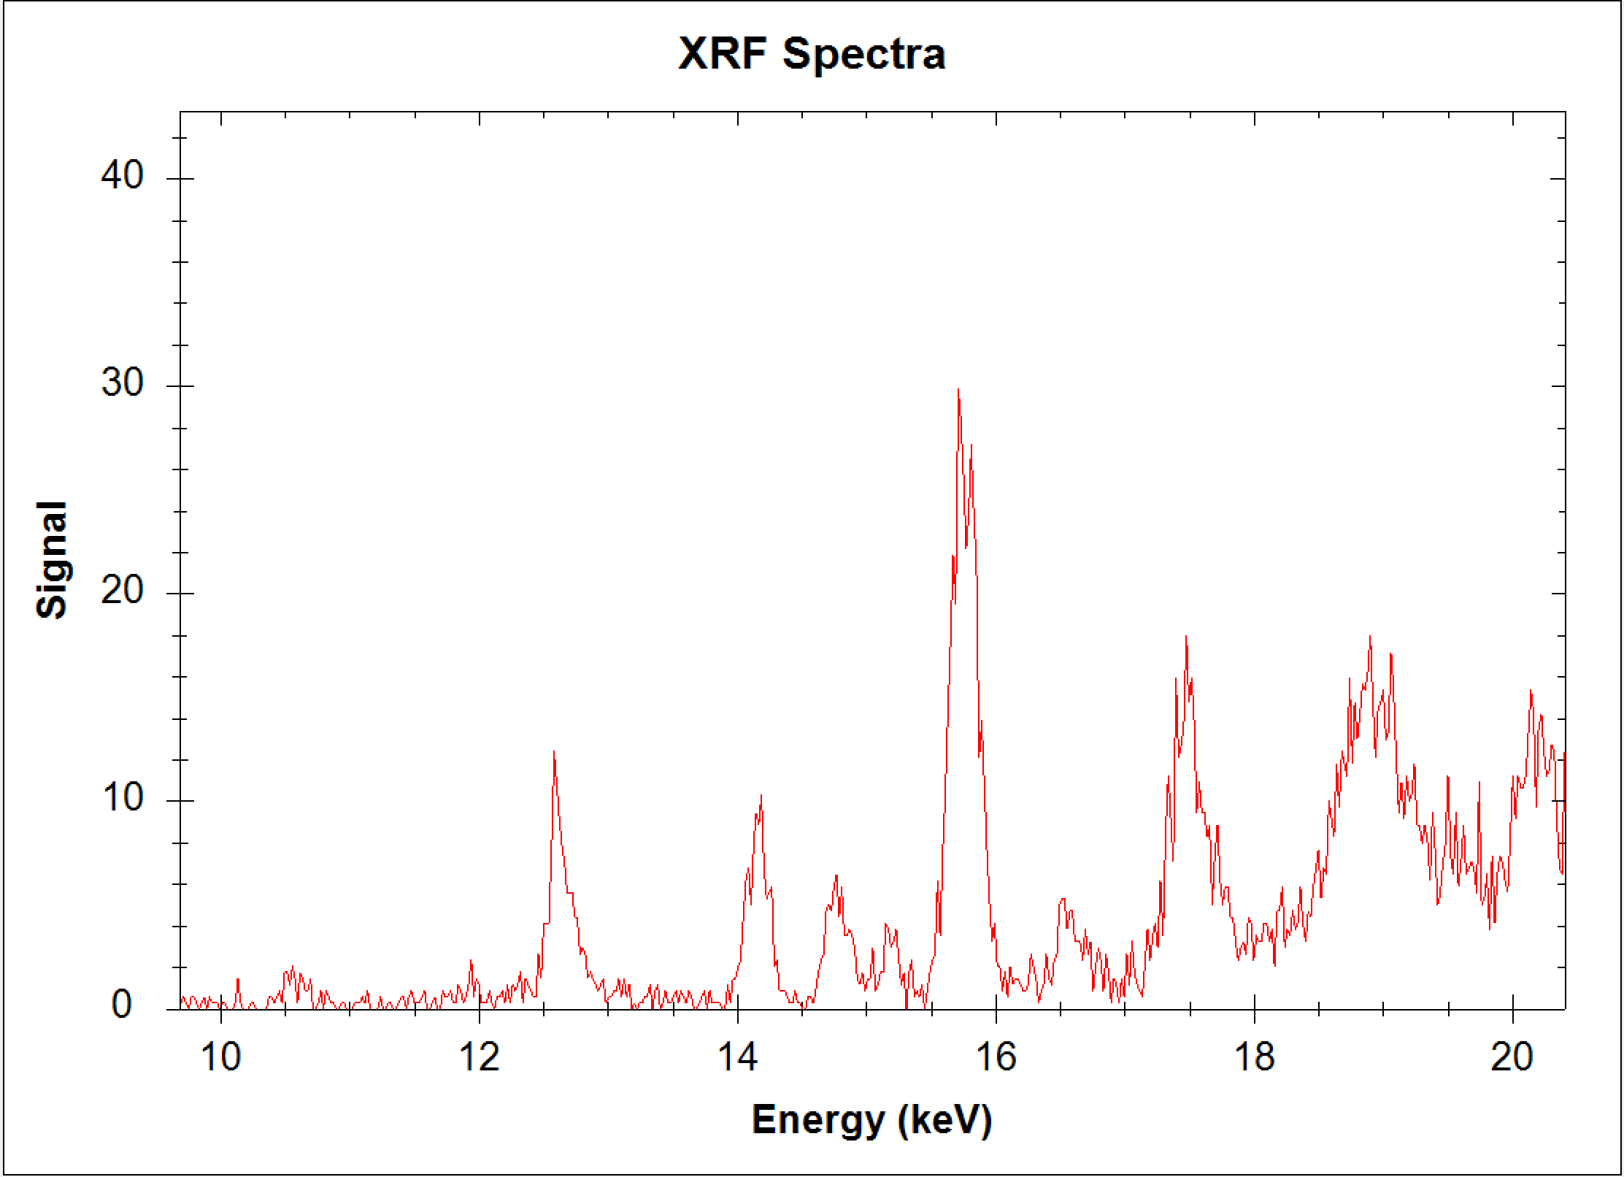
Example
Thick paint sample from old MA home,
Nearly ¼” of paint thickness.
High Zn, Ba and TiO2 paints on top of lead.
Previous L-shell methods fail because there’s no lead L-alpha signal, so no way to correct lead results. Yield false negative.
The SciAps unit with X-ray tube and SDD detector measures the lead L-gamma line.
Correction made from L-beta and L-gamma.
Key: L-gamma is about 300 times more penetrating than L-alpha in a highly absorbing paint matrix like ZnO and BaO.

Slide 20
In the field
Start-up about 1 minute
Calibration 15 seconds
Cal check 30 seconds
Off and running

Slide 21
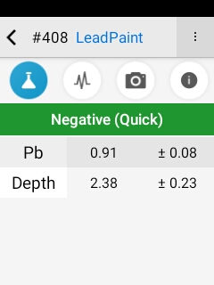
Screen Results

Slide 22
Sample csv Report
Date | Test # | Pass/Fail | Unit type | Calibration Model/ Matrix ID | Display Sigma | LOD Sigma | Pb | Pb +/- | Pb P/F | Job Number | Room | Room Choices | Structure | Choice | Substrate | Wall | Location | Condition | Condition Choices
######## | 46 | Pass | mg/cm2 | PCS Cal | 1 | 3 | 1.06 | 0.04 | Positive
######## | 47 |  | mg/cm2 | LeadPaint | 1 | 3 | 1.01 | 0.01 | Positive
######## | 48 |  | mg/cm2 | LeadPaint | 1 | 3 | 1 | 0.01 | Positive
######## | 49 | Pass | mg/cm2 | PCS Cal | 1 | 3 | 1.02 | 0.03 | Positive
######## | 50 |  | mg/cm2 | LeadPaint | 1 | 3 | 1.18 | 0.05 | Positive
######## | 51 | Pass | mg/cm2 | PCS Cal | 1 | 3 | 1.08 | 0.04 | Positive
######## | 52 |  | mg/cm2 | LeadPaint | 1 | 3 | 1.02 | 0.01 | Positive
######## | 53 |  | mg/cm2 | LeadPaint | 1 | 3 | 1.12 | 0.05 | Positive
######## | 54 |  | mg/cm2 | LeadPaint | 1 | 3 | 0 | 0.01 | Negative | 333 |  |  | Bookcase | Shelf
######## | 55 |  | mg/cm2 | LeadPaint | 1 | 3 | 0 | 0.01 | Negative | 333
######## | 56 |  | mg/cm2 | LeadPaint | 1 | 3 | 0 | 0.01 | Negative | 333
######## | 57 |  | mg/cm2 | LeadPaint | 1 | 3 | 0 | 0.01 | Negative | 333 | Single Fam House | Vestibule | Trim |  |  |  |  | Intact
######## | 58 |  | mg/cm2 | LeadPaint | 1 | 3 | 0 | 0.01 | Negative | 333 | Single Fam House | Vestibule
######## | 59 |  | mg/cm2 | LeadPaint | 1 | 3 | 0 | 0.01 | Negative | 333 | Single Fam House | Vestibule
######## | 60 |  | mg/cm2 | LeadPaint | 1 | 3 | 0.05 | 0.01 | Negative | 333 | Single Fam House | Vestibule
######## | 61 |  | mg/cm2 | LeadPaint | 1 | 3 | 0.04 | 0.01 | Negative | 333 | Single Fam House | Vestibule
######## | 62 |  | mg/cm2 | LeadPaint | 1 | 3 | 0 | 0.01 | Negative | 333 | Single Fam House | Vestibule
######## | 63 |  | mg/cm2 | LeadPaint | 1 | 3 | 2.96 | 0.13 | Positive | 333 | Single Fam House | Vestibule
######## | 64 |  | mg/cm2 | LeadPaint | 1 | 3 | 2.88 | 0.13 | Positive | 333 | Single Fam House | Vestibule

Slide 23
Quick Demonstration

Slide 24
Technology to help you
Bluetooth, Wi/Fi, USB interfaces
Micro Camera for assuring proper location
Macro Camera for adding location images
Results exported in .csv or .pdf with no special software needed

Slide 25
What about other elements in paint?
Currently not able to analyze other elements in buried paint
Soil mode will allow surface elements to be analyzed

Slide 26
Steps for a total assessment
Analyze painted surfaces for lead
Analyze soil for lead and other toxic elements
Analyze water for lead

Slide 27
Water….really?
Dr. Marya Lieberman at Notre Dame
Good results with concentrating lead from water onto filters
Developed kits for use with XRF
https://pubs.acs.org/doi/abs/10.1021/acs.analchem.9b05058

Slide 28
What’s next?
Dust wipes
Enable client to check that cleanup is complete
Air Filters
Check for indoor air quality
???

Slide 29
Questions?

Slide 30



Get Social with RAECO Rents
www.linkedin.com/company/raeco-rents
@RaecoRents
www.youtube.com/user/RaecoRentsVideos

